Slide 1
Supporting and Enhancing Mathematics and Statistics
UNIT: The Normal Distribution

Slide 2
UNIT:
The Normal Distribution
The Normal Distribution
The Normal Distribution is a key component of Data Science
With its bell shaped symmetry, it can be used to model many situations in life, including the IQ (Intelligence Quotient) of people.
There are four sections in this unit, namely:
Looking at Data
Standardised Normal Distribution
3. Transformation of Standardised Normal Distribution
4. Examples in Context

Slide 3
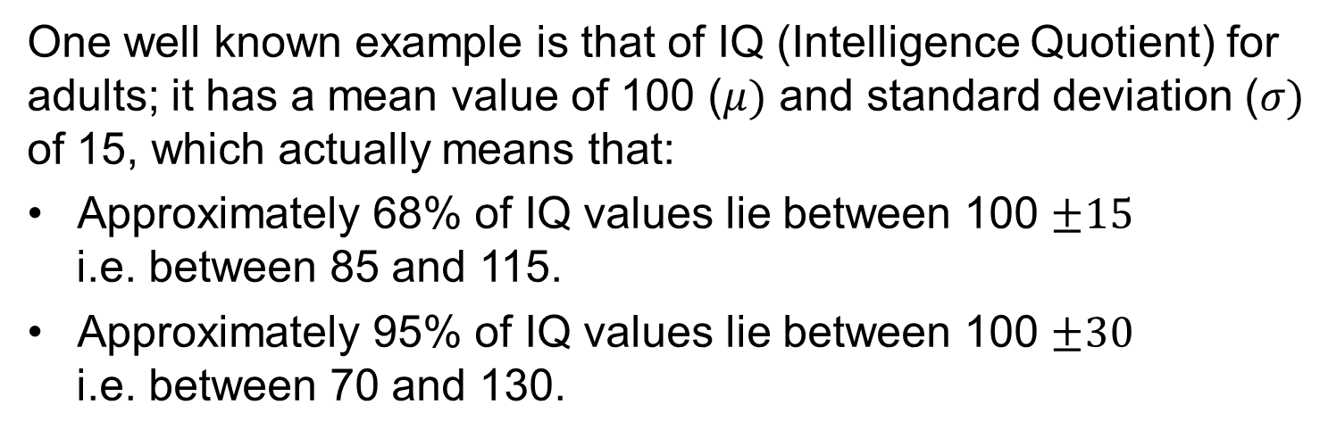
Looking at Data
UNIT:
The Normal Distribution
Section 1
The Normal Distribution is a very useful way of summarising and working with symmetric data sets, as shown opposite.
Note that it is bell shaped and symmetric about the mean.
One well known example is that of IQ (Intelligence Quotient) for adults; it has a mean value of 100 ($μ)$ and standard deviation ($σ)$ of 15, which actually means that:
Approximately 68% of IQ values lie between 100 $±15$
i.e. between 85 and 115.
Approximately 95% of IQ values lie between 100 $±30$
i.e. between 70 and 130.

Slide 4
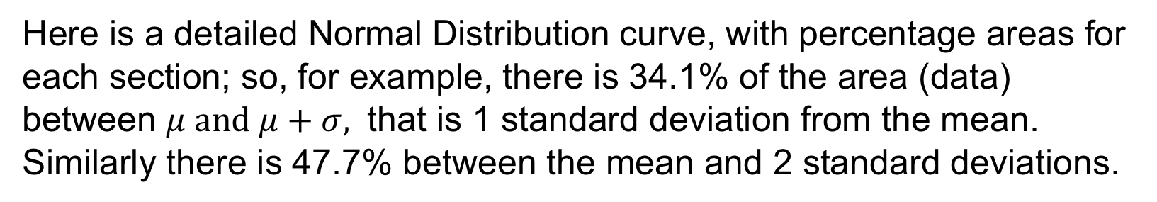



Normal Distribution Characteristics
UNIT:
The Normal Distribution
Section 1
34.1%
34.1%
13.6$\%$
13.6$\%$
2.1$\%$
2.1$\%$
$μ −3σ$ $μ −2σ μ −σ μ μ+σ μ+2σ μ+3σ$
Here is a detailed Normal Distribution curve, with percentage areas for each section; so, for example, there is 34.1% of the area (data) between $μ and μ+σ,$ that is 1 standard deviation from the mean. Similarly there is 47.7% between the mean and 2 standard deviations.

Slide 5
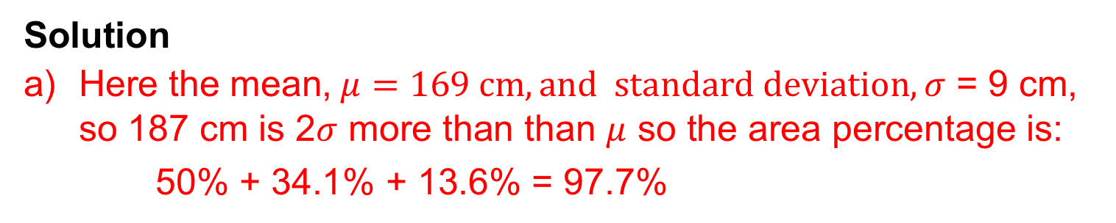
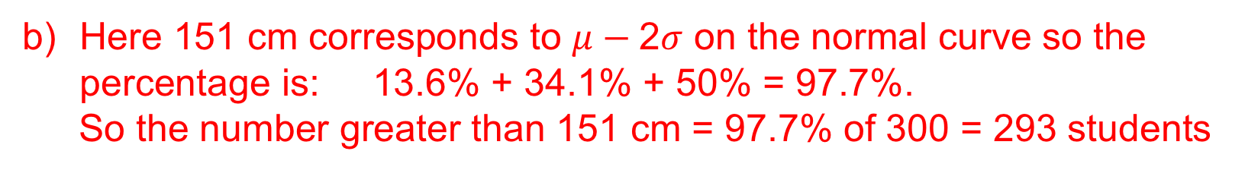
Looking at Data
UNIT:
The Normal Distribution
Section 1
Example
A survey showed that the average height of 16-19 year olds was approximately 169 cm with SD 9 cm. Assuming the data follows a normal distribution, find:
a) the percentage of sixth formers shorter than 187 cm;
b) the number taller than 151 cm if there are 300 students in total.
Solution
Here the mean,$μ=169 cm, and standard deviation, σ$ = 9 cm, so 187 cm is 2$σ$ more than than $μ$ so the area percentage is:
50% + 34.1% + 13.6% = 97.7%
Here 151 cm corresponds to $μ−\text{2}σ$ on the normal curve so the percentage is: 13.6% + 34.1% + 50% = 97.7%.
So the number greater than 151 cm = 97.7% of 300 = 293 students
Note: because of the symmetry of the normal curve, we could have used the calculation in a) to solve part b).

Slide 6
Section 1: Fitness Test
UNIT:
The Normal Distribution
Section 1
142 151 160 169 178 187 196
Using the data in the previous slide, estimate:
a) the number of students who are taller than 178 cm;
b) the number of students who are taller than 160 cm.
Answers
a) 47 (or 48)
b) 252

Slide 7
UNIT:
The Normal Distribution
Section 1
Section 1: Review
You have completed the first section.
If you have completed and mastered this section,
click to start the next Section
If you need more examples and interactive practice,
press here
You might also find it helpful to look at:
Essential Information: press here

Slide 8
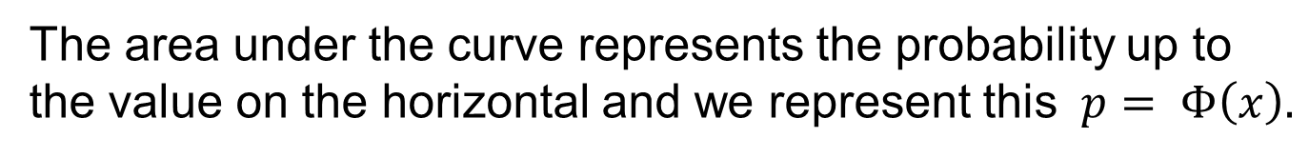
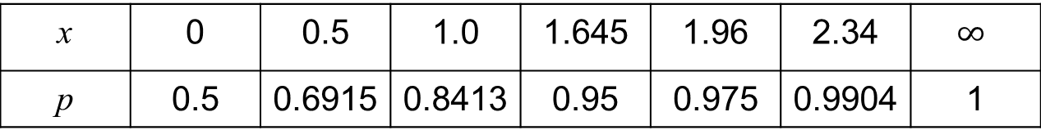
Standardised Normal Distribution
UNIT:
The Normal Distribution
Section 2
This diagram shows the graph of STANDARDISED normal distribution that has mean 0 and standard deviation 1.
It is known as the
probability density function (p.d.f.)
p = area
x
The area under the curve represents the probability up to the value on the horizontal and we represent this $p= Φ\left(x\right).$
We can look up values of this probability either in tables or on a calculator; here are some important values:
x | 0 | 0.5 | 1.0 | 1.645 | 1.96 | 2.34 | $$∞$$
p | 0.5 | 0.6915 | 0.8413 | 0.95 | 0.975 | 0.9904 | 1
You can see all these and other values on the next slide.

Slide 9
Normal Distribution Table
UNIT:
The Normal Distribution
Section 2
This table gives the area under the graph for values of x from 0 to 3.
You can see that:
p(1.45) = 0.9265
p(1.96) = 0.9750

Slide 10
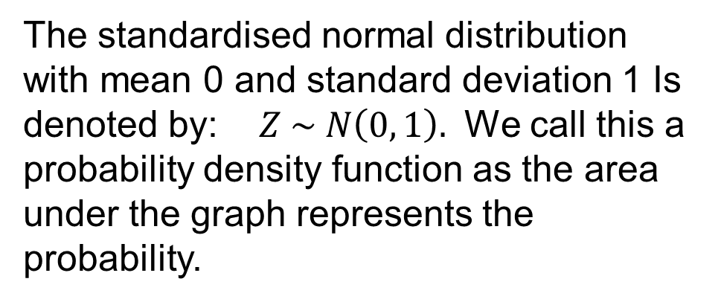
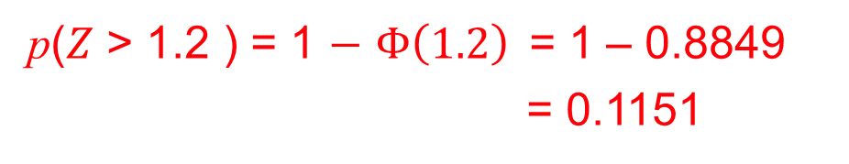
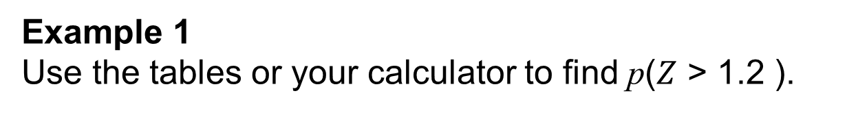
Standardised Normal Distribution: Examples
UNIT:
The Normal Distribution
Section 2
The standardised normal distribution with mean 0 and standard deviation 1 Is denoted by: $Z \sim N\left(0, 1\right).$ We call this a probability density function as the area under the graph represents the probability.
A
Area = p§
x
Example 1
Use the tables or your calculator to find p($Z$ > 1.2 ).
NOTE: always draw a diagram to show the area needed.
Solution
The area of the shaded region is needed; as the complete area is 1, we find the shaded area from:
p($Z$ > 1.2 ) = 1 $−$ $Φ\left(1.2\right)$= 1 – 0.8849
= 0.1151

Slide 11
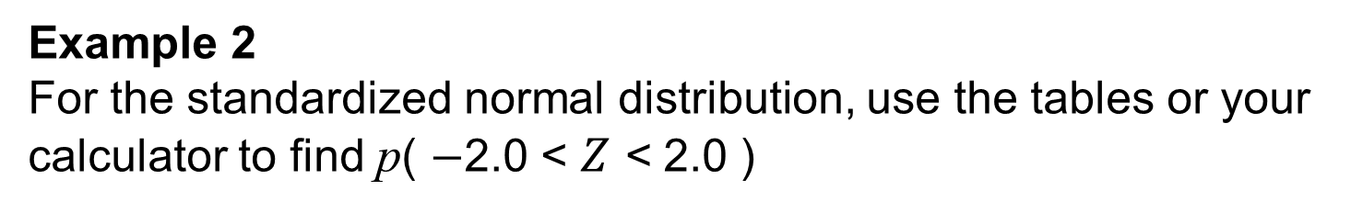
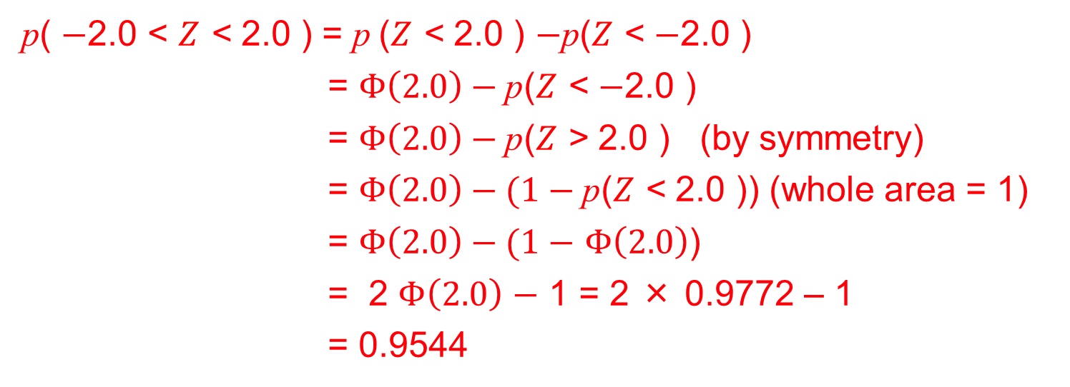
Standardised Normal Distribution: Examples
UNIT:
The Normal Distribution
Section 2
Example 2
For the standardized normal distribution, use the tables or your calculator to find p( $−$2.0 < $Z$ < 2.0 )
Solution
As before we first illustrate the required area as opposite
p( $−$2.0 < $Z$ < 2.0 ) = $\text{p}$($Z$ < 2.0 ) $−\text{p}$($Z$ < $−$2.0 )
= $Φ\left(2.0\right)−\text{p}$($Z$ < $−$2.0 )
= $Φ\left(2.0\right)−\text{p}$($Z$ > 2.0 ) (by symmetry)
= $Φ\left(2.0\right)−(1−\text{p}$($Z$ < 2.0 )) (whole area = 1)
= $Φ\left(2.0\right)−(1−$ $Φ\left(2.0\right)$)
= 2 $Φ\left(2.0\right)$ $−$ 1 = 2 × 0.9772 – 1
= 0.9544

Slide 12
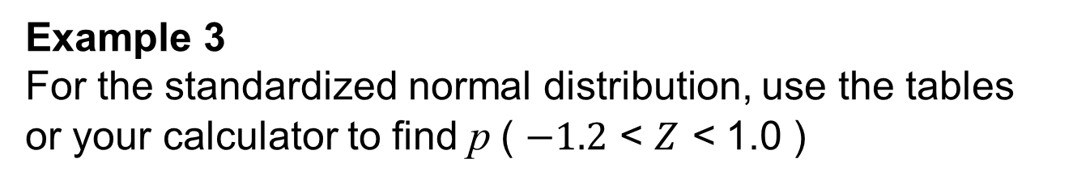
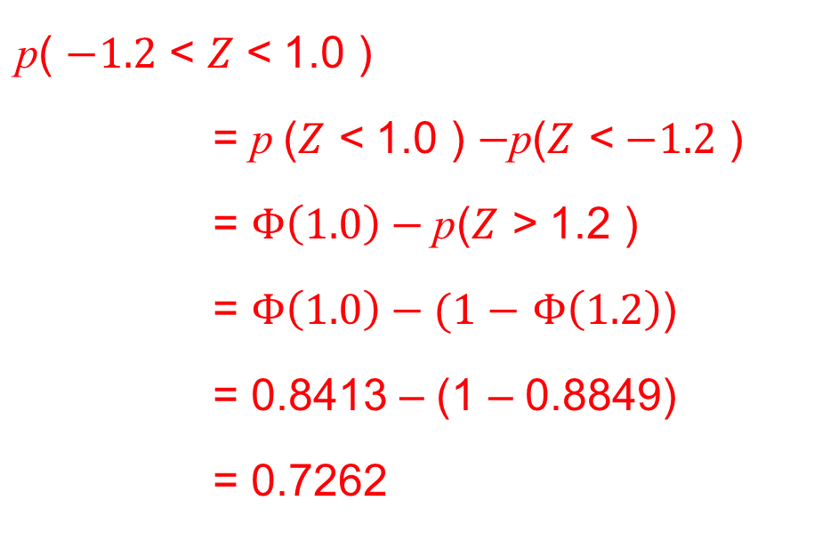
Standardised Normal Distribution: Examples
UNIT:
The Normal Distribution
Section 2
Example 3
For the standardized normal distribution, use the tables or your calculator to find $\text{p}$( $−1.2$ < $Z$ < 1.0 )
Solution
As before we first illustrate the required area as opposite.
$\text{p}$( $−1.2$ < $Z$< 1.0 )
= $\text{p}$($Z$ < 1.0 ) $−\text{p}$($Z$ < $−1.2$ )
= $Φ\left(1.0\right)−\text{p}$($Z$ > 1.2 )
= $Φ\left(1.0\right)−(1−$ $Φ\left(1.2\right)$)
= 0.8413 – (1 – 0.8849)
= 0.7262

Slide 13
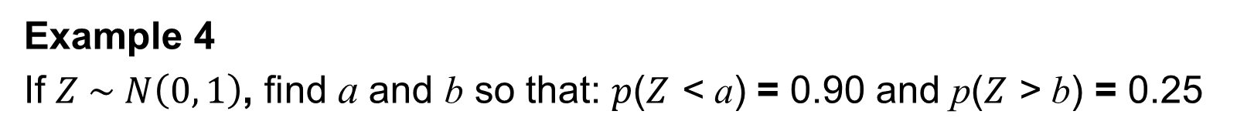
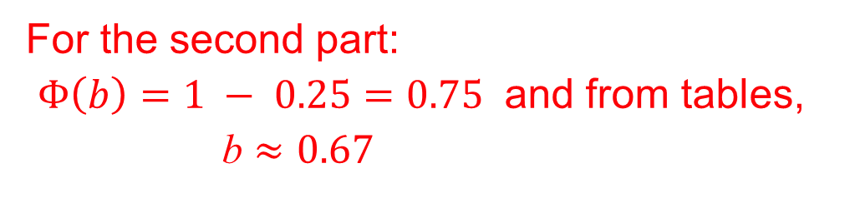

Standardised Normal Distribution: Examples
UNIT:
The Normal Distribution
Section 2
Example 4
If $Z \sim N\left(0, 1\right)$, find a and b so that: $p$($Z$ < a) = 0.90 and p($Z$ > b) = 0.25
Solution
We show the situation in a diagram as usual but note this is the ”reverse” problem of earlier examples.
So here $Φ\left(a\right)=0.90$and from tables,
a $≈1.28$
For the second part:
$Φ\left(b\right)=1 − 0.25=0.75$ and from tables,
b $≈0.67$
b

Slide 14
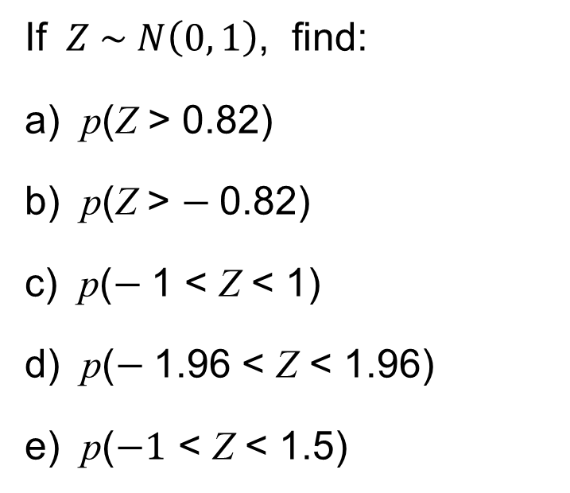
Section 2: Fitness Check
UNIT:
The Normal Distribution
Section 2
Answers
If $Z \sim N\left(0, 1\right)$, find:
a) p(Z > 0.82)
b) p(Z > $−$0.82)
c) p($−$1 < Z < 1)
d) p($−$1.96 < Z < 1.96)
e) p($−1$ < Z < 1.5)
0.2061
0.2061
0.6827
0.9500
0.7745

Slide 15
UNIT:
The Normal Distribution
Section 2
Section 2: Review
You have completed the second section.
If you have completed and mastered this section,
click to start the next Section
If you need more examples and interactive practice,
press here
You might also find it helpful to look at:
Essential Information: press here

Slide 16

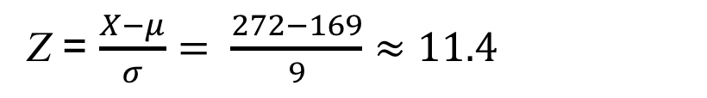
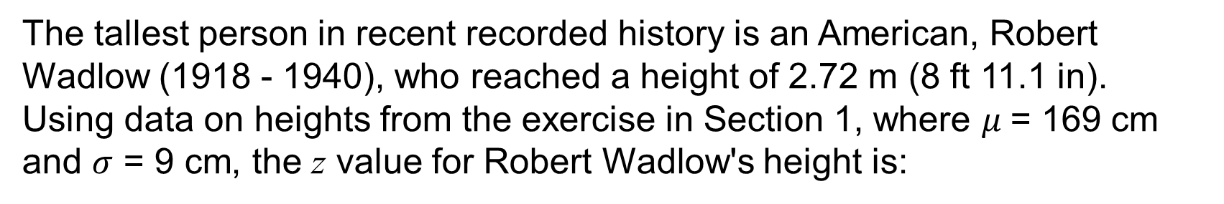

UNIT:
The Normal Distribution
Section 3
Transformation of Standardised Normal Distribution
When a variable X follows a normal distribution,
with mean $μ$and variance $σ^{2}$, this is denoted by:
We can transform this to the Standardised Normal Distribution using the simple formula opposite.
This ensures that this new probability density function has mean 0 and standard deviation $σ$ and we will see how to use this in practical contexts.
The tallest person in recent recorded history is an American, Robert Wadlow (1918 - 1940), who reached a height of 2.72 m (8 ft 11.1 in).
Using data on heights from the exercise in Section 1, where $μ$= 169 cm and $σ$ = 9 cm, the z value for Robert Wadlow's height is:
Z = $\frac{X−μ}{σ}= \frac{272−169}{9}≈11.4$
This is about 11 standard deviations about the mean and more accurate tables suggest that it is only exceeded with probability of ${10}^{−10}$ and so extremely unlikely that a taller person will ever appear in our lifetime.

Slide 17
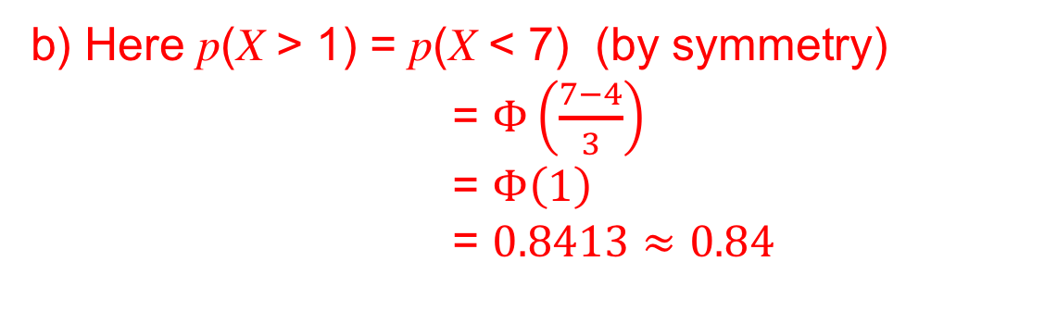
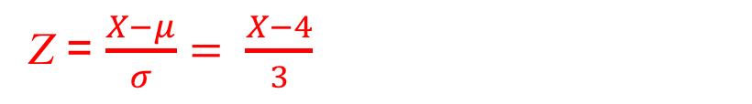
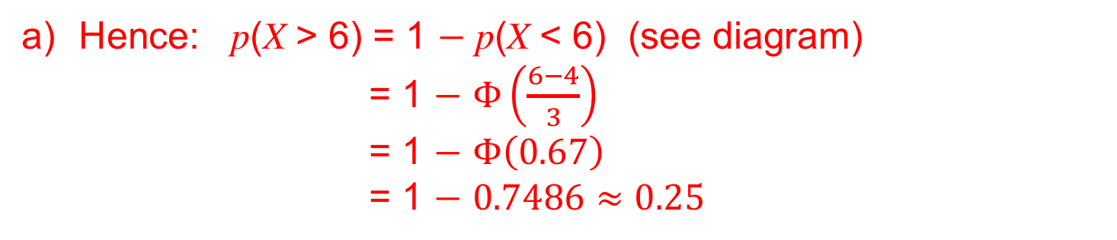

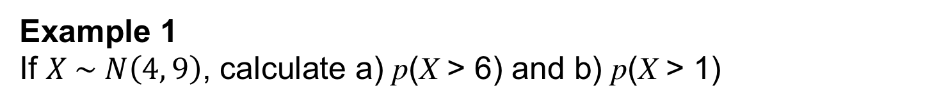
UNIT:
The Normal Distribution
Section 3
Examples
Example 1
If $X \sim N\left(4, 9\right)$, calculate a) p(X > 6) and b) p(X > 1)
Solution
Here $μ$ = 4 and $σ= \sqrt{9}=3$ so we use the transformation
Z = $\frac{X−μ}{σ}= \frac{X−4}{3}$
Hence: p(X > 6) = 1 $−$ p(X < 6) (see diagram)
= 1 $−$ $Φ\left(\frac{6−4}{3}\right)$
= 1 $−$ $Φ\left(0.67\right)$
= 1 $−$ $0.7486≈0.25$
b) Here p(X > 1) = p(X < 7) (by symmetry)
= $Φ\left(\frac{7−4}{3}\right)$
= $Φ\left(1\right)$
= $0.8413≈0.84$
7

Slide 18
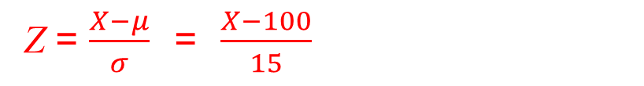
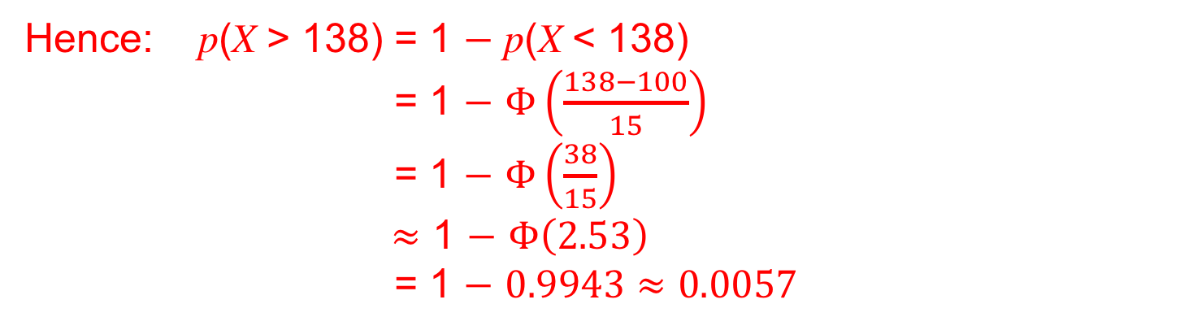

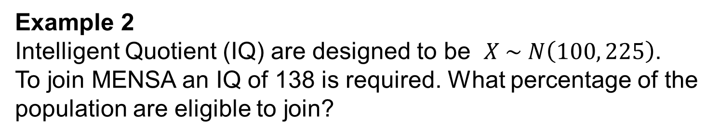
UNIT:
The Normal Distribution
Section 3
Examples
Example 2
Intelligent Quotient (IQ) are designed to be $X \sim N\left(100, 225\right)$.
To join MENSA an IQ of 138 is required. What percentage of the population are eligible to join?
Solution
Here $μ$ = 100 and $σ \text{=} \sqrt{225} \text{=} 15$ so we use the transformation
Z = $\frac{X−μ}{σ} \text{=} \frac{X−100}{15}$
Hence: p(X > 138) = 1 $−$ p(X < 138)
= 1 $−$ $Φ\left(\frac{138−100}{15}\right)$
= 1 $−$ $Φ\left(\frac{38}{15}\right)$
$≈$ 1 $−$ $Φ\left(2.53\right)$
= 1 $−$ $0.9943≈0.0057$
This is about 0.57% or just over $\frac{1}{2}\%, that is 1 in every 200 people$

Slide 19
UNIT:
The Normal Distribution
Section 3
Section 3: Fitness Check
1. A psychologist claims that any child with an IQ of 150+ is 'gifted’. How many 'gifted' children would you expect to find in a school of 1800 pupils?
Answer:
Approximately 1
2. Components in a personal stereo are normally distributed with a mean life of 2400 hours with SD 300 hours. It is estimated that the average user listens for about 1000 hours in one year. What is the probability that a component lasts for more than three years?
Answer:
0.0275

Slide 20
UNIT:
The Normal Distribution
Section 3
Section 3: Review
You have completed the third section.
If you have completed and mastered this section,
click to start the next Section
If you need more examples and interactive practice,
press here
You might also find it helpful to look at:
Essential Information: press here

Slide 21
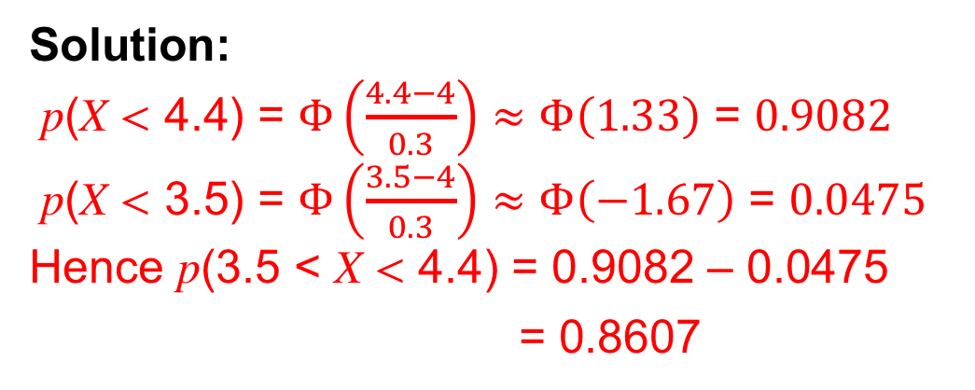
UNIT:
The Normal Distribution
Section 4
Examples in Context
The following examples illustrate some of the many uses and applications of the normal distribution.
Example 1
A machine produces bolts which are N (4, 0.09) , where measurements are in mm. Bolts are measured accurately and any which are smaller than 3.5 mm or bigger than 4.4 mm are rejected.
Out of a batch of 500 bolts how many would be acceptable?
Solution:
p(X < 4.4) = $Φ\left(\frac{4.4−4}{0.3}\right)≈Φ\left(1.33\right)$ = $0.9082$
p(X < 3.5) = $Φ\left(\frac{3.5−4}{0.3}\right)≈Φ\left(−1.67\right)$ = $0.0475$
Hence p(3.5 < X < 4.4) = 0.9082 – 0.0475
= 0.8607
The number of acceptable items is therefore:
0.8607× 500 = 430.35 ≈ 430 (to nearest whole number)

Slide 22
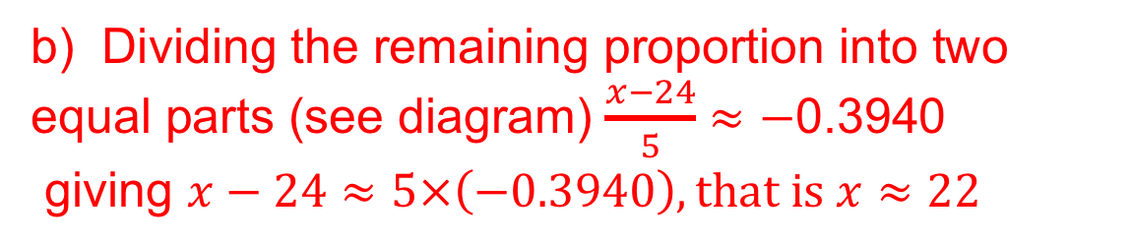
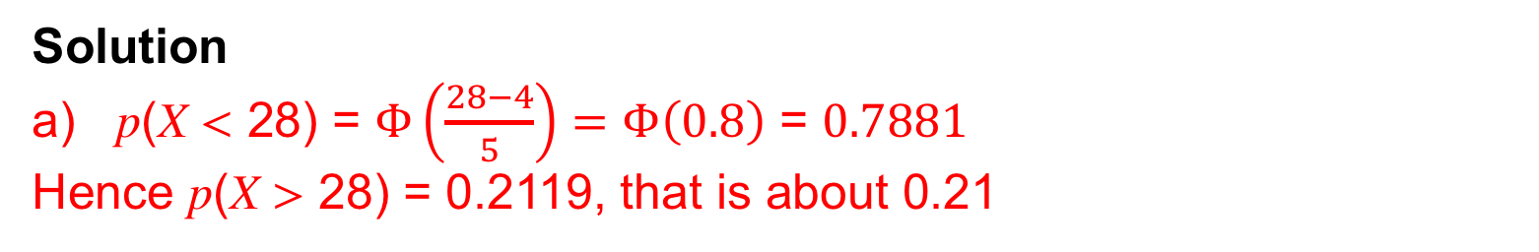
UNIT:
The Normal Distribution
Section 4
Examples in Context
Example 2
The masses of plums from a certain orchard have mean 24g and standard deviation 5g. The plums are graded small, medium or large. All plums over 28g in mass are regarded as large and the rest equally divided between small and medium.
Assuming a normal distribution find:
a) the proportion of plums graded large;
b) the upper limit of the masses of the plums in the small grade.
Solution
a) p(X < 28) = $Φ\left(\frac{28−4}{5}\right)=Φ\left(0.8\right)$ = $0.7881$
Hence p(X > 28) = 0.2119, that is about 0.21
b) Dividing the remaining proportion into two equal parts (see diagram) $\frac{x−24}{5}$ $≈$ $−$0.3940
giving $x−24≈5×\left(−0.3940\right), that is x≈22$

Slide 23
UNIT:
The Normal Distribution
Section 4
Section 4: Fitness Check
IQ tests are measured on a scale which is N (100, 225).
A professor wants to form an 'Eggheads Society' which only admits people with the top 1% of IQ scores. What would the professor have to set as the cut-off point in the test to allow this to happen?
Answer
135 to the nearest whole number
2. Yuk Ping belongs to an athletics club. In javelin throwing competitions her throws are normally distributed with mean
41.0 m and standard deviation 2.0 m.
a) What is the probability of her throwing between 40 m and 46 m?
b) What distance will be exceeded by 60% of her throws?
Answers
a) About 0.69
b) 40.49 m

Slide 24
UNIT:
The Normal Distribution
Section 4
Section 4: Review
You have completed the fourth section.
If you have completed and mastered this last section,
click here for the Unit audit.
If you need more examples and interactive practice,
press here
You might also find it helpful to look at:
Essential Information: press here

