Slide 1
Supporting and Enhancing Mathematics and Statistics
UNIT: Straight Lines

Slide 2
UNIT:
Straight Lines
Straight Lines
Straight lines represent a common relationship found in mathematics,
known as a linear relationship. This Unit shows how straight lines can
be described, as an equation, and how they can be applied to real life
problems.
You have four sections to work through and there are check up audits
and fitness tests for each section.
Gradient
Gradients of Perpendicular Lines
Applications of Graphs
4. Equation of a Straight Line

Slide 3
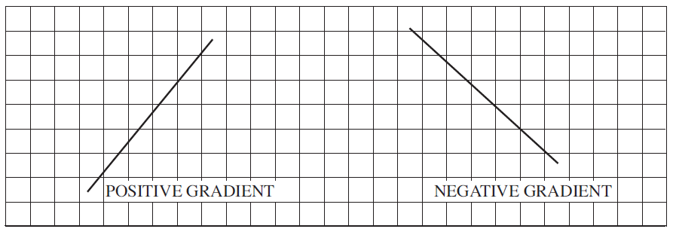
UNIT:
Straight Lines
Section 1
Gradient
The gradient of a line describes how steep it is.
The diagram below shows two lines, one with a positive gradient and
the other with a negative gradient.
A positive gradient can be seen to go ‘uphill’ in moving from left
to right and a negative gradient goes ‘downhill’.

Slide 4
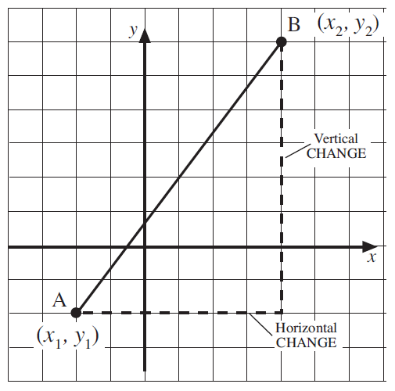
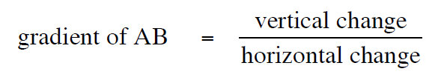
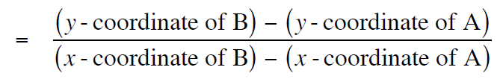

UNIT:
Straight Lines
Section 1
Gradient
The gradient of a line between two points, A and B, is calculated
using
Note that parallel lines have the same gradient.

Slide 5
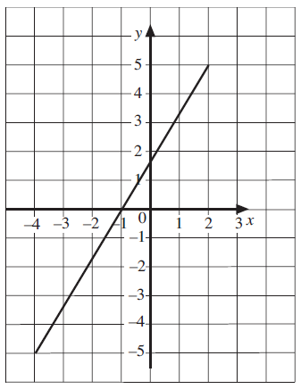
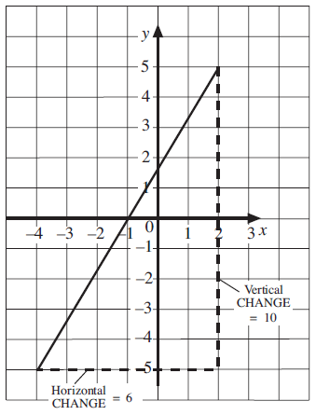
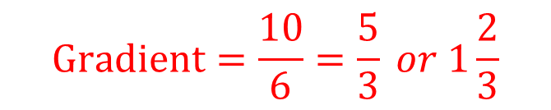
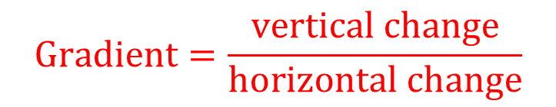
UNIT:
Straight Lines
Section 1
Gradient: Examples
Example 1
Find the gradient of the line shown in the diagram.
Solution
Draw any triangle under the line below to show the horizontal and vertical distances.
Here the vertical distance is 10 and the horizontal
distance is 6.
$$Gradient=\frac{vertical change}{horizontal change}$$
$$Gradient=\frac{10}{6}=\frac{5}{3} or 1\frac{2}{3}$$

Slide 6
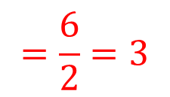
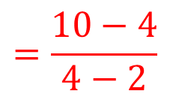
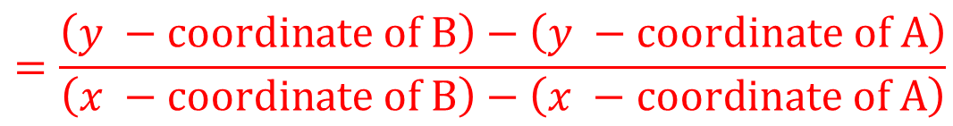
UNIT:
Straight Lines
Section 1
Gradient: Examples
Example 2
Find the gradient of the line joining the point A with coordinates (2, 4) and the point B with coordinates (4, 10).
Solution
$$=\frac{\left(y −coordinate of B\right)−\left(y −coordinate of A\right)}{\left(x −coordinate of B\right)−\left(x −coordinate of A\right)}$$
Gradient
$$=\frac{10−4}{4−2}$$
Gradient
$$=\frac{6}{2}=3$$
Gradient

Slide 7
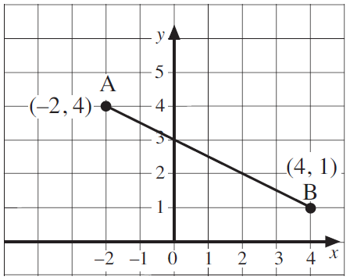
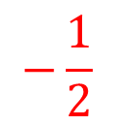
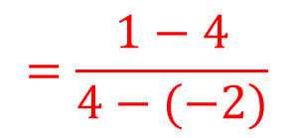
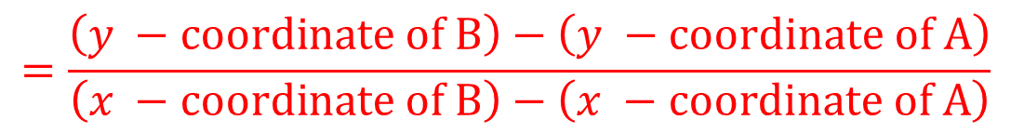
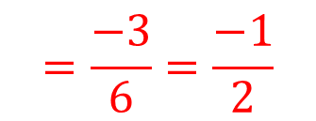
UNIT:
Straight Lines
Section 1
Gradient: Examples
Example 3
Find the gradient of the line that joins the points with coordinates (–2, 4) and (4, 1).
Solution
$$=\frac{\left(y −coordinate of B\right)−\left(y −coordinate of A\right)}{\left(x −coordinate of B\right)−\left(x −coordinate of A\right)}$$
Gradient
$$=\frac{1−4}{4−(−2)}$$
$$=\frac{−3}{6}=\frac{−1}{2}$$
$$−\frac{1}{2}$$
Gradient
So the gradient is

Slide 8
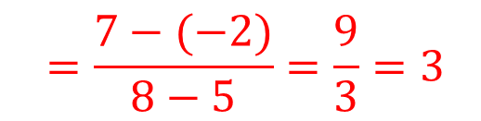
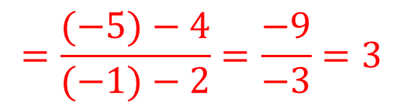
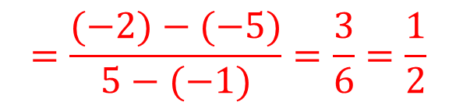
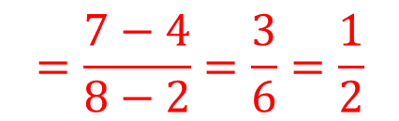
UNIT:
Straight Lines
Section 1
Gradient: Examples
Example 4
The coordinates of the points A, B, C and D are listed below.
A (2, 4) B (8, 7) C (–1, –5) D (5, –2)
Show that the line segments AB and CD are parallel.
Are the line segments AC and BD parallel?
Solution
$$=\frac{7−4}{8−2}=\frac{3}{6}=\frac{1}{2}$$
$$=\frac{(−2)−(−5)}{5−(−1)}=\frac{3}{6}=\frac{1}{2}$$
Gradient of AB
Gradient of CD
The line segments have the same gradient and so are parallel.
$$=\frac{(−5)−4}{(−1)−2}=\frac{−9}{−3}=3$$
Gradient of AC
$$=\frac{7−(−2)}{8−5}=\frac{9}{3}=3$$
Gradient of BD
The line segments have the same gradient and so are parallel.
The results in Example 4 mean that the quadrilateral ABDC is, in fact, a parallelogram.

Slide 9
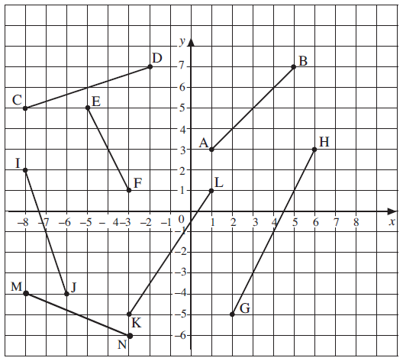
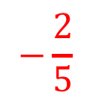



UNIT:
Straight Lines
Section 1
Section 1: Fitness Check
Here are some questions to check your progress; there are more practice questions if needed.
1. a) Which lines below have a positive gradient; which are negative?
b) Find the gradient of each line and confirm your answers.
Answers
a) CD, AB, KL, GH positive
EF, I J , MN negative
$$\frac{1}{3}$$
b) AB : 1 CD :
EF : GH : 2
I J : −3 KL :
MN :
$$−2$$
$$\frac{3}{2}$$
$$−\frac{2}{5}$$

Slide 10
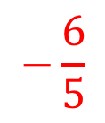
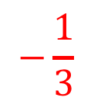
UNIT:
Straight Lines
Section 1
Section 1: Fitness Check
2. A quadrilateral is formed by joining the points A, B, C and D. The coordinates of each point are:
A (2, 4) B (–1, 5) C (– 4, 5) D (1, –1)
Find the gradient of each side of the quadrilateral.
Answers
$$−\frac{1}{3}$$
$$−\frac{6}{5}$$
AB: , BC: 0 , CD: , DA: 5

Slide 11
UNIT:
Straight Lines
Section 1
Section 1: Review
You have completed the first Section.
If you have completed and understood this section,
click to start the next Section
If you need more examples and interactive practice,
press here
You might also find it helpful to look at:
Essential Information: press here

Slide 12
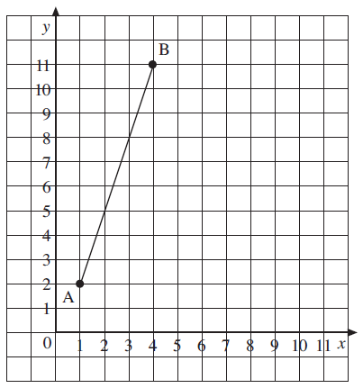
UNIT:
Straight Lines
Section 2
Gradients of Perpendicular Lines
In this section we explore the relationship between the gradients of perpendicular (at right angles to each other) lines and line segments.
Example 1
a) Plot the points A (1, 2) and B (4, 11), join them to form the line AB and then calculate the gradient of AB.
b) On the same set of axes, plot the points P (5, 4) and Q (8, 3), join them to form the line PQ and calculate the gradient of PQ.
c) Measure the angle between the lines AB and PQ. What do you notice about the two gradients?
Solution
a) First draw the points, as shown here.
Continued on next slide

Slide 13
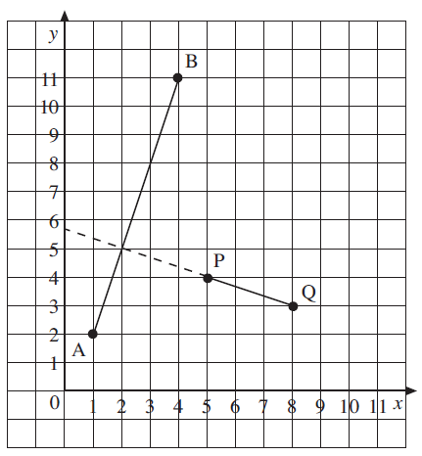
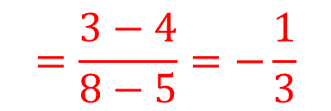
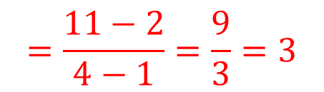
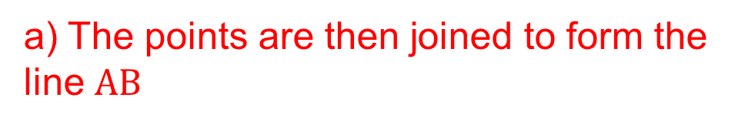
UNIT:
Straight Lines
Section 2
Gradients of Perpendicular Lines: Examples
Solution (continued)
a) The points are then joined to form the line $AB$
$$=\frac{11−2}{4−1}=\frac{9}{3}=3$$
Gradient of AB
b) The points P and Q can now be added to the diagram as shown here.
$$=\frac{3−4}{8−5}=−\frac{1}{3}$$
Gradient of PQ
Continued on next slide

Slide 14


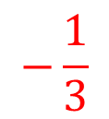
UNIT:
Straight Lines
Section 2
Gradients of Perpendicular Lines: Examples
Solution (continued)
c) The line PQ has been extended on the diagram, so that the angle between the two lines can be measured.
The angle is 90 ̊ , a right angle.
In this case,
the gradient of AB = 3;
$$−\frac{1}{3}$$
the gradient of PQ =
$$3×−\frac{1}{3}=−1$$
the gradients multiply to give
Note that if two lines are perpendicular, when you multiply
together the gradients, you always get $−$1 as your answer.

Slide 15
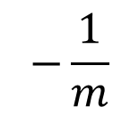
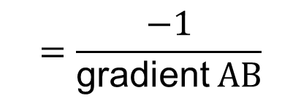
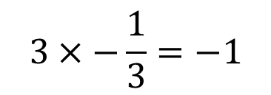
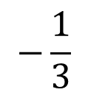
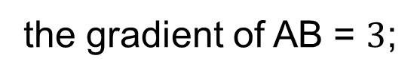
UNIT:
Straight Lines
Section 2
Gradients of Perpendicular Lines
The product of the gradients of two perpendicular lines will always be –1, unless one of the lines is horizontal and the other is vertical.
This was found in the previous example with the perpendicular lines of AB and PQ:
$$−\frac{1}{3}$$
the gradient of AB = $3$;
the gradient of PQ =
$$3×−\frac{1}{3}=−1$$
and
An equivalent way of describing this is by showing
$$=\frac{−1}{\text{gradient} AB}$$
gradient of AC
If the gradient of a line is $m$, and $m$ ≠ 0 , then the gradient of a
$$−\frac{1}{m}$$
perpendicular line will be .

Slide 16

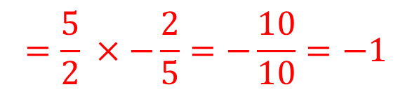
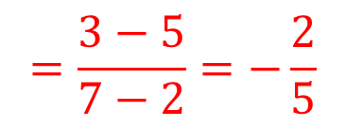
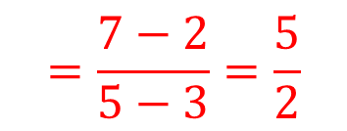
UNIT:
Straight Lines
Section 2
Gradients of Perpendicular Lines: Examples
Example 2
Show that the line segment joining the points A (3, 2) and B (5, 7) is perpendicular to the line segment joining the points P (2, 5) and Q (7, 3).
Solution
$$=\frac{7−2}{5−3}=\frac{5}{2}$$
$$=\frac{3−5}{7−2}=−\frac{2}{5}$$
Gradient of AB
Gradient of PQ
$$=\frac{5}{2} ×−\frac{2}{5}=−\frac{10}{10}=−1$$
Gradient of AB $×$
gradient of PQ
So the line segments AB and PQ are perpendicular.

Slide 17
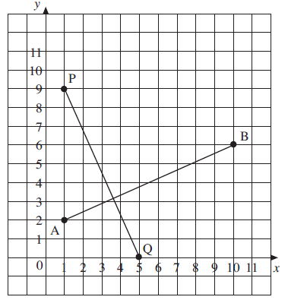
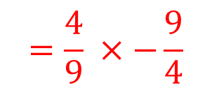
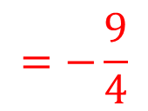
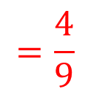

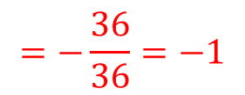
UNIT:
Straight Lines
Section 2
Section 2: Fitness Check
Here are some questions to check your progress; there are more practice questions if needed.
1. a) On a set of axes, draw the lines AB and PQ where the co- ordinates of these points are A (1, 2), B (10, 6), P (1, 9,) Q (5, 0),
b) Are the lines perpendicular?
c) Calculate the gradient of AB and the gradient of PQ.
d) Check that the product of these gradients is –1.
Solution
a) See the diagram on the right
Yes, they are perpendicular
Gradient AB Gradient PQ
d)
$$=\frac{4}{9}$$
$$=−\frac{9}{4}$$
$$=\frac{4}{9} ×−\frac{9}{4}$$
Gradient of AB $×$
gradient of PQ
$$=−\frac{36}{36}=−1$$

Slide 18


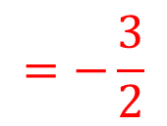
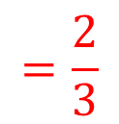

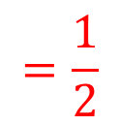
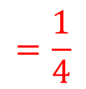
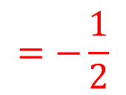
UNIT:
Straight Lines
Section 2
Section 2: Fitness Check
2. In each case, decide whether the lines AB and PQ are parallel, perpendicular or neither.
a) A (4, 3) B (8, 4) P (7, 1) Q (6, 5)
b) A (–2, 0) B (1, 9) P (2, 5) Q (6, 17)
c) A (8, –5) B (11, –3) P (1, 1) Q (–3, 7)
d) A (3, 1) B (7, 3) P (–3, 2) Q (1, 0)
Solutions
$$=\frac{1}{4}$$
$$=−4$$
a) Gradient of AB Gradient of PQ lines perpendicular
b) Gradient of AB Gradient of PQ lines parallel
c) Gradient of AB Gradient of PQ lines perpendicular
d) Gradient of AB Gradient of PQ neither
$$=3$$
$$=3$$
$$=\frac{2}{3}$$
$$=−\frac{3}{2}$$
$$=\frac{1}{2}$$
$$=−\frac{1}{2}$$

Slide 19
UNIT:
Straight Lines
Section 2
Section 2: Review
You have completed the second Section.
If you have completed and understood this section,
click to start the next Section
If you need more examples and interactive practice,
press here
You might also find it helpful to look at:
Essential Information: press here

Slide 20
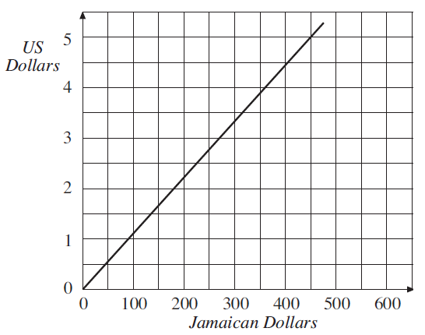
Conversion Graphs
UNIT:
Straight Lines
Section 3
In this section some applications of graphs are considered, particularly conversion graphs and graphs to describe motion.
The graph on the right is a conversion graph: it can be used for converting US Dollars into and from Jamaican Dollars.
As currency exchange rates are continually changing, these rates might not be correct now.

Slide 21
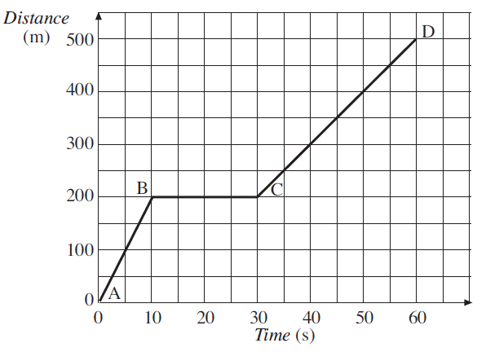
Distance-Time Graphs
UNIT:
Straight Lines
Section 3
The following graph is used to describe motion.
A distance-time graph of a car is shown opposite. The gradient of this graph gives the speed of the car. The gradient is steepest from A to B, so this is when the car has the greatest speed. The gradient BC is zero, so the car is not moving.
Note that we sometimes use speed and other times velocity.
In fact, velocity is the speed in a given direction.

Slide 22

UNIT:
Straight Lines
Section 3
Velocity/Speed-Time Graphs
The following graph is also used to describe motion.
The area under a speed/velocity-time graph gives the distance travelled.
Finding the shaded area on the graph shown opposite would give the distance travelled.
The gradient of this graph gives the acceleration of the car. There is constant acceleration from 0 to 20
seconds, then zero acceleration from 20 to 40 seconds (when the car has constant speed), constant deceleration from 40 to 50 seconds, etc.

Slide 23

UNIT:
Straight Lines
Section 3
Applications of Graphs: Examples
Example 1
A temperature of 20 ̊ C is equivalent to 68 ̊ F and a temperature of 100 ̊ C is equivalent to a temperature of 212 ̊ F. Use this information to draw a conversion graph. Use the graph to convert:
30 ̊ C to ̊ Fahrenheit,
180 ̊ F to ̊ Celsius.
Solution
Taking the horizontal axis as temperature in ̊ C and the vertical axis as temperature in ̊ F gives the two points, (20, 68) and (100, 212).
These are plotted on a graph and
a straight line drawn through the points.
Continued on next slide

Slide 24
UNIT:
Straight Lines
Section 3
Applications of Graphs: Examples
Solution (continued)
a) Start at 30 ̊ C, then move up to the line and across to the vertical axis, to give a
temperature of about 86 ̊ F.
b) Start at 180 ̊ F , then move across to the line and down to the horizontal axis, to give a temperature of about 82 ̊ C.

Slide 25

UNIT:
Straight Lines
Section 3
Applications of Graphs: Examples
Example 2
The graph shows the distance travelled by a girl on a bike.
Find the speed she is travelling on each stage of the journey.
Solution on next slide

Slide 26



UNIT:
Straight Lines
Section 3
Applications of Graphs: Examples
Solution
Note that units are m/s (metres per second), as m are the units for distance and s the units for time.
$$=\frac{750}{200}=3.75$$
For AB the gradient So the speed is 3.75 m/s.
$$=\frac{500}{50}=10$$
For BC the gradient So the speed is 10 m/s.
For CD the gradient is zero So the speed is 0 m/s.
$$=\frac{500}{100}=5$$
For DE the gradient So the speed is 5 m/s.

Slide 27

UNIT:
Straight Lines
Section 3
Applications of Graphs: Examples
Example 3
The graph shows how the velocity of a bird varies as it flies between two trees. How far apart are the two trees?

Slide 28




UNIT:
Straight Lines
Section 3
Applications of Graphs: Examples
Solution
The distance is given by the area under the graph. In order to find this area it has been split into three sections, A, B and C.
$$=\frac{1}{2} ×6×6=18 m^{2}$$
Area of A
Area of B
$$=6×6=36{ m}^{2}$$
$$=\frac{1}{2} ×2×6=6 m^{2}$$
Area of C
So the trees are 60 m apart. Note that the units are m (metres) because the units of velocity are m/s and the units of time are s (seconds).

Slide 29

UNIT:
Straight Lines
Section 3
Applications of Graphs: Examples
Example 4
The velocity-time graph below, not drawn to scale, shows that a train stops at two stations, A and D. The train accelerates uniformly from A to B, maintains a constant speed from B to C and decelerates uniformly from C to D.
Using the information on the graph,
(i) Calculate, in ms⁻², the train's acceleration
(ii) Show that the train took 30 secs from C to D if it decelerated at ms⁻ ² .
(iii) If the time taken from A to D is 156 seconds, calculate the distance in metres between the two stations.
Solution on next slide

Slide 30



UNIT:
Straight Lines
Section 3
Applications of Graphs: Examples
Solution
Using the information on the graph,
(i)
$$=\frac{15}{15}=1ms^{−2}$$
Acceleration
(ii) If it takes t seconds from C to D, then
$$=\frac{1}{2}=\frac{15}{t}$$
acceleration
and so $\text{t}=$30 seconds
Continued on next slide

Slide 31



UNIT:
Straight Lines
Section 3
Applications of Graphs: Examples
Solutions (continued)
(iii)
Time from B to C = 156 − (15 + 30) = 111 seconds
Total distance $=$ area under graph
$$=\frac{1}{2} ×15×15+15×111+\frac{1}{2} ×15×30$$
$$=\frac{225}{2} +1665+225=\frac{4005}{2}=2002\frac{1}{2}$$
So the total distance is 2002.5 metres

Slide 32
UNIT:
Straight Lines
Section 3
Section 3: Fitness Check
Here are some questions to check your progress; there are more practice questions if needed.
1. Use the approximation that 10 kg is about the same as 22 lbs to draw a graph for converting between pounds and kilograms. Use
the graph to convert the following:
a) 6 lbs to kilograms b) 8 lbs to kilograms
c) 5 kg to pounds d) 3 kg to pounds.
Answers
2.7 kg
3.6 kg
11 lbs
d) 6.6 lbs

Slide 33

UNIT:
Straight Lines
Section 3
Section 3: Fitness Check
2. The graph shows how the distance travelled by a taxi increased.
a) How many times did the taxi stop?
b) Find the velocity of the taxi on each section of the journey.
c) On which part of the journey did the taxi travel fastest?
Answers
3
b) AB: 20 m/s ; CD: 5 m/s ; EF: 10 m/s ; GH:10 m/s
c) AB

Slide 34

UNIT:
Straight Lines
Section 3
Section 3: Fitness Check
3. The graph shows the distance run by an athlete.
What was the distance of the race?
Answer
16 + 88 + 4 = 108 metres

Slide 35
UNIT:
Straight Lines
Section 3
Section 3: Review
You have completed the third Section.
If you have completed and understood this section,
click to start the next Section
If you need more examples and interactive practice,
press here
You might also find it helpful to look at:
Essential Information: press here

Slide 36



UNIT:
Straight Lines
Section 4
Equation of a Straight Line
The equation of a straight line is usually written in the form
$$y=mx+c$$
where m is the gradient and c is the y intercept.
Example 1
Find the equation of the line shown in the diagram.
Continued on next slide

Slide 37







UNIT:
Straight Lines
Section 4
Equation of a Straight Line: Examples
Solution
The first step is to find the gradient of the line, the diagram on the right can be used.
Drawing the triangle shown under the line gives
$$=\frac{vertical change}{horizontal change}$$
gradient
$$=\frac{4}{6}$$
$$=\frac{2}{3}$$
$$\frac{2}{3}$$
So the value of $m$ is . The line intersects the $y$-axis at 2
so the value of $c$ is 2.
The equation of a straight line is $y=mx+c$
In this case $y=\frac{2}{3}x+2$

Slide 38






UNIT:
Straight Lines
Section 4
Equation of a Straight Line: Examples
Example 2
Find the equation of the line that passes through the points (1, 5) and (3, 1).
Solution
Plotting these points gives the straight line shown. Using the triangle drawn underneath the line allows the gradient to be found.
$$=\frac{vertical change}{horizontal change}$$
Gradient
$$=\frac{−4}{2}$$
$$=−2$$
The $y$ intercept is 7. So $m$ = −2 and $c$ = 7 and the equation of the line is
$$y=−2x+7$$
or $y=7−2x$
(either is correct)

Slide 39




UNIT:
Straight Lines
Section 4
Equation of a Straight Line: Examples
Example 3
Draw the line 𝑥 = 4 .
Draw the line 𝑦 = 2.
c) Write down the coordinates of the point of intersection of these lines.
Solution
a) For the line $x$ = 4 the $x$-coordinate of every point will always be 4. So the points (4, 0) (4, 3) (4, 5) all lie on the line $x$ = 4.
b) For the line $y$ = 2 the $y$-coordinate of every
point will always be 2. So the points (0, 2)
(3, 2) and (5, 2) all lie on the line $y$ = 2.
c) The graph on the right shows that the lines intersect at the point with coordinates (4, 2).

Slide 40








UNIT:
Straight Lines
Section 4
Equation of a Straight Line: Examples
Example 4
The point with coordinates (4, 9) lies on the line with equation
$y=2x+1$. Determine the equation of the perpendicular line that also passes through this point.
Solution
The line 𝑦=2𝑥+1 has gradient 2.
$$−\frac{1}{2}$$
The perpendicular line will have gradient, $m$, is and so its equation will be of the form
$$y=−\frac{1}{2}x+c$$
As the line passes through (4, 9), we can use $x$ = 4 and $y$ = 9
to determine the value of $c$:
$$9=−\frac{1}{2}×4+c$$
$$9=−2+c$$
so
$$c=11$$
Continued on next page

Slide 41



UNIT:
Straight Lines
Section 4
Equation of a Straight Line: Examples
Solution (continued)
We now have the values of $m=−\frac{1}{2}$ , and $c=11$ . These are the values we use in the equation 𝑦 = m𝑥+c .
The equation of the perpendicular
line is
$$y=−\frac{1}{2}x+11$$
The graph on the right shows both lines.

Slide 42

UNIT:
Straight Lines
Section 4
Equation of a Straight Line: Examples
Example 5
In the diagram below, not drawn to scale, AB is the straight line joining A (−1, 9) and B (3, 1).
a) Calculate the gradient of the line, AB.
b) Determine the equation of the line, AB.
c) Write the coordinates of G, the point of intersection of AB and the y-axis.
d) Write the equation of the line through O, the origin, that is perpendicular to AB.
e) Write the equation of the line through O that is parallel to AB.
Solution on next slide

Slide 43









Equation of a Straight Line: Examples
UNIT:
Straight Lines
Section 4
Solution
a) Gradient $=\frac{9−1}{−1−3}=\frac{8}{−4}$
$$=−2$$
b) So the equation of line AB is
$$y=−2x+c$$
As it passes through (3, 1),
$$1=−2×3+c$$
so
$$c=7$$
equation is
$$y=−2x+7$$
c) $x$ = 0, so $y$ = −2 × 0 + 7 = 7. G is point (0, 7).
d) Gradient$=\frac{−1}{m}=\frac{−1}{−2}=\frac{1}{2}$ so $y=−\frac{1}{2}x$ (as it passes
through the origin)
e) The line parallel to AB has gradient −2, so the line through O has equation $y=−2x$

Slide 44



UNIT:
Straight Lines
Section 4
Section 4: Fitness Check
Here are some questions to check your progress; there are more practice questions if needed.
1. The diagram shows the straight line that passes through the points (2, 1) and (5, 4).
a) Find the gradient of the line.
b) Write down the $y$-intercept.
c) Write down the equation of the straight line.
Answers
1
–1
c) $y$ = $x$ −1

Slide 45







UNIT:
Straight Lines
Section 4
Section 4: Fitness Check
2. Find the equation of each line in the diagram below.
Solutions
$$y=5−\frac{1}{2}x$$
A:
B:
C:
D:
E:
F:
$$y=\frac{4}{3}x+4$$
$$y=2x−3$$
$$y=−\frac{2}{5}x−2$$
$$y=x−7$$
$$y=\frac{2}{5}x−5$$

Slide 46










UNIT:
Straight Lines
Section 4
Section 4: Fitness Check
3. Write down the gradient of each line and the coordinates of the $y$-intercept (make sure you re-arrange to $y=mx+c$ first).
$$y=2x−8$$
$$y=−3x+2$$
$$y=4x−3$$
b) c)
d) e) f)
g) h)
$$y=−\frac{1}{2}x+2$$
$$y=8−2x$$
$$y=4−3x$$
$$x+y=8$$
$$y=3(5−x)$$
Answers
2, (0, –8) b) –3, (0, 2) c) 4, (0, –3)
, (0, 2) e) –2, (0, 8) f) –3, (0, 4)
g) –1, (0, 8) h) –3, (0, 15)
$$\frac{1}{2}$$

Slide 47
UNIT:
Straight Lines
Section 4
Section 4: Review
You have completed the fourth Section.
If you have completed and mastered this last section,
click here for the Unit audit
If you need more examples and interactive practice,
press here
You might also find it helpful to look at:
Essential Information: press here

