Slide 1
Supporting and Enhancing Mathematics and Statistics
UNIT: Sine and Cosine Rules

Slide 2
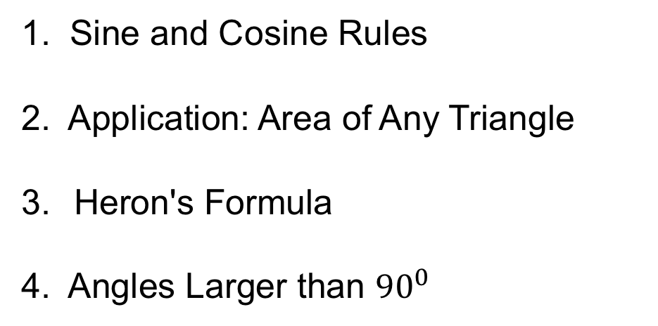
Sine and Cosine Rules
Unit:
Sine and Cosine
Rules
Section 1
The sine and cosine rules are used to find a side or an angle in a triangle.
You have four sections to work through and there are check up audits and fitness tests for each section
1. Sine and Cosine Rules
2. Application: Area of Any Triangle
Heron's Formula
4. Angles Larger than ${90}^{0}$

Slide 3
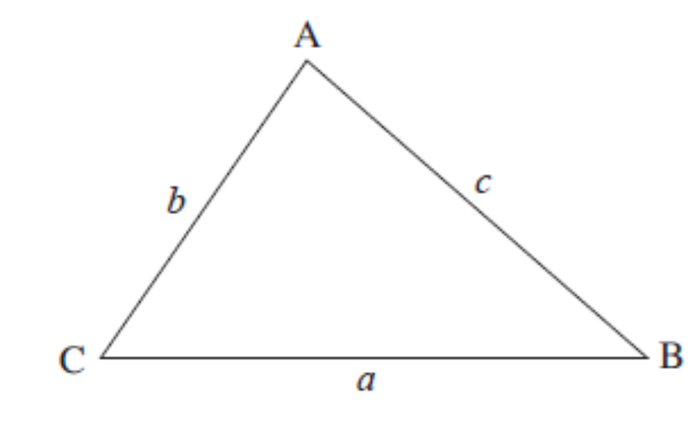
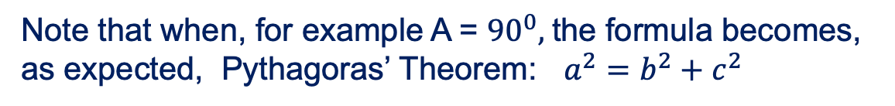
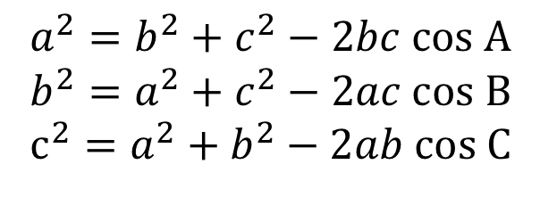
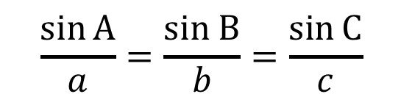
Sine and Cosine Rules
Unit:
Sine and Cosine Rules
Section 1
In the triangle ABC, the side opposite angle A has length a, the side opposite angle B has length b and the side opposite angle C has length c.
The sine rule states
The cosine rule states
$$a^{2}=b^{2}+c^{2}−2bc cos A$$
$$b^{2}=a^{2}+c^{2}−2ac cos B$$
$$c^{2}=a^{2}+b^{2}−2ab cos C$$
$$\frac{\sin{A}}{a}=\frac{sin B}{b}=\frac{\sin{C}}{c}$$
Note that when, for example A = ${90}^{0},$the formula becomes, as expected, Pythagoras’ Theorem: $a^{2}=b^{2}+c^{2}$

Slide 4
Unit:
Sine and Cosine
Rules
Section 1
Sine and Cosine Rules
The cosine rule can be used in any triangle to calculate:
a side when two sides and the angle in between them are known (SAS)
an angle when three sides are known (SSS)
The sine rule can be used in any triangle to calculate:
a side when two angles and an opposite side
are known (AAS)
an angle when two sides and an opposite angle are known (SSA)

Slide 5
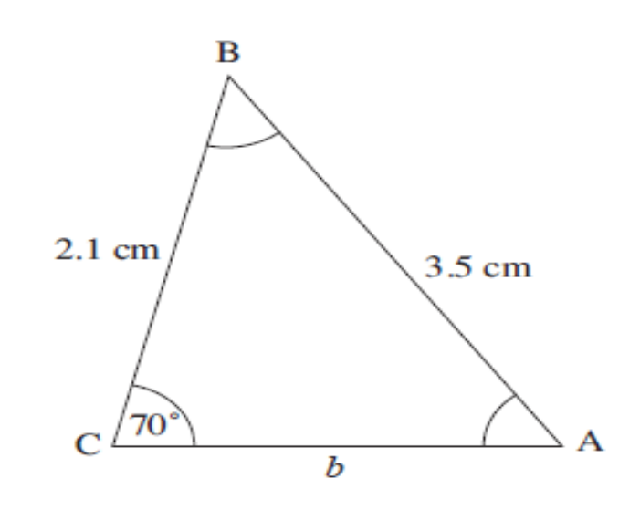
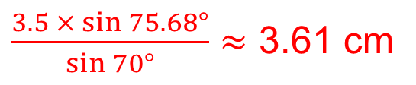
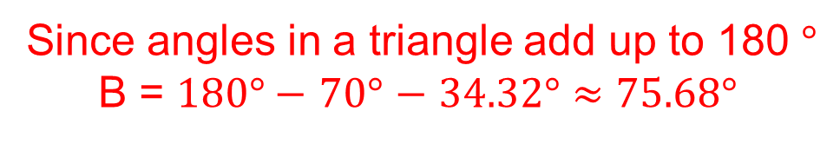
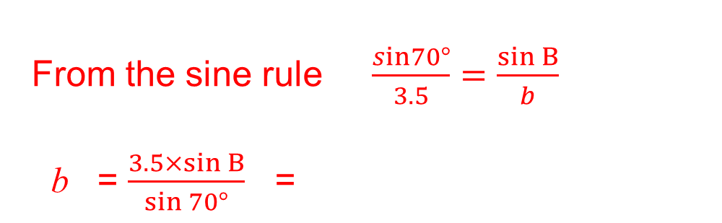
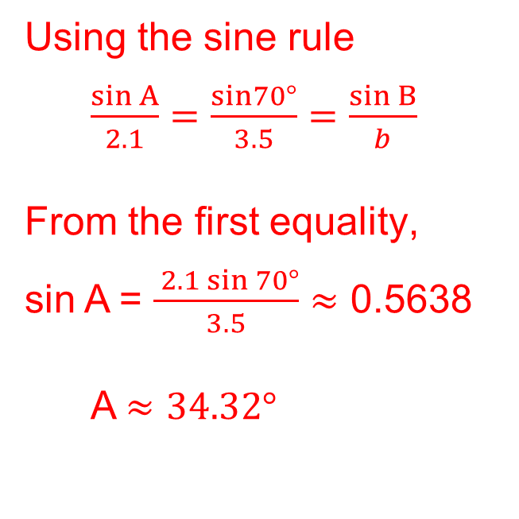
Unit:
Sine and Cosine
Rules
Section 1
Sine Rule
Example 1
Find the unknown angles and side length of the triangle shown.
Solution
Using the sine rule
$\frac{\sin{A}}{2.1}=\frac{sin70°}{3.5}=\frac{\sin{B}}{b}$
From the first equality,
sin A = $\frac{ 2.1\sin{70°}}{3.5}$ $≈$ 0.5638
A $≈$ $34.32°$
Since angles in a triangle add up to 180 $°$
B = $180°−$ $70°$ $−$ $34.32°≈75.68°$
From the sine rule $\frac{sin70°}{3.5}=\frac{\sin{B}}{b}$
b = $\frac{3.5×sin{B}}{\sin{70°}}$ =
$\frac{3.5 × sin{75.68°}}{\sin{70°}}$ $≈$ 3.61 cm

Slide 6
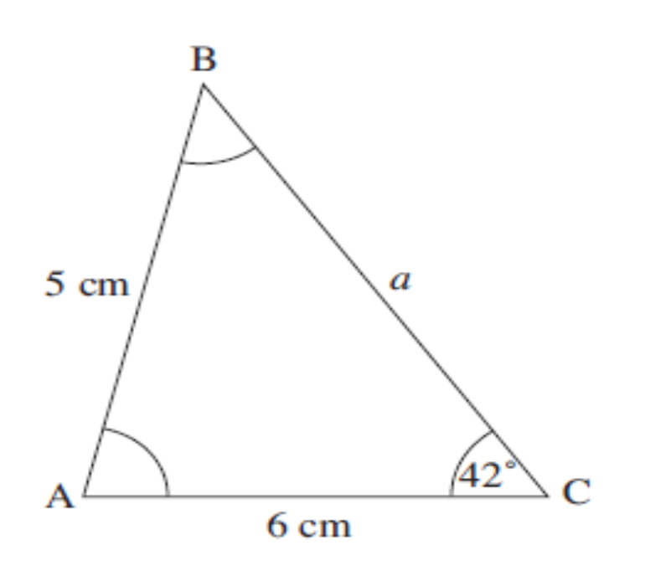
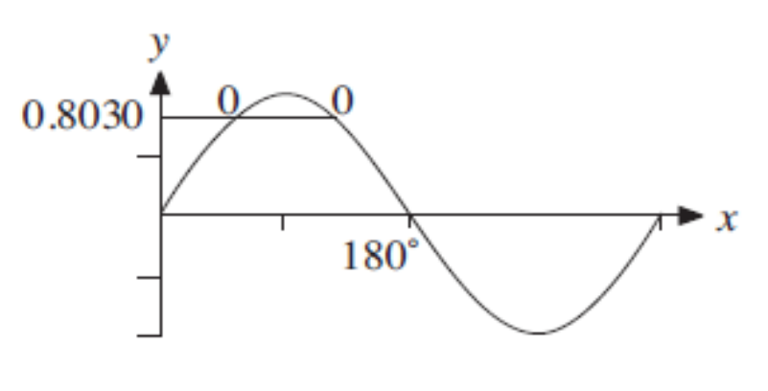
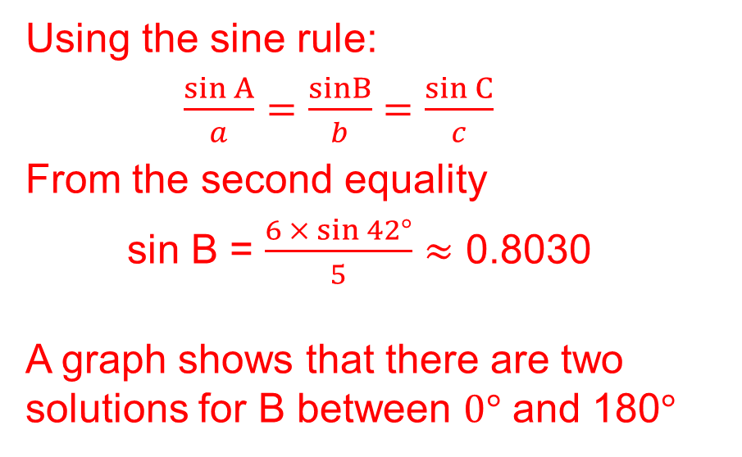
Unit:
Sine and Cosine
Rules
Section 1
Sine Rule
Example 2
Find two solutions for the unknown angles and side of the triangle shown.
Solution
Using the sine rule:
$\frac{\sin{A}}{a}=\frac{sinB}{b}=\frac{\sin{C}}{c}$
From the second equality
sin B = $\frac{6 × sin{42°}}{5}≈$ 0.8030
A graph shows that there are two solutions for B between $0°$ and 180$°$
Solution continues on next slide

Slide 7
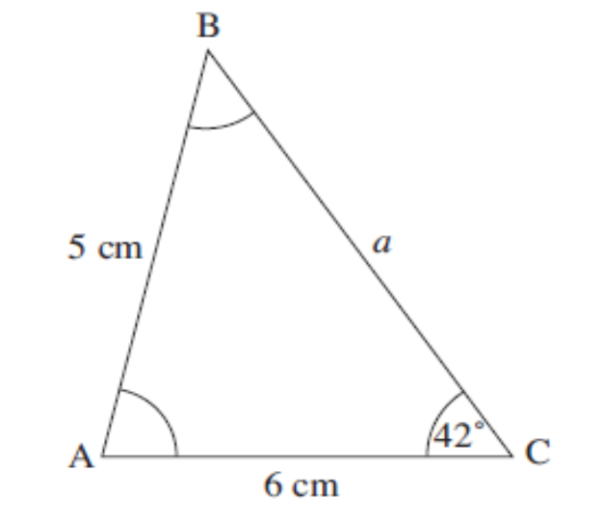
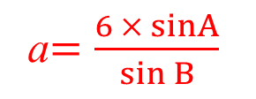
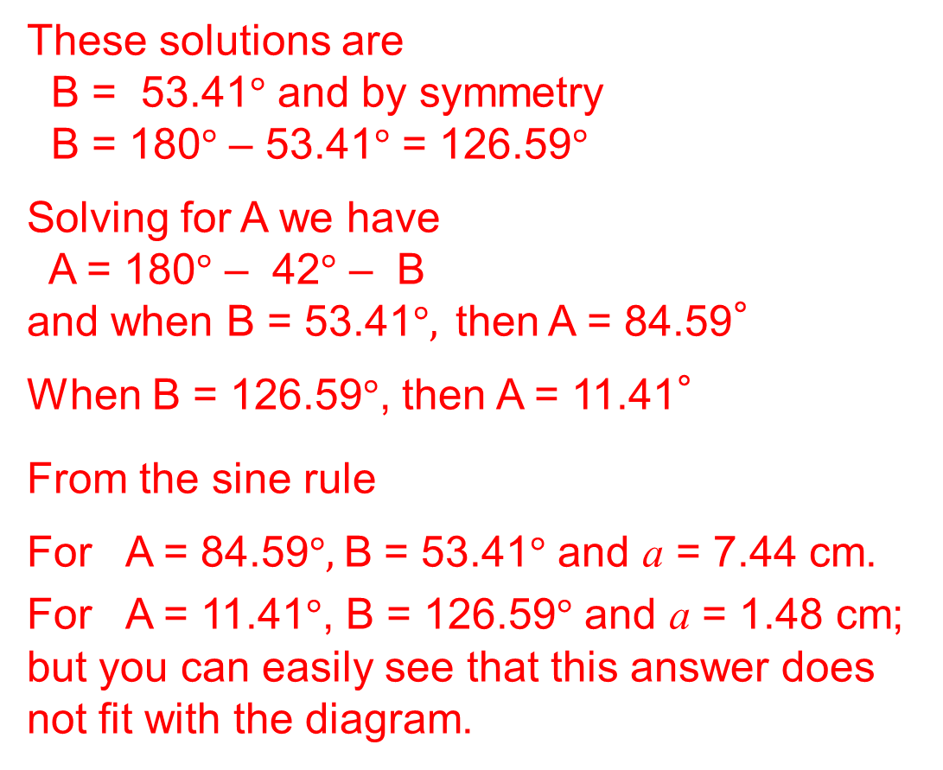
Unit:
Sine and Cosine
Rules
Section 1
Sine Rule
Solution (continued)
These solutions are
B = 53.41$°$ and by symmetry
B = 180$°$ – 53.41$°$ = 126.59$°$
Solving for A we have
A = 180$°$ – 42$°$ – B
and when B = 53.41$°, \text{then}$ A = 84.59°
When B = 126.59$°$, then A = 11.41°
From the sine rule
For A = 84.59$°,$B = 53.41$°$ and a = 7.44 cm.
For A = 11.41$°$, B = 126.59$°$ and a = 1.48 cm; but you can easily see that this answer does not fit with the diagram.
a$=\frac{6 × sinA}{\sin{B}}$
Solution
Looking at the diagram above
a = 7.44 cm

Slide 8
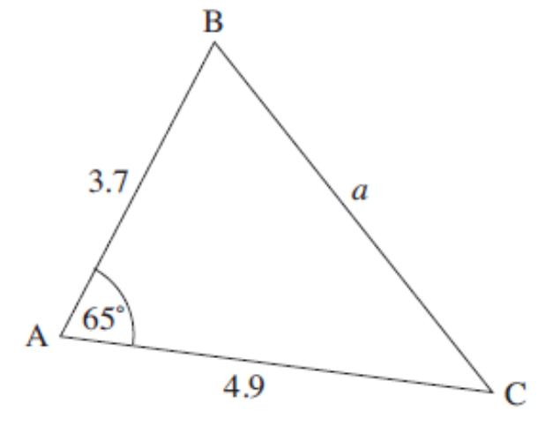
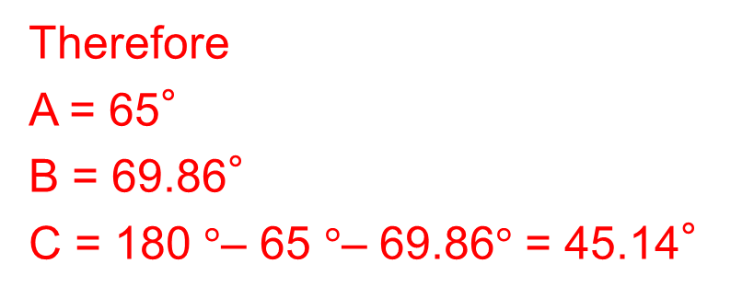
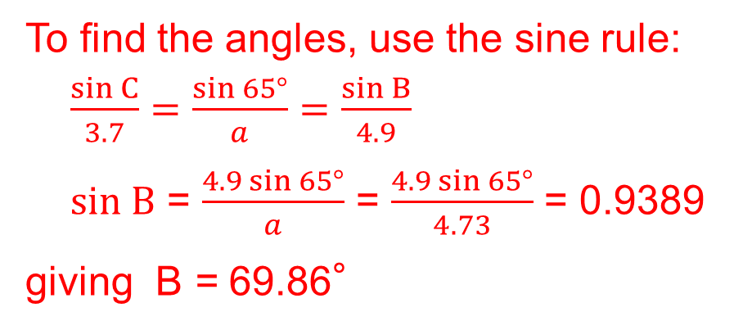
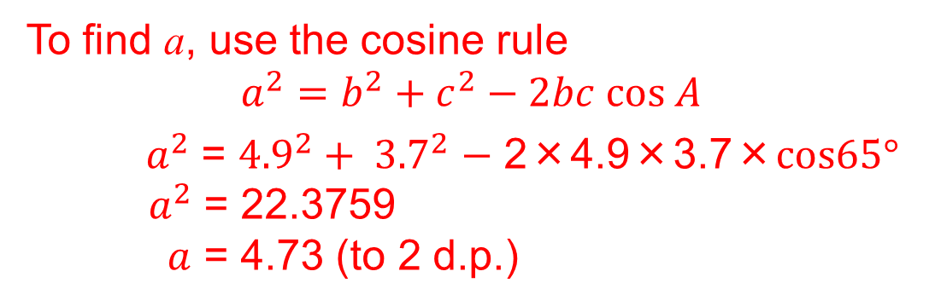
Unit:
Sine and Cosine
Rules
Section 1
Cosine and Sine Rules
Example
Find the unknown side and angles
of the triangle shown.
Solution
To find a, use the cosine rule
$$a^{2}=b^{2}+c^{2}−2bc cos A$$
${ a}^{2}$ = ${4.9}^{2}+ {3.7}^{2}$ $−$ 2×4.9×3.7×$cos65°$
${ a}^{2}$ = 22.3759
$a$ = 4.73 (to 2 d.p.)
To find the angles, use the sine rule:
$\frac{\sin{C}}{3.7}=\frac{sin 65°}{a}=\frac{\sin{B}}{4.9}$
$sin B$ = $\frac{4.9\sin{65°}}{a}$ = $\frac{4.9\sin{65°}}{4.73}$ = 0.9389
giving B = 69.86°
Therefore
A = 65°
B = 69.86°
C = 180 $°$– 65 $°$– 69.86$°$ = 45.14°

Slide 9
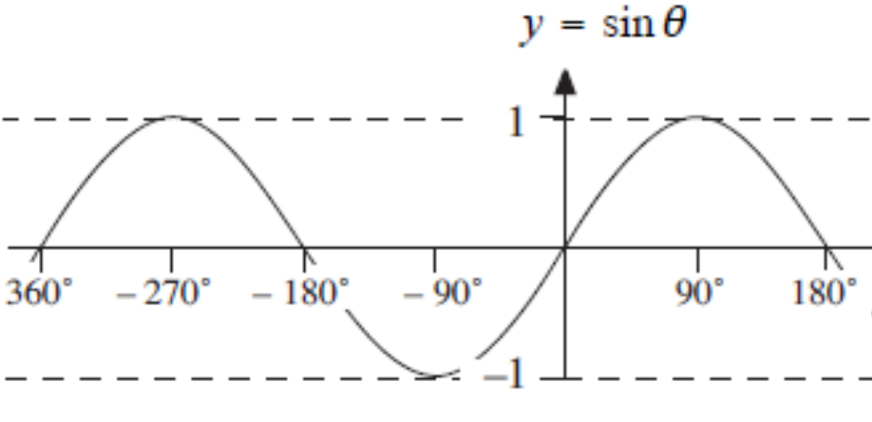
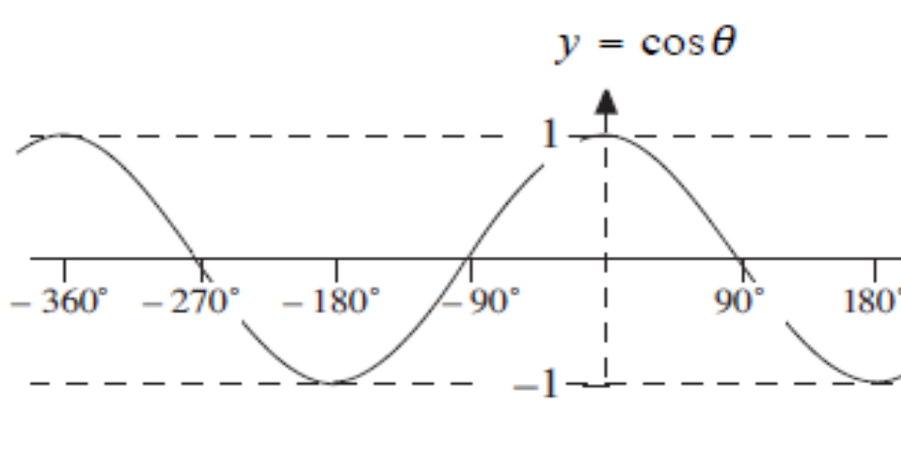
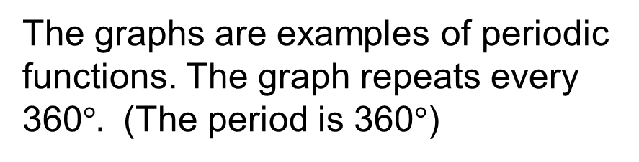
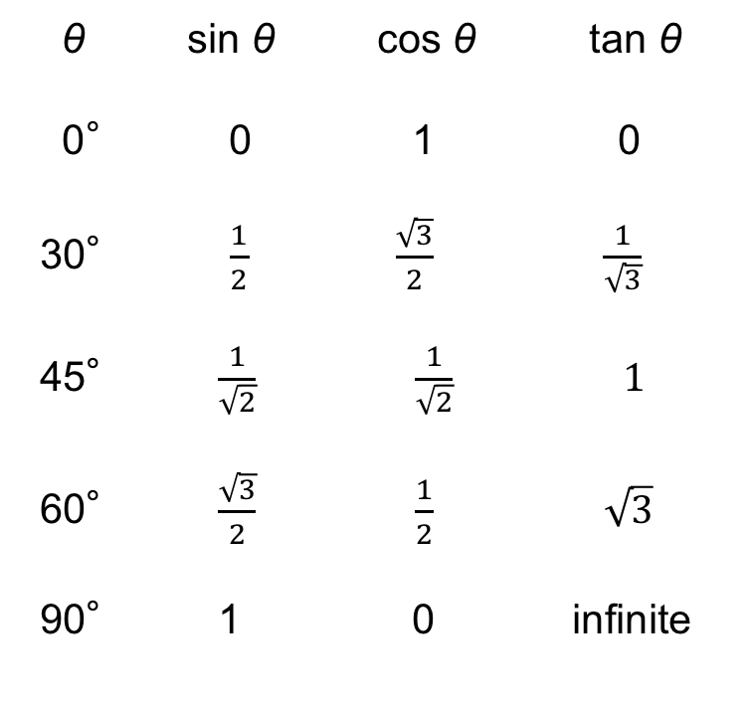
Unit:
Sine and Cosine
Rules
Section 1
sin θ , cos θ and tan θ
Some key values of sin θ , cos θ and tan θ are shown below.
θ sin θ cos θ tan θ
0° 0 1 0
30° $\frac{1}{2}$ $\frac{\sqrt{3}}{2}$ $\frac{1}{\sqrt{3}}$
45° $\frac{1}{\sqrt{2}}$ $\frac{1}{\sqrt{2}} 1$
60° $\frac{\sqrt{3}}{2}$ $\frac{1}{2}$ $\sqrt{3}$
90° 1 0 infinite
The graphs of sin θ and cos θ for any angle are shown below.
The graphs are examples of periodic functions. The graph repeats every 360$°.$ (The period is 360$°$)

Slide 10
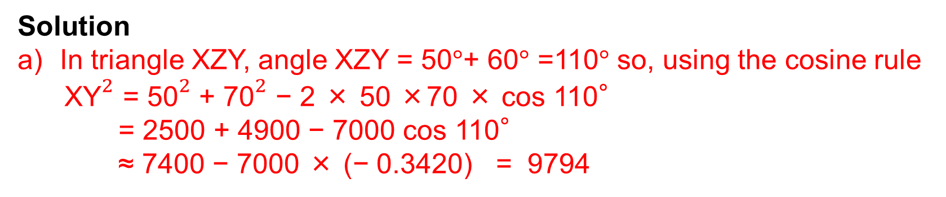
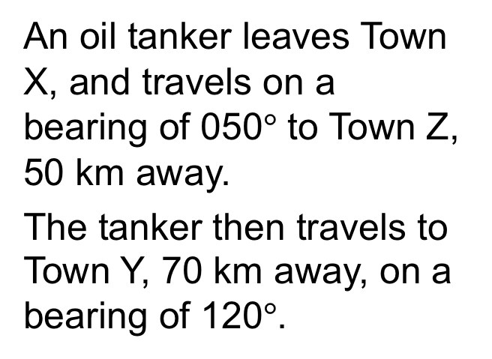
Unit:
Sine and Cosine
Rules
Section 1
Sine and Cosine Rules
Example
An oil tanker leaves Town X, and travels on a bearing of 050$°$ to Town Z,
50 km away.
The tanker then travels to Town Y, 70 km away, on a bearing of 120$°$.
a) Find the distance of Y from X, giving your answer to 3 sig. figs.
Solution
In triangle XZY, angle XZY = 50$°$+ 60$°$ =110$°$ so, using the cosine rule
${\text{XY}}^{2}$ = ${\text{50}}^{2}$ + ${\text{70}}^{2}$ − 2 × 50 ×70 × cos 110°
= 2500 + 4900 − 7000 cos 110°
≈ 7400 − 7000 × (− 0.3420) = 9794
XY ≈ 98.965 = 99.0 to 3 sig. figs.

Slide 11
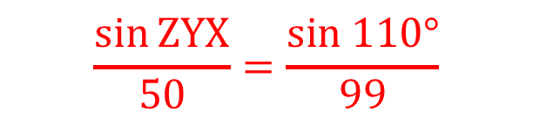
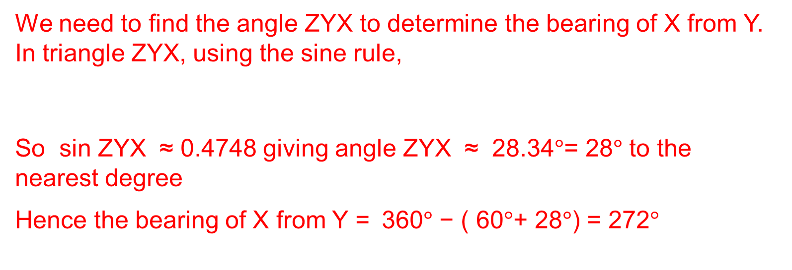
Unit:
Sine and Cosine
Rules
Section 1
Sine and Cosine Rules
Example (continued)
b) Calculate the bearing of X from Y, giving your answer to the nearest degree
Solution
We need to find the angle ZYX to determine the bearing of X from Y. In triangle ZYX, using the sine rule,
So sin ZYX ≈ 0.4748 giving angle ZYX ≈ 28.34$°$= 28$°$ to the nearest degree
Hence the bearing of X from Y = 360$°$ − ( 60$°$+ 28$°$) = 272$°$
$$\frac{\sin{ZYX}}{50}=\frac{sin 110°}{99}$$

Slide 12
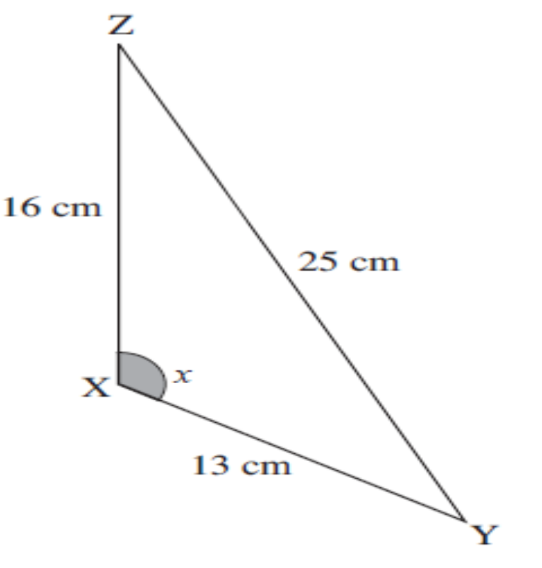
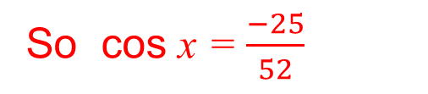
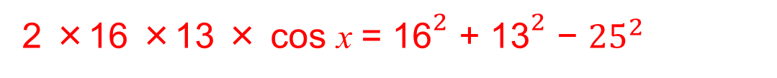
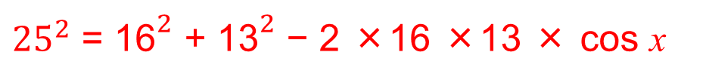
Unit:
Sine and Cosine
Rules
Section 1
Sine and Cosine Rules
Example
Find the shaded angle in the
triangle shown, giving your answer to one decimal place.
Solution
Using the cosine rule,
${25}^{2}$ = ${\text{16}}^{2}$ + ${\text{13}}^{2}$ − 2 ×16 ×13 × cos x
Rearranging:
2 ×16 ×13 × cos x = ${\text{16}}^{2}$ + ${\text{13}}^{2}$ − ${25}^{2}$
416 × cos x = −200
So cos x = $\frac{−25}{52}$
and using the SHIFT and COS buttons on a calculator:
x =$\cos^{−1}$($\frac{−25}{52}$) = 118.7$°$ (to 1decimal place)

Slide 13
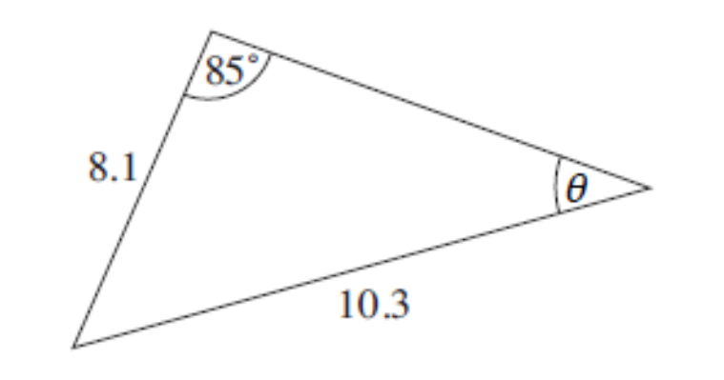
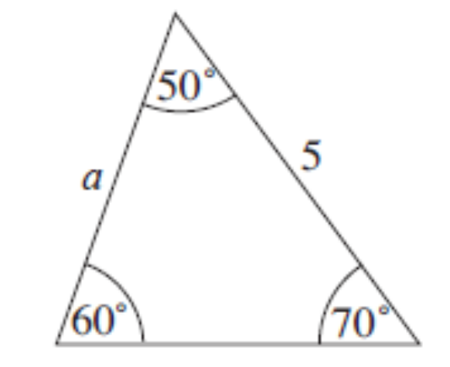
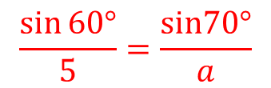
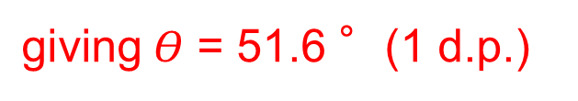
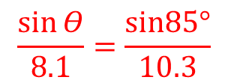
Unit:
Sine and Cosine
Rules
Section 1
Section 1: Fitness Check
Here are some questions to check your progress
1. a) Find the unknown angle marked θ .
Answer
$$\frac{\sin{Θ}}{8.1}=\frac{sin85°}{10.3}$$
$\text{giving} Θ$ = 51.6 °(1 d.p.)
b) Find the unknown side marked a.
Answer
$$\frac{\sin{60°}}{5}=\frac{sin70°}{a}$$
giving a = 5.43 (2 d.p.)

Slide 14
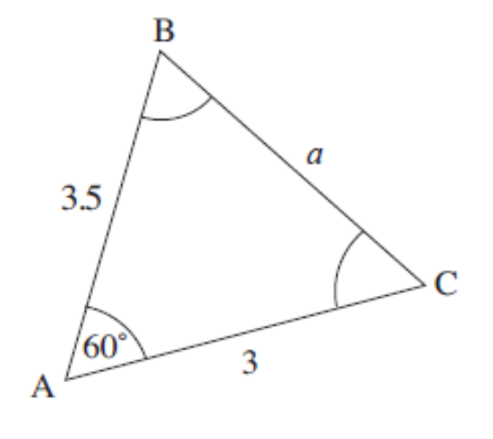
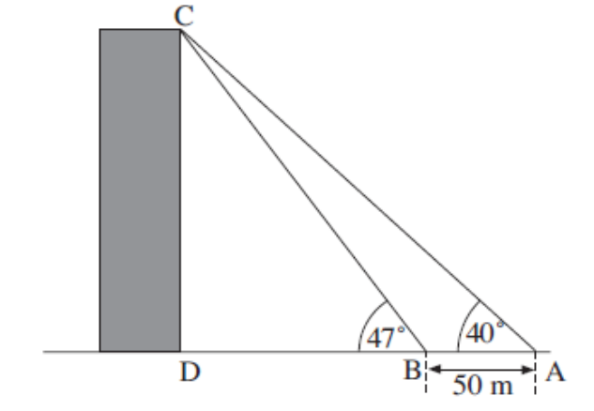
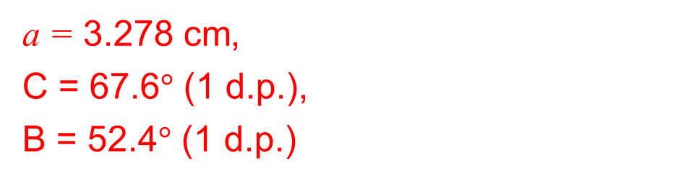
Unit:
Sine and Cosine
Rules
Section 1
Section 1: Fitness Check
Here are some questions to check your progress
3. Find the unknown angles and sides.
Answers
a = 3.278 cm,
C = 67.6$°$ (1 d.p.),
B = 52.4$°$ (1 d.p.)
4. To calculate the height of a church tower, a surveyor measures the angle of elevation of the top of the tower from two points 50 m apart.
a) Calculate the distance BC.
b) Hence calculate the height CD.
Answers
24.12 m (b) 32.98 m

Slide 15
Unit:
Sine and Cosine
Rules
Section 1
Section 1: Review
You have completed the first section.
If you have completed and mastered this section,
click to start the next Section
If you need more examples and interactive practice,
press here
You might also find it helpful to look at:
Essential Information: press here

Slide 16
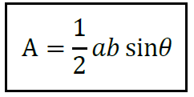
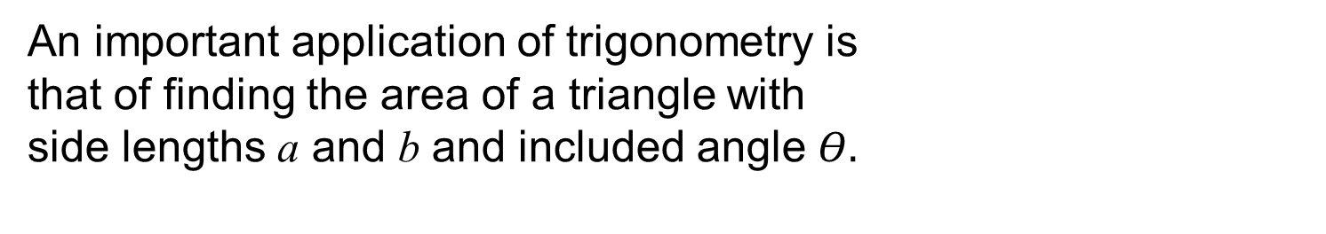
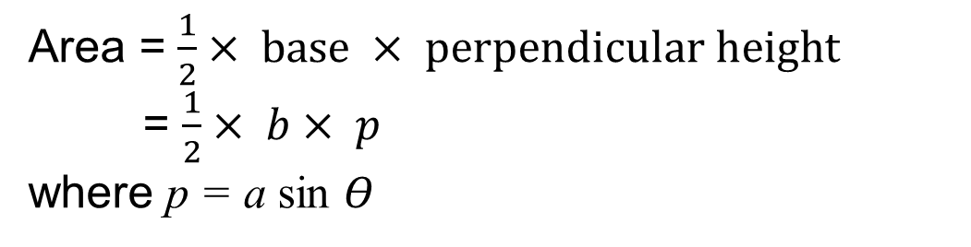
Unit:
Sine and Cosine
Rules
Section 2
Application: Area of any Triangle
An important application of trigonometry is
that of finding the area of a triangle with
side lengths a and b and included angle $Θ.$
This area, A, is given by
We can prove this result by constructing the perpendicular line from point B to the line AC.
Area = $\frac{1}{2}× base × perpendicular height$
= $\frac{1}{2}× b× p$
where p = a sin $Θ$
So Area = $\frac{1}{2}× b × \text{a} \text{sin}Θ \text{= }\frac{1}{2} a b\sin{Θ }$

Slide 17
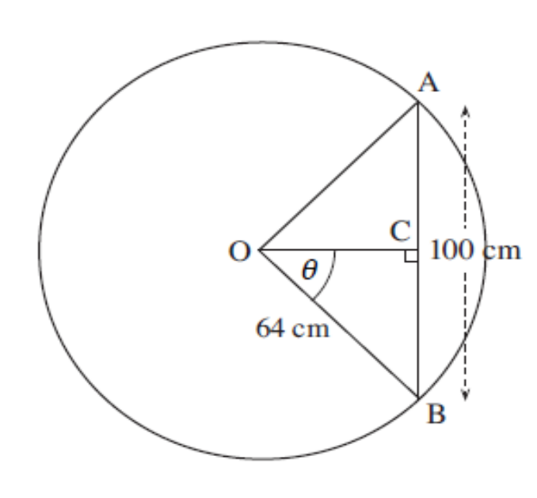
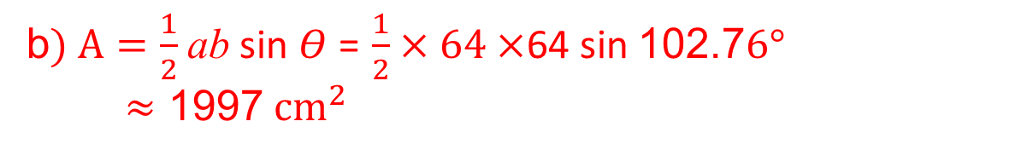
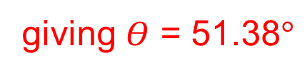
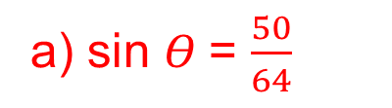
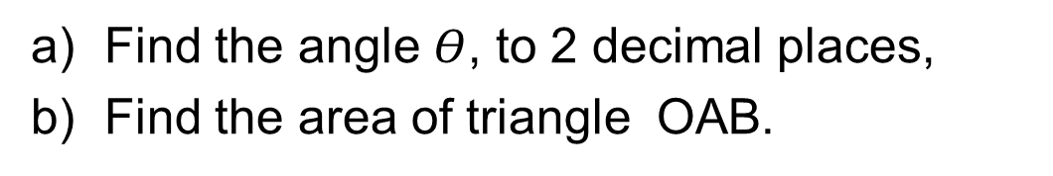
Unit:
Sine and Cosine
Rules
Section 2
Application: Area of any Triangle
Example
The diagram shows a circle of radius 64 cm. The length of the chord AB is 100 cm.
a) Find the angle $Θ$, to 2 decimal places,
b) Find the area of triangle OAB.
Solution
a) sin $Θ$= $\frac{50}{64}$
giving $Θ$ = 51.38$°$
b$) A=\frac{1}{2}$ ab sin $Θ$ = $\frac{1}{2}×64×$64 sin 102.7$6°$
$≈$ 1997${ cm}^{2}$

Slide 18
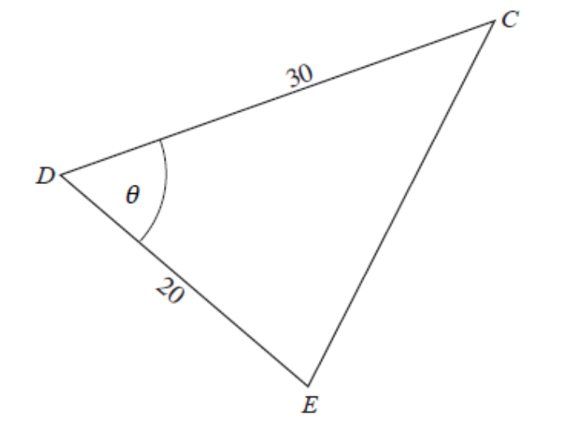
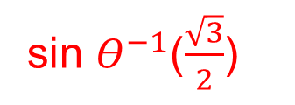











Unit:
Sine and Cosine
Rules
Section 2
Application: Area of any Triangle
Example
Given that sin $Θ$ = $\frac{\sqrt{3}}{2}$ , 0$°$≤ $Θ$ ≤ 90$, find$
a) the area of triangle CDE where
CD = 30 units and DE = 20 units;
b) the length CE.
Solution
$\text{a}\text{)} \text{Area}=\frac{1}{2}$ a b sin $Θ$ = $\frac{1}{2}× 30 ×$ 20 $×$ $\frac{\sqrt{3}}{2}$ = 150$\sqrt{3 }{cm}^{2}$
b) We first find the angle $Θ$:
sin $Θ$ =$\frac{\sqrt{3}}{2}$
sin $Θ^{−1}$($\frac{\sqrt{3}}{2}$)
$Θ$ = 60 $°$
$$⟹$$
$$⟹$$
Now we use the cosine rule to find the length CE
${ CE}^{2}$ = ${30}^{2}+ {20}^{2}$ $−$2 $×$ 30 $×$ 20 $×$ $cos\text{ 60}°$
${ CE}^{2}$ = 900$+400$ $−$ 1200 $×$ $cos\text{ 60}°$
${ CE}^{2}$= 700
$$⟹$$
$$CE=√700$$
$$CE=26.46 2 d.p.$$
$$⟹$$

Slide 19



Unit:
Sine and Cosine
Rules
Section 2
Section 2: Fitness Check
Here are some questions to check your progress
1. Find the area of the shaded region.
Give your answer to 2 decimal places.
Answer
${24.13 cm}^{2}$
2. Find the area of the shaded region.
Give your answer to 2 decimal places
Answer
${ 94.53 cm}^{2}$

Slide 20




Unit:
Sine and Cosine
Rules
Section 2
Section 2: Fitness Check
Here are some questions to check your progress
3. In the diagram ST = 5 cm, TW = 9 cm and STW = 52$°$.
Calculate, giving answers to 2 decimal places:
a) the length of SW;
b) the area of triangle STW.
Answers
a) $SW =7.11 cm$
b) Area $=17.73{ cm}^{2}$

Slide 21
Unit:
Sine and Cosine
Rules
Section 2
Section 2: Review
You have completed the second section.
If you have completed and mastered this section,
click to start the next Section
If you need more examples and interactive practice,
press here
You might also find it helpful to look at:
Essential Information: press here

Slide 22




Unit:
Sine and Cosine
Rules
Section 3
Heron’s Formula
You have already met the formula for the area of a triangle when the lengths of two sides and the included angle are known:
Area $=\frac{1}{2}$ ab sin C
There is another formula for the area of a triangle when all 3 sides are given. This is credited to Heron (or Hero) of Alexandria; a proof can be found in his book, Metrica, written in about AD 60.
The formula, known as Heron's formula, is given by
Area =$\sqrt{s(s−a)(s−b)(s−c)}$
where $s$ = $\frac{a+b+c }{2}$

Slide 23













Unit:
Sine and Cosine
Rules
Section 3
Heron’s Formula
Example
For the triangle shown, find
a) the area of the triangle,
b) angle θ .
Solution
a) Using Heron's formula
Area =$\sqrt{s(s−a)(s−b)(s−c)}$
where $s$ = $\frac{a+b+c }{2}$ gives
$s$ = $\frac{4+5+7 }{2}$ = 8
Hence area =$\sqrt{8(8−4)(8−7)(8−5)}$
= 9.80 ${cm}^{2 } to 2 d.p.$
$A=\frac{1}{2}$ ab sin $Θ$
b) To find angle $Θ$, we use
9.80 $=\frac{1}{2}$ $×$ 4 $×$ 5 $×$ sin $Θ$
$$⟹$$
sin $Θ$= 0.98
$$⟹$$
$Θ$ = 78.5° to 1 d.p.

Slide 24






Unit:
Sine and Cosine
Rules
Section 3
Section 3: Fitness Check
Here are some questions to check your progress
1. Calculate this area of the triangle.
Answer
Area =${ 12 cm}^{2}$
2. Find:
a) the area of the triangle opposite,
b) the angle shown by $Θ$ .
Answers
a) Area = 27.81${ mm}^{2}$
b)$Θ$= 44°

Slide 25
Unit:
Sine and Cosine
Rules
Section 3
Section 3: Review
You have completed the third section.
If you have completed and mastered this section,
click to start the next Section
If you need more examples and interactive practice,
press here
You might also find it helpful to look at:
Essential Information: press here

Slide 26


Unit:
Sine and Cosine
Rules
Section 4
Angles larger than ${90}^{0}$
Let us explore how we define the trig rules for angles greater than ${90}^{°}$
First consider the x-y plane is divided into four quadrants by the x and y axes as shown in the picture below The angle θ that a line OP makes with the positive x-axis lies between $0^{°}$ and ${360}^{°}$.

Slide 27

Unit:
Sine and Cosine
Rules
Section 4
Angles larger than ${90}^{0}$
Angles between $0^{°}$ and ${90}^{°}$are in the first quadrant.
Angles between ${90}^{°}$and ${180}^{°}$ are in the second quadrant.
Angles between ${180}^{°}$ and ${270}^{°}$ are in the third quadrant.
Angles between ${270}^{°}$ and ${360}^{°}$ are in the fourth quadrant.
Angles larger than ${360}^{°}$ can be reduced to lie between $0^{°}$ and ${360}^{°}$
by subtracting multiples of ${360}^{°}$

Slide 28

Unit:
Sine and Cosine
Rules
Section 4
Angles larger than ${90}^{0}$
The trigonometric formulae, $cosθ$ and$sinθ$, are defined for all angles between $0^{°}$and ${360}^{°}$as the coordinates of a point, P, where OP is a line of length 1, making an angle $θ$ with the positive x-axis.
This is illustrated in the diagram below:

Slide 29
Unit:
Sine and Cosine
Rules
Section 4
Important values of Trig Functions
Here are some of the important values of sinθ , cosθ and tanθ which we have meet before; you should already be familiar with these.

Slide 30

Unit:
Sine and Cosine
Rules
Section 4
Graphs of sinθ and cosθ
The graphs of sinθ and cosθ for any angle are shown below.
The graphs are examples of periodic functions. Each basic pattern repeats itself every ${360}^{°}$. We say that the period is ${360}^{°}$.
For any angle, note that sin(${90}^{°}−θ$) = cosθ

Slide 31

Unit:
Sine and Cosine
Rules
Section 4
Graph of tanθ
The graph of tanθ has period ${180}^{°}$.
It is an example of a discontinuous graph.

Slide 32

Unit:
Sine and Cosine
Rules
Section 4
Trigonometric equations
The trigonometric equations sin$θ=a$ , cos$θ=b$ and tan$θ=c$
can have many solutions.
The inverse trig keys on a calculator (that is $\sin^{−1}$, $\cos^{−1},\tan^{−1}$)
give the principal value solution.
For sin$θ=a$ and tan$θ=c$ , the principal value solution is in the range:
$−{90}^{°}≤θ≤{90}^{°}$
For cos$θ=b$, the principal value solution is in the range:
$0≤θ≤{180}^{°}$

Slide 33




Unit:
Sine and Cosine
Rules
Section 4
Trigonometric equations: Examples
Example 1
Find a) cos${150}^{°}$ b) sin ${240}^{°}$
Solution
a) ${150}^{°}$ is in the second quadrant so P has coordinates ( $−cos{30}^{°}$, sin${30}^{°}$)
Hence cos${150}^{°}$= $−cos{30}^{°}$= $−\frac{\sqrt{3}}{2}$
b) ${240}^{°}$ is in the third quadrant so P has coordinates ( $−cos{60}^{°}$, $−$sin${60}^{°}$).
Hence sin${240}^{°}$= $−sin{60}^{°}$= $−\frac{\sqrt{3}}{2}$

Slide 34


Unit:
Sine and Cosine
Rules
Section 4
Trigonometric equations: Examples
Example 2
If $cosθ= −\frac{1}{2},$how many values of the angle θ are possible for 0 ≤ θ ≤ ${720}^{°}$. Find these values of θ .
Solution
The graph of $cosθ$shows that there are 4 possible values of θ
Using the symmetry of the graph, the values of θ are:
θ = ${120}^{°}$, ${240}^{°}$, ${480}^{°}$, ${600}^{°}$

Slide 35

Unit:
Sine and Cosine
Rules
Section 4
Trigonometric equations: Examples
Example 3
Use a calculator to solve the equation sin$θ=−0.2.$
Sketch the sin graph to show this solution.
Give the principal value solution
Solution
Using the $\sin^{−1}$ key on a calculator, $θ$= $\sin^{−1}$($−0.2$) = $−{11.537}^{°}$
The graph of $the graph$of sin$θ$shows why $θ$ is negative
The principal value solution is $−{11.537}^{°}$

Slide 36


Unit:
Sine and Cosine
Rules
Section 4
Section 4: Fitness Check
Here are some questions to check your progress
1. Sketch a graph of y = cosθ for $−{360}^{°}$≤ θ ≤ ${360}^{°}$.
For this domain of θ , how many solutions are there of the equation cosθ = $\frac{1}{2}$
Use the symmetry of the graph to deduce these solutions. What is the principal value?
Answers; 6; $−{300}^{°}$, $−{60}^{°}$, ${60}^{°}, {300}^{°},{420}^{° },{600}^{°}$
Use a calculator and a sketch graph of y = tanθ to solve the equation for 0 ≤ θ ≤ 720°and
a) tanθ = 0.25 b) tanθ = 1
Answers a) ${14.0}^{°} ,{194.0}^{°},{374.0}^{°},{554.0}^{°}$
b) ${45}^{°},{225}^{°}$, ${405}^{°},{585}^{°}$

Slide 37
Unit:
Sine and Cosine
Rules
Section 4
Section 4: Review
You have completed the fourth and last section.
If you have completed and mastered this section,
click here for the Unit audit
If you need more examples and interactive practice,
press here
You might also find it helpful to look at:
Essential Information: press here

