Slide 1
Supporting and Enhancing Mathematics and Statistics
UNIT: Pythagoras’ Theorem

Slide 2
UNIT:
Pythagoras’ Theorem
Pythagoras’ Theorem
Pythagoras' Theorem gives a relationship between the lengths of the sides of a right-angled triangle.
You have two sections to work through and there are check up audits and fitness tests for each section.
Pythagoras' Theorem
2. Further Work With Pythagoras’ Theorem

Slide 3
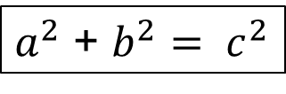
UNIT:
Pythagoras’ Theorem Section 1
Pythagoras’ Theorem
Pythagoras' Theorem states that:
In any right-angled triangle, the area of the square on the hypotenuse (the side opposite the right angle) is equal to the sum of the areas of the squares on the other two sides (the two sides that meet at the right angle).
Area A + Area B = Area C
For the triangle shown opposite
$a^{2}$ + $b^{2}= c^{2}$
Note: The longest side of a right-angled triangle is called the hypotenuse.

Slide 4
UNIT:
Pythagoras’ Theorem Section 1
Pythagoras: Finding the Hypotenuse
Hypotenuse
The hypotenuse is the side opposite the largest angle in a right-angled triangle. In the diagram opposite “a” is opposite the
90 degree angle (largest angle).
a
Use the idea above to identify the hypotenuse on the following:
Solution
Side PQ
Side YZ
Side JK
Side TS

Slide 5
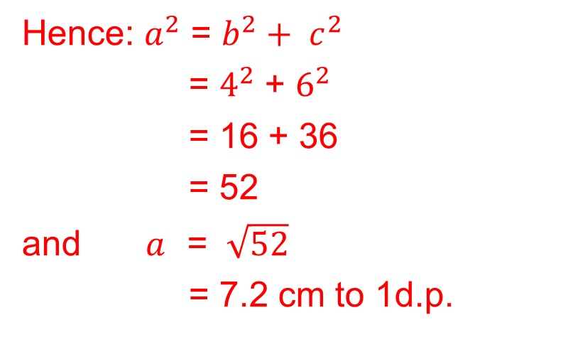
UNIT:
Pythagoras’ Theorem Section 1
Pythagoras: Finding the Hypotenuse
Example
Find the length of the hypotenuse of the triangle shown in the diagram. Give your answer correct to 2 decimal places.
Solution
As this is a right-angled triangle Pythagoras’ Theorem can be used.
If the length of the hypotenuse is a, then b = 4 cm and c = 6 cm
Hence: $a^{2}$ = $b^{2}+ c^{2}$
= $4^{2}$ + $6^{2}$
= 16 + 36
= 52
and $a$ = $\sqrt{52}$
= 7.2 cm to 1d.p.

Slide 6
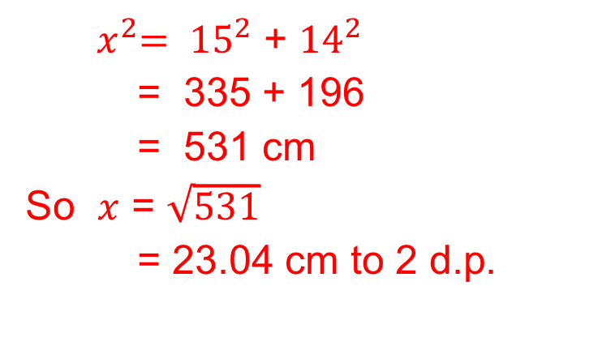
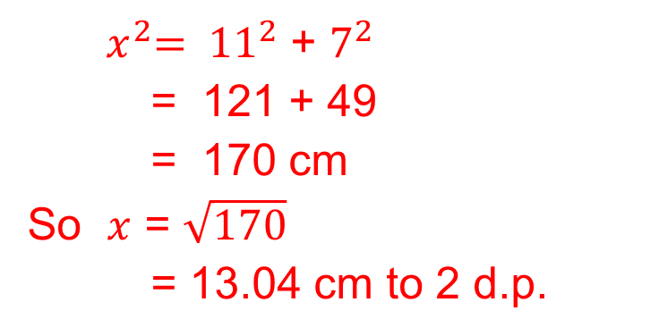
UNIT:
Pythagoras’ Theorem Section 1
Pythagoras: Finding the Hypotenuse
Example
Find the length of the hypotenuse of the triangles shown in the diagrams below. Give your answers correct to 2 decimal places.
Solutions
${ x}^{2}= {11}^{2}$ + $7^{2}$
= 121 + 49
= 170 cm
So $x$ = $\sqrt{170}$
= 13.04 cm to 2 d.p.
${ x}^{2}= {15}^{2}$ + ${14}^{2}$
= 335 + 196
= 531 cm
So $x$ = $\sqrt{531}$
= 23.04 cm to 2 d.p.
a)
b)

Slide 7
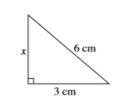
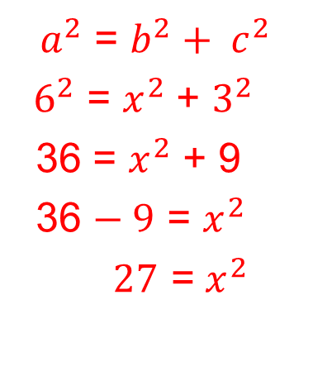
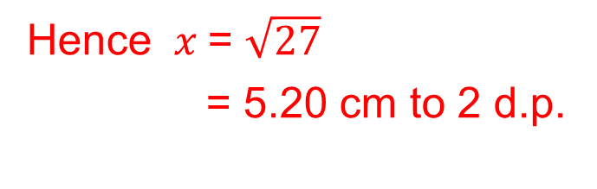
UNIT:
Pythagoras’ Theorem Section 1
Pythagoras: Finding the Shorter Side
Example
Find the length of the side marked x in this triangle.
Solution
As this is a right-angled triangle,
Pythagoras’ Theorem can be used.
Here the length of the hypotenuse, a
is 6 cm and c = 3 cm with b = x ,
so we have:
${ a}^{2}$ = $b^{2}+ c^{2}$
${ 6}^{2}$ = $x^{2}$ + $3^{2}$
36 = $x^{2}$ + 9
36 $− 9$ = $x^{2}$
$27$ = $x^{2}$
Hence $x$= $\sqrt{27}$
= 5.20 cm to 2 d.p.

Slide 8
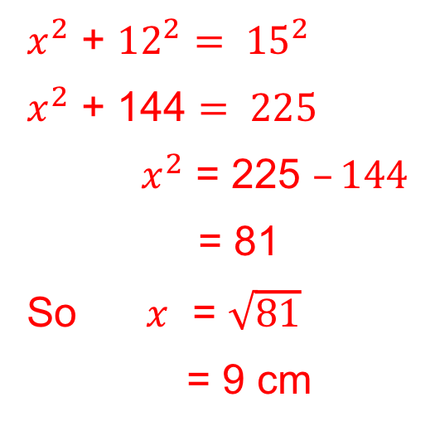
UNIT:
Pythagoras’ Theorem Section 1
Pythagoras: Finding the Shorter Side
Example
Find the length of the side marked x in this triangle.
Solution
$x^{2}$ + ${12}^{2}= {15}^{2}$
$x^{2}$ + 144 $= 225$
$x^{2}$ = 225 $–144$
= 81
So $x$ = $\sqrt{81}$
= 9 cm

Slide 9
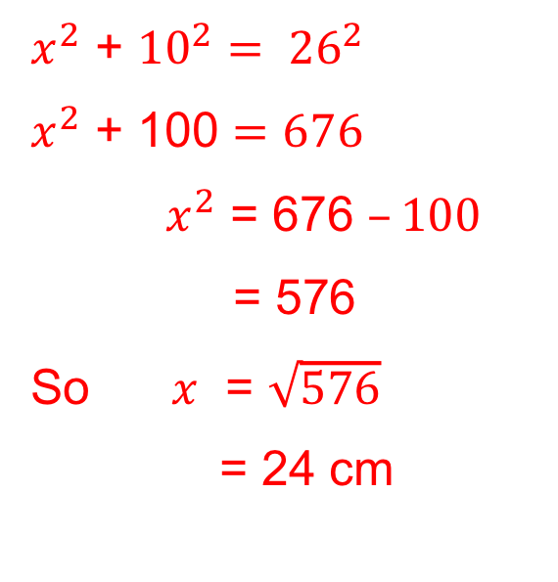
UNIT:
Pythagoras’ Theorem Section 1
Pythagoras: Finding the Shorter Side
Example
Find the length of the side marked x in this triangle.
Solution
$x^{2}$ + ${10}^{2}= {26}^{2}$
$x^{2}$ + 100 $=676$
$x^{2}$ = 676 $–100$
= 576
So $x$ = $\sqrt{576}$
= 24 cm

Slide 10
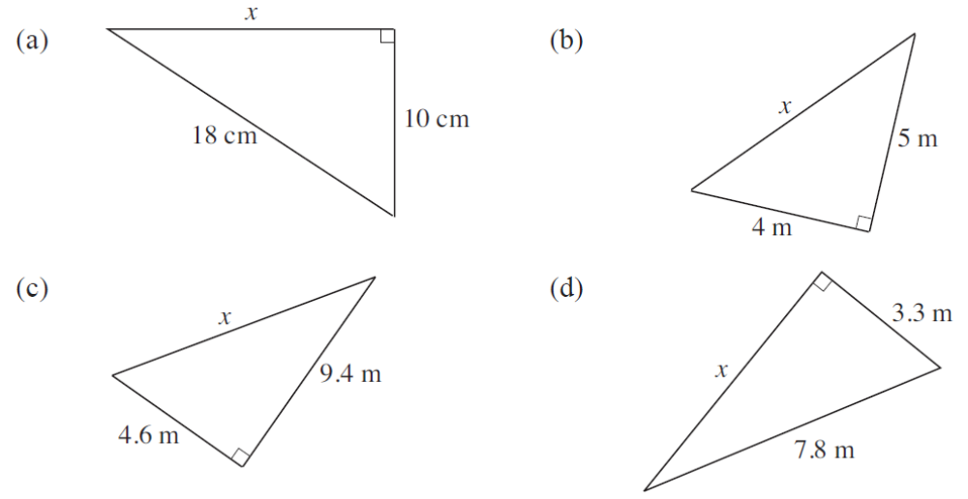
UNIT:
Pythagoras’ Theorem Section 1
Section 1: Fitness Check
Here are some questions to check your progress.
Find the length of the side x in each of the triangles below.
Solutions
(a)14.97 cm
(b) 6.4 cm
(c) 10.47 cm
(d) 7.07 cm

Slide 11
UNIT:
Pythagoras’ Theorem Section 1
Section 1: Fitness Check
Here is a problem solving question to solve.
Solutions (a) 320 m
(b) 233.2 m
(c) 86.8 m

Slide 12
UNIT:
Pythagoras’ Theorem Section 1
Section 1: Review
You have completed the first Section.
If you have mastered this section, continue onto the next Section
If you need more examples and interactive practice,
press here
You might also find it helpful to look at:
Essential Information: press here

Slide 13
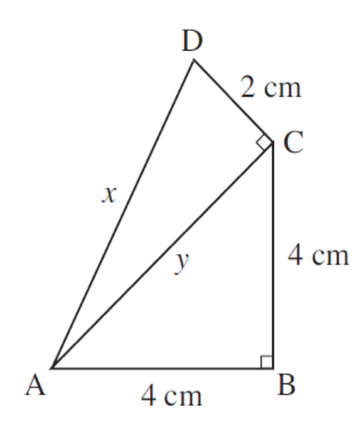
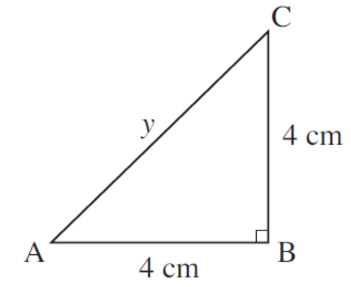
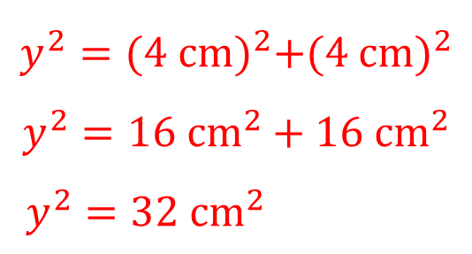
UNIT:
Pythagoras’ Theorem Section 2
Further work with Pythagoras’ Theorem
Example
Find the length of the side marked x in the diagram.
Solution
First consider triangle ABC. The unknown length of the hypotenuse has been marked y.
$$y^{2}={(4 cm)}^{2}+{(4 cm)}^{2}$$
$$y^{2}={16 cm}^{2}+{16 cm}^{2}$$
$y^{2}={32 cm}^{2}$
Solution continued on next slide

Slide 14
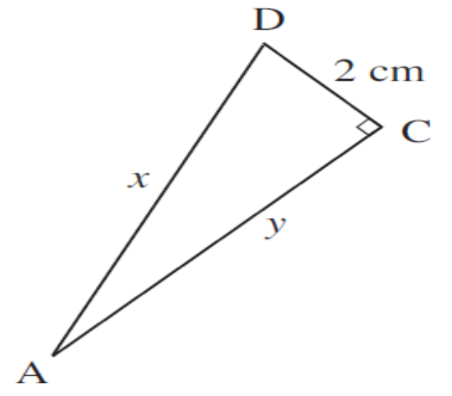
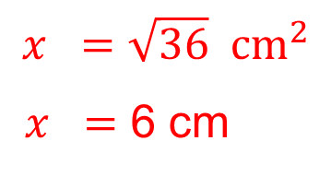
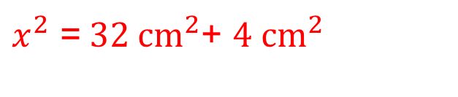
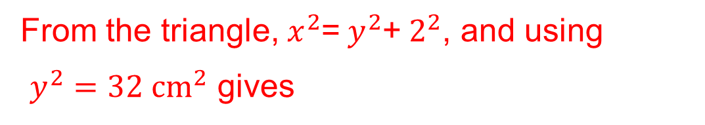

UNIT:
Pythagoras’ Theorem Section 2
Further work with Pythagoras’ Theorem
Solution continued
Triangle ACD can now be considered using the value for${ y}^{2}$
From the triangle, $x^{2}$=$y^{2}$+$2^{2}$, and using
$y^{2}={32 cm}^{2}$ gives
$x^{2}$ =${ 32 cm}^{2}$+ ${4 cm}^{2}$
$$x =\sqrt{36} {cm}^{2}$$
$x =$ 6 cm

Slide 15
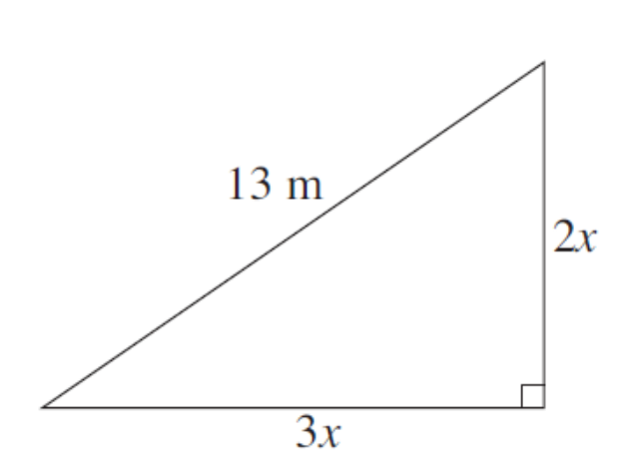
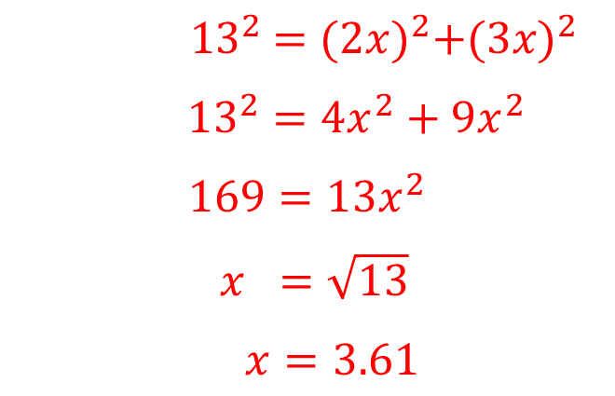
UNIT:
Pythagoras’ Theorem Section 2
Further work with Pythagoras’ Theorem: 2
Example continued
Find the value of x as shown on the diagram.
Solution
Using Pythagoras' Theorem gives
$${ 13}^{2} ={(2x)}^{2}+{(3x)}^{2}$$
${13}^{2}={4x}^{2}+{9x}^{2}$
$$169={13x}^{2}$$
$x =\sqrt{13}$
$x=3.61$

Slide 16
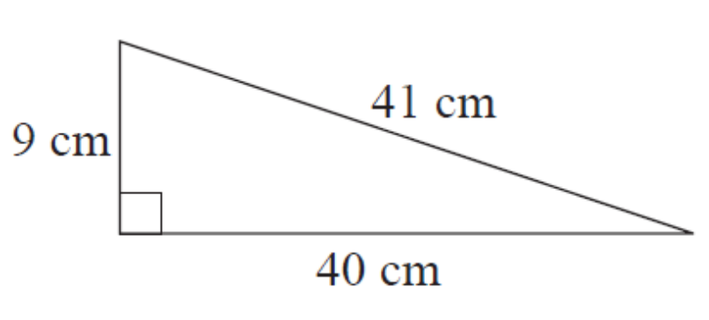


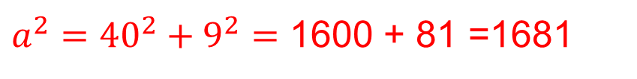

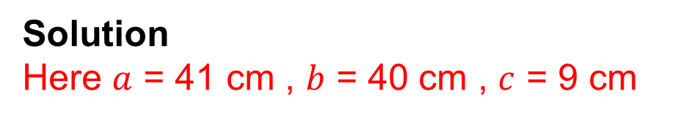
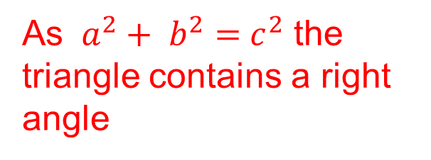
UNIT:
Pythagoras’ Theorem Section 2
Further work with Pythagoras’ Theorem 3
Example
Verify Pythagoras' Theorem for the right-angled triangle opposite.
Solution
Here $a$ = 41 cm , $b$ = 40 cm , $c$ = 9 cm
$a^{2}$ $=b^{2}+{ c}^{2}$
${a^{2}=40}^{2}+9^{2}=$ 1600 + 81 =1681
$$a =\sqrt{1681}$$
$$=41 cm$$
As $a^{2}+ b^{2}={ c}^{2}$ the triangle contains a right angle

Slide 17
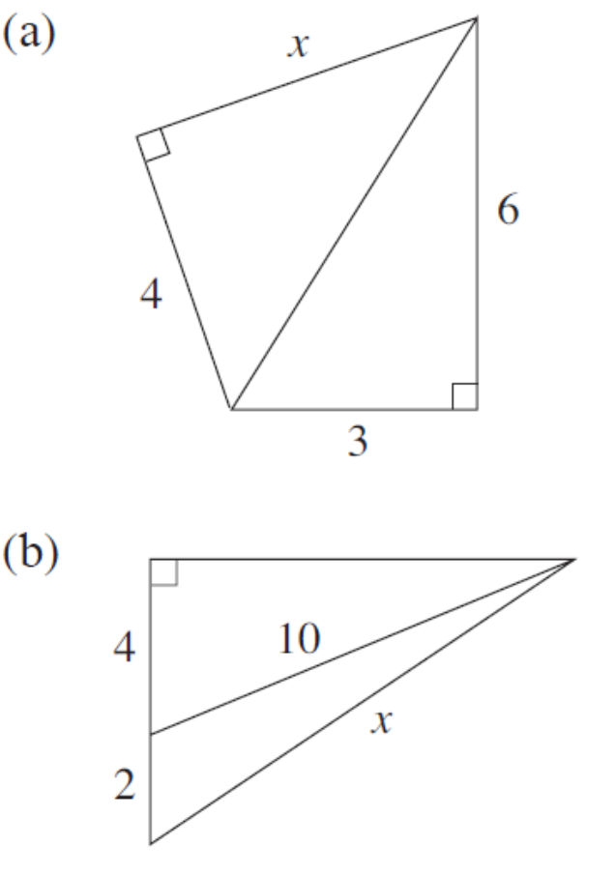
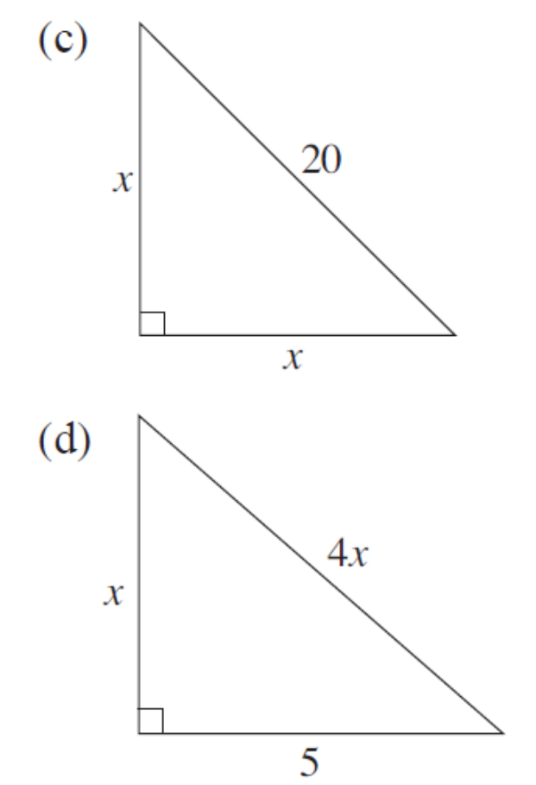
UNIT:
Pythagoras’ Theorem Section 2
Section 2: Fitness Check
Here are some questions to check your progress.
Find the value of x, giving your answer to 2 decimal places.
Solution
(a) 5.39
(b) 10.95
Solution
(c) 3.16
(d) 1.29

Slide 18
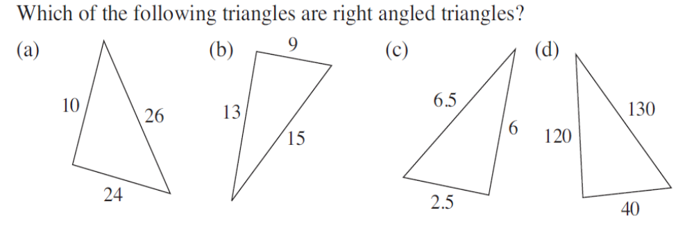
UNIT:
Pythagoras’ Theorem Section 2
Section 2: Fitness Check
Here are some questions to check your progress.
Use Pythagoras Theorem to check that the following triangles contain a right angle.
Solution
(a) Yes
(b) No
(c) Yes
(d) No

Slide 19
UNIT:
Pythagoras’ Theorem Section 2
Section 2: Review
You have completed the second Section.
If you have completed and mastered this section,
click here for the Unit audit
If you need more examples and interactive practice,
press here
You might also find it helpful to look at:
Essential Information: press here

