Slide 1
Supporting and Enhancing Mathematics and Statistics
UNIT: Probability of Two or More Events

Slide 2
UNIT:
Probability of Two or More Events
Probability of Two or More Events
This unit on probability is divided into the following three sections:
1. Outcome of Two Events
2. Probability of Two Events
3. Use of Tree Diagrams

Slide 3
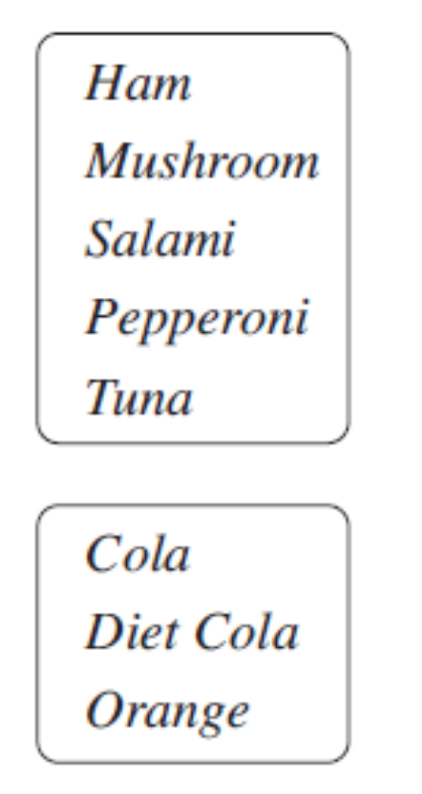
UNIT:
Probability of Two or More Events
Section 1
Outcome of Two Events
When dealing with probabilities for two events, it is important to be able to identify all the possible outcomes. Here are examples to show the methods that can be used.
Method A: Systematic Listing
For a special meal, customers at a pizza parlour can choose a pizza with one of the following toppings
and a drink from the following list.
How many possible combinations of toppings and drinks are there?
Solution
HC HD HO, MC MD MO,….. 5×3 = 15 combinations

Slide 4
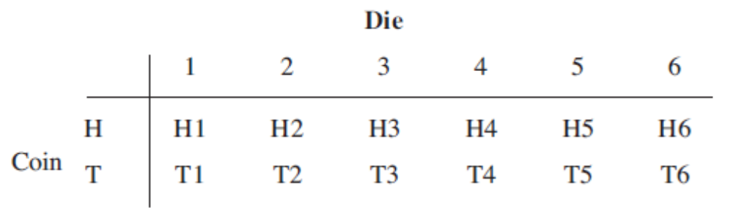
UNIT:
Probability of Two or More Events
Section 1
Outcome of Two Events
Method B: 2-way Tables
A die and a coin are tossed. List all the possible outcomes.
Solution
The coin can land heads (denoted by H) or tails (T), whilst the die can show 1, 2, 3, 4, 5 or 6. So for heads on the coin, the possible outcomes are
H1, H2, H3, H4, H5 and H6
whilst for tails, they are
T1, T2, T3, T4, T5 and T6.
The listing method used here can be displayed in a 2-way table.

Slide 5
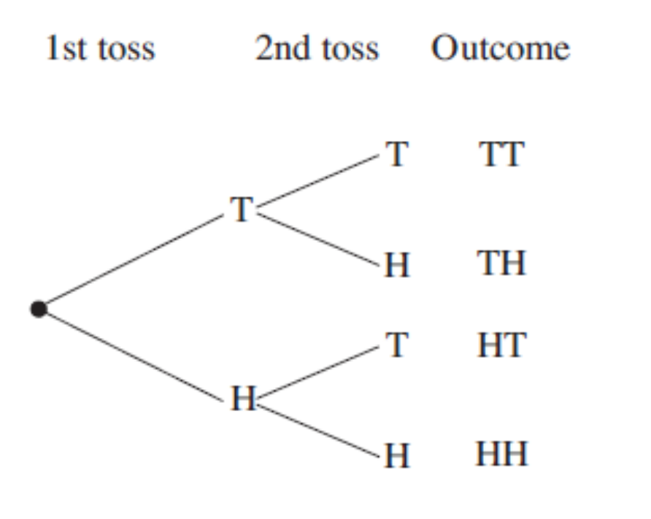
UNIT:
Probability of Two or More Events
Section 1
Outcome of Two Events
Method C: Tree Diagrams
A coin is tossed twice. List all the possible outcomes.
Solution
You can use a tree diagram to represent this solution.
Note that 'TH' is not the same as ‘HT’ because of the order of events.

Slide 6
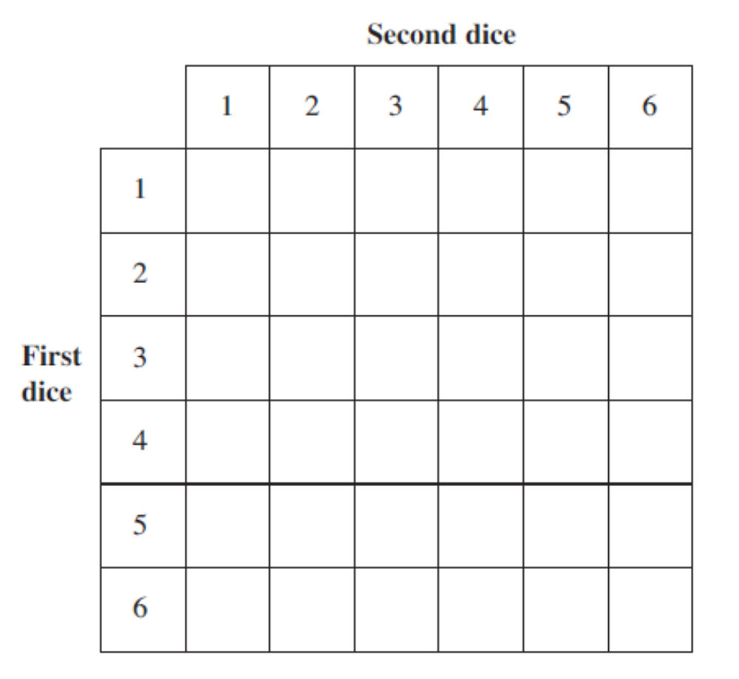
UNIT:
Probability of Two or More Events
Section 1
Section 1: Fitness Check
Here are some questions to check your progress
Two dice are rolled together.
Complete the table below to show all the possible outcomes.
2
3
4
5
6
7
Answer
3
4
5
6
7
8
4
5
6
7
8
9
5
6
7
8
9
10
6
7
8
9
10
11
7
8
9
10
11
12

Slide 7
UNIT:
Probability of Two or More Events
Section 1
Section 1: Fitness Check
2. In every packet of a cereal, there is one of four different model dinosaurs: Brontosaurus (B), Stagosaurus (S), Tyrannosaurus-Rex (T) and Diplodocus (D).
A mother buys two packets of cereal for her children. List all combinations of models possible when the two packets are opened.
Answers
BS BT BD, ST SD, TD assuming order does not matter (6 ways)
3. List the possible outcomes when a) 3 coins and b) 4 coins are thrown.
Answers
a) HHH, TTT, THH, HTH, HHT, THH, HTH, HHT (8 ways)
HHHH, TTTT, HTTT, THTT, TTHT, TTTH, THHH, HTHH, HHTH,
HHHT, TTHH, HTTH, HHTT, THHT, HTHT, THTH (16 ways)

Slide 8
UNIT:
Probability of Two or More Events
Section 1
Section 1: Review
You have completed the first section.
If you have completed and mastered this section,
click to start the next Section
If you need more examples and interactive practice,
press here
You might also find it helpful to look at:
Essential Information: press here

Slide 9
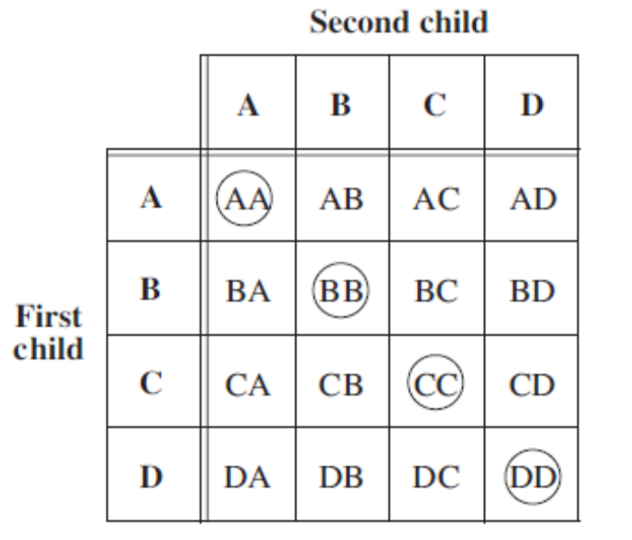
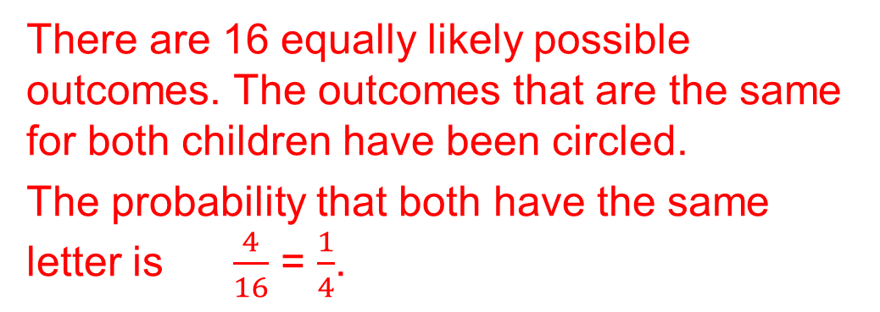

UNIT:
Probability of Two or More Events
Section 2
Probability of Two Events
When two events take place, and every outcome is equally likely to happen, the probability of a particular combined outcome can be readily found from the formula
probability = $\frac{number of successful outcomes}{total number of outcomes}$
Example
A spinner that forms part of a children's game can point to one of four regions, A, B, C or D, when spun. What is the probability that when two children spin the spinner, it points to the same letter?
Solution
There are 16 equally likely possible outcomes. The outcomes that are the same for both children have been circled.
The probability that both have the same letter is $\frac{4}{16}$ = $\frac{1}{4}$.

Slide 10
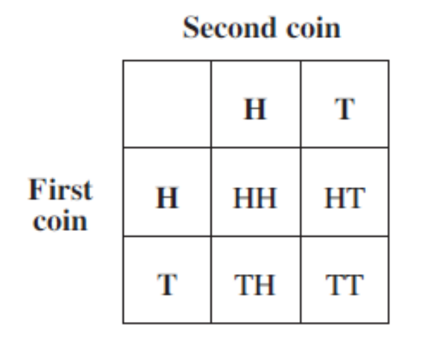
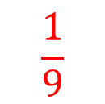
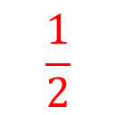
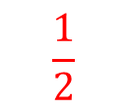
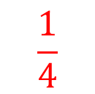
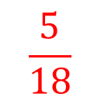
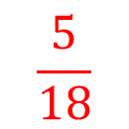
UNIT:
Probability of Two or More Events
Section 2
Section 2 : Fitness Check
Here are some questions to check your progress.
1. The possible outcomes when two fair coins are tossed together are as shown in the table.
$$\frac{1}{4}$$
a) What is the probability that both coins show heads?
b) What is the probability that only one coin shows a tail?
c) What is the probability that both coins land the same way up?
$$\frac{1}{2}$$
$$\frac{1}{2}$$
Using a table similar to the one above, determine the probability
that when two fair dice are rolled and their scores added together,
the total is a:
$$\frac{1}{9}$$
$$\frac{5}{18}$$
$$\frac{5}{18}$$
a) score of 5
b) score more than 8
c) score less than 6.

Slide 11
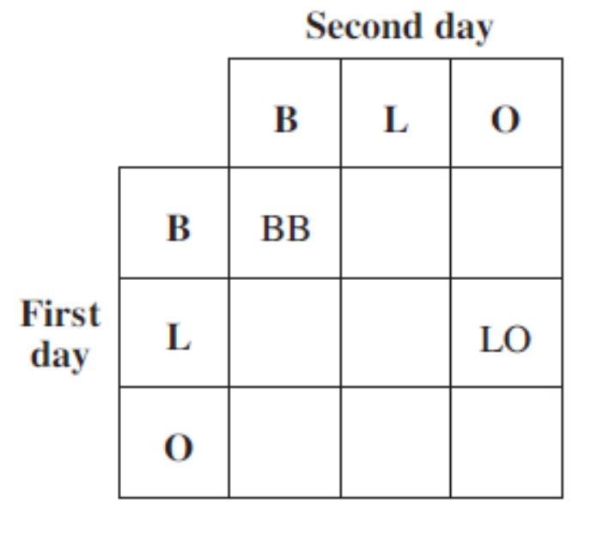
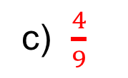
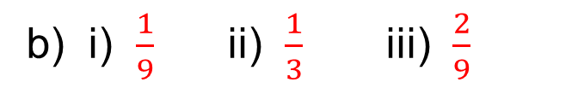
UNIT:
Probability of Two or More Events
Section 2
Section 2: Fitness Check
3. A school cook decides at random what flavour drink to serve at lunch time. She chooses from blackcurrant (B), orange (O) and lemon (L).
a) Complete a copy of the table to show the possible outcomes from two consecutive days.
b) What is the probability that she serves:
i) blackcurrant on both days,
ii) the same flavour on both days,
iii) lemon or blackcurrant on both days?
BL
BO
LB
LL
OB
OL
OO
c) Clare will not drink lemon squash. What is the probability that she is unable to drink the squash on two consecutive days?
Answers
b) i) $\frac{1}{9}$ ii) $\frac{1}{3}$ iii) $\frac{2}{9}$
c) $\frac{4}{9}$

Slide 12
UNIT:
Probability of Two or More Events
Section 2
Section 2: Review
You have completed the second section.
If you have completed and mastered this section,
click to start the next Section
If you need more examples and interactive practice,
press here
You might also find it helpful to look at:
Essential Information: press here

Slide 13
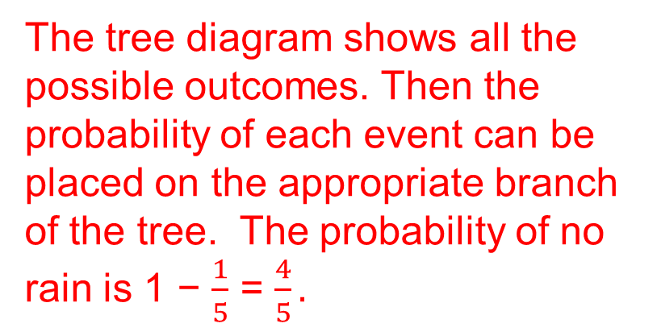
UNIT:
Probability of Two or More Events
Section 3
Use of Tree Diagrams
Tree diagrams can be used to find the probabilities for two events, when the outcomes are not necessarily equally likely.
Example 1
If the probability that it rains on any day is $\frac{1}{5}$ , draw a tree diagram and
find the probability
a) that it rains on two consecutive days,
b) that it rains on only one of two consecutive days.
Solution
The tree diagram shows all the possible outcomes. Then the probability of each event can be placed on the appropriate branch of the tree. The probability of no rain is 1 − $\frac{1}{5}$ = $\frac{4}{5}.$
Solution continued on next slide.

Slide 14
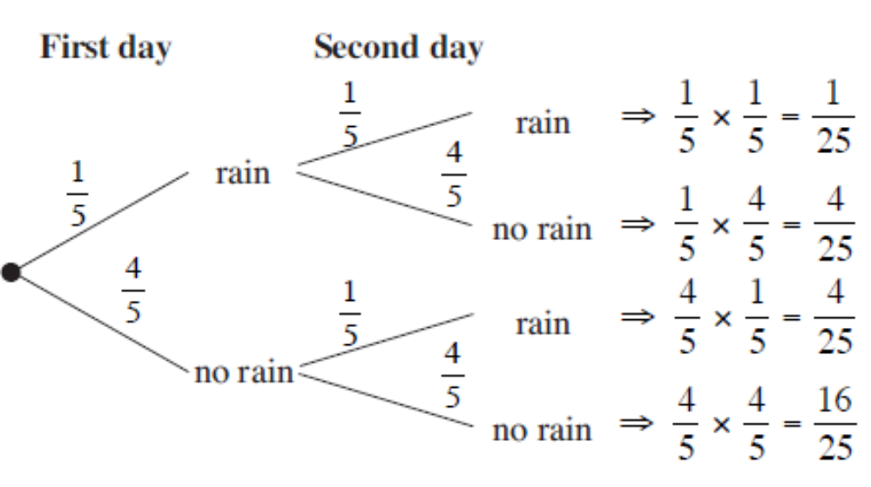
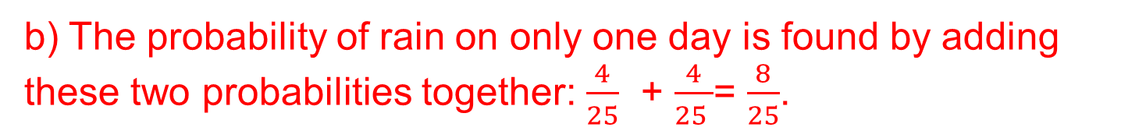
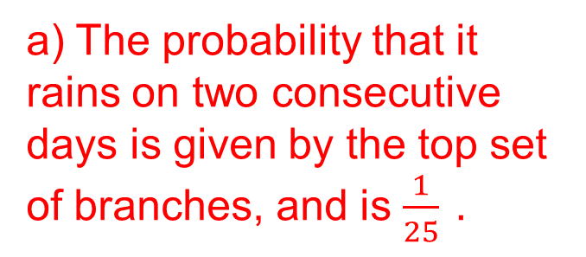
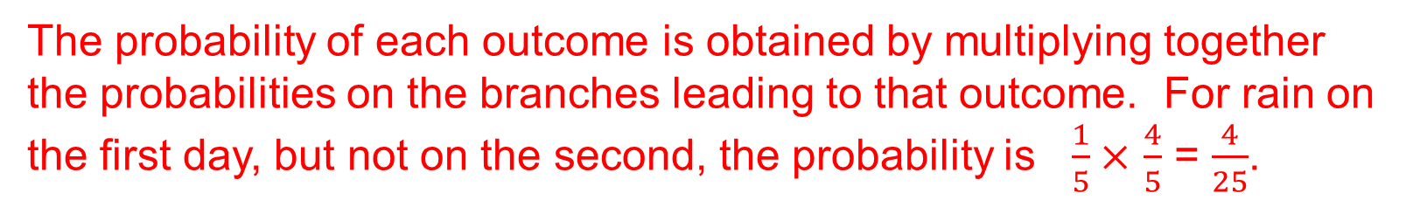
UNIT:
Probability of Two or More Events
Section 3
Use of Tree Diagrams
Solution (continued)
The probability of each outcome is obtained by multiplying together the probabilities on the branches leading to that outcome. For rain on the first day, but not on the second, the probability is $\frac{1}{5}×$ $\frac{4}{5}$ = $\frac{4}{25}$.
a) The probability that it rains on two consecutive days is given by the top set of branches, and is $\frac{1}{25} .$
b) The probability of rain on only one day is found by adding these two probabilities together: $\frac{4}{25}$ + $\frac{4}{25 }$= $\frac{8}{25}$.

Slide 15
UNIT:
Probability of Two or More Events
Section 3
Use of Tree Diagrams
Example 2
The probability that Jenny is late for school is 0.3. Find the probability that on two consecutive days she is:
a) never late
b) late only once.
Solution
The tree diagram shows the possible outcomes and their probabilities. Note that the probability of not being late is 1−0.3 = 0.7
Solution continued
on next slide

Slide 16
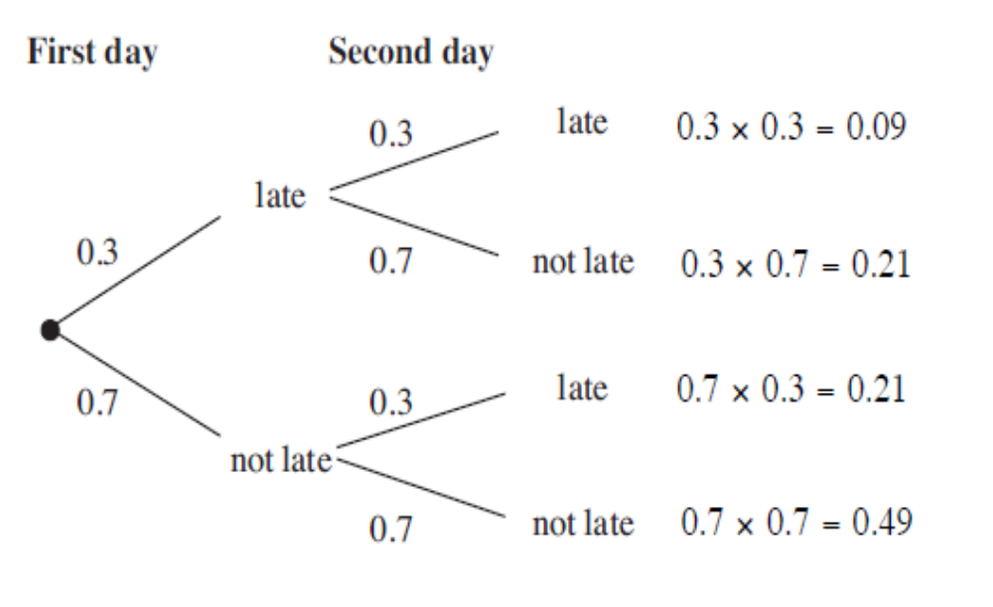
UNIT:
Probability of Two or More Events
Section 3
Use of Tree Diagrams
Solution (Continued)
The probability that Jenny
is never late is given by the
bottom set of branches
and has probability 0.49.
The probability that she is late once is given by the two middle
sets of branches which both have a probability 0.21. So the
probability that she is late once is given by
0.21+ 0.21= 0.42

Slide 17
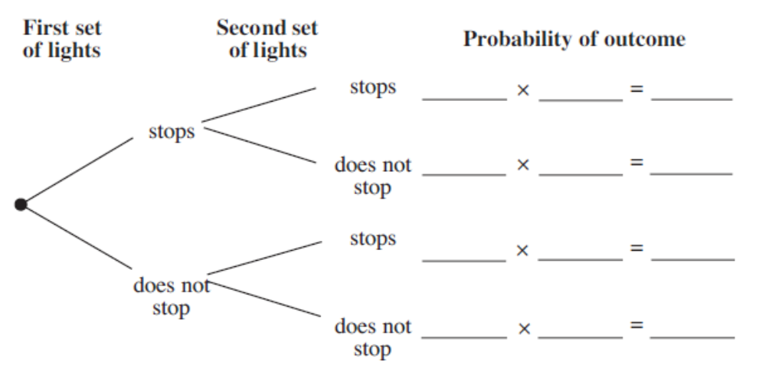
UNIT:
Probability of Two or More Events
Section 3
Section 3: Fitness Check
1. On a route to a factory a truck must pass through two sets of traffic lights. The probability that the truck has to stop at a set of lights is 0.6.
a) What is the probability that the truck does not have to stop at a set of traffic lights?
1 – 0.6 = 0.4
b) Copy the tree diagram below and add the correct probabilities to each branch.
0.6
0.6
0.36
0.6
0.4
0.24
0.4
0.6
0.24
0.4
0.4
0.16
Continued on next slide

Slide 18
UNIT:
Probability of Two or More Events
Section 3
Section 3: Fitness Check
Continued
c) What is the probability that the truck gets to the factory without having to stop at a traffic light?
d) What is the probability that the truck stops at both sets of traffic lights?
e) What is the probability that the truck stops at one set of traffic lights?
0.16
0.36
0.24 + 0.24 = 0.48
0.6
0.6
0.36
0.6
0.4
0.24
0.4
0.6
0.24
Note: the sum of probabilities on the last column equals 1.
0.4
0.4
0.16

Slide 19
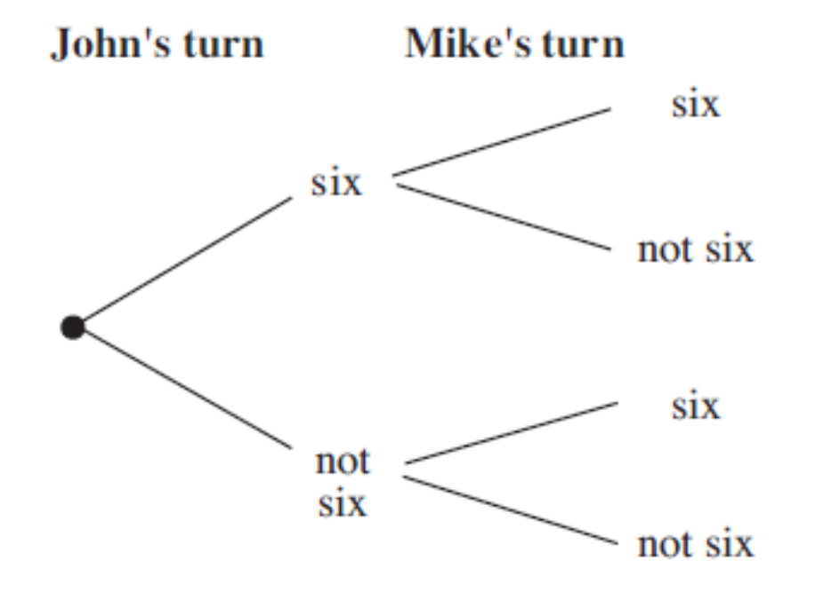
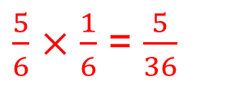

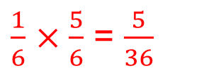

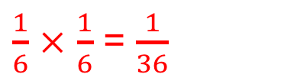




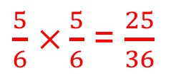

UNIT:
Probability of Two or More Events
Section 3
Section 3: Fitness Check
Two boys are playing a game. They take it in turns to start. Before they can start they must throw a six using a fair sided die.
John throws first.
a) What is the probability of throwing a six?
$$\frac{1}{6}$$
b) Copy the tree diagram and add the appropriate
probabilities to each branch. Also calculate the probability
of each outcome shown on the tree diagram.
$$\frac{1}{6}$$
$\frac{1}{6}$ $×$ $\frac{1}{6}$ = $\frac{1}{36}$
$$\frac{1}{6}$$
$\frac{1}{6}$ $×\frac{5}{6}$ = $\frac{5}{36}$
$$\frac{5}{6}$$
$\frac{5}{6}$ $×$ $\frac{1}{6}$ = $\frac{5}{36}$
$$\frac{1}{6}$$
$$\frac{5}{6}$$
$$\frac{5}{6}$$
$\frac{5}{6}$ $×\frac{5}{6}$ = $\frac{25}{36}$

Slide 20
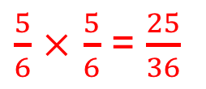
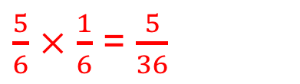
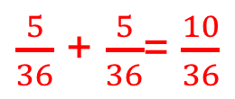

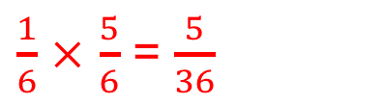
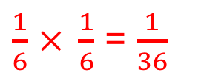

UNIT:
Probability of Two or More Events
Section 3
Section 3: Fitness Check
Continuation
Find the probability that:
i) both boys start the game on their first throws
ii) only one of them starts the game on their first throw
iii) neither of them starts the game on their first throw.
$$\frac{1}{36}$$
$\frac{5}{36}$ + $\frac{5}{36}$= $\frac{10}{36}$
$$\frac{25}{36}$$
$$\frac{1}{6}$$
$\frac{1}{6}$ $× \frac{1}{6}$ = $\frac{1}{36}$
$$\frac{1}{6}$$
$\frac{1}{6}$ $×$ $\frac{5}{6}$ = $\frac{5}{36}$
$$\frac{5}{6}$$
$\frac{5}{6}$ $×$ $\frac{1}{6}$ = $\frac{5}{36}$
$$\frac{1}{6}$$
$$\frac{5}{6}$$
$$\frac{5}{6}$$
$\frac{5}{6}$ $×$ $\frac{5}{6}$ = $\frac{25}{36}$

Slide 21
UNIT:
Probability of Two or More Events
Section 3
Section 3: Review
You have completed the third section.
If you have completed and mastered this last section,
click here for the Unit audit
If you need more examples and interactive practice,
press here
You might also find it helpful to look at:
Essential Information: press here

