Slide 1
Supporting and Enhancing Mathematics and Statistics
UNIT: Probability of One Event

Slide 2
UNIT:
Probability of One Event
Probability of One Event
Probabilities are used to describe how likely or unlikely it is that something will happen. Weather forecasters often talk about how likely it is to rain, or perhaps snow, in particular parts of the world.
The unit is divided into the following four sections
Probabilities
Straightforward Probability
Finding Probabilities Using Relative Frequency
Determining Probabilities

Slide 3
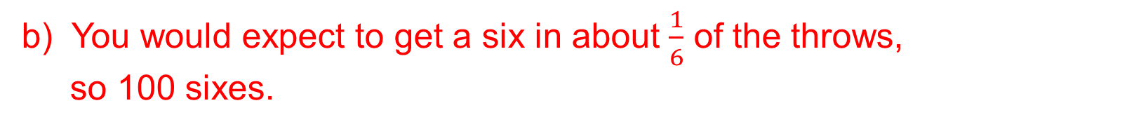
UNIT:
Probability of One Event
Section 1
Probabilities
Example
a) When you roll a fair die, which number are you most likely to get?
If you rolled a die 600 times how many sixes would you
expect to get?
c) Would you expect to get the same number of ones?
Solution
a) You are equally likely to get any of the six numbers.
b) You would expect to get a six in about $\frac{1}{6}$ of the throws,
so 100 sixes.
c) Yes, in fact you would expect to get about 100 of each number.

Slide 4
UNIT:
Probability of One Event
Section 1
Probability of One Event
Example
Use one of the following to describe each one of the statements a) to d).
Very likely
Unlikely
Impossible
Certain
Likely
Very unlikely
a) It will snow in Barbados tomorrow.
b) It will rain in London on Saturday.
c) You win a car in a competition tomorrow.
d) You will be late for school tomorrow.
Solution
Impossible (It will never snow in the Caribbean because of the
islands' close proximity to the Equator and no high mountains.)
b) Likely or Very likely.
Very unlikely if you have entered the competition;
Impossible if you have not entered the competition.
d) Very unlikely.

Slide 5
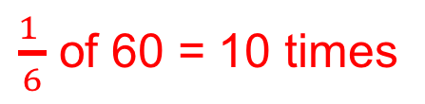
UNIT:
Probability of One Event
Section 1
Section 1: Fitness Check
How many sixes would you expect to get if you rolled a fair
6-sided die:
a) 60 times
b) 120 times
c) 6000 times
d) 36 000 times
$\frac{1 }{6}$ of 60 = 10 times
20 times
1000 times
6000 times
2. Describe each of the following events as:
Certain
Likely
Very unlikely
Impossible
a) You roll a 6-sided die and score 7.
b) You fall off your bike on the way home from school.
It will rain all day for the next 7 days
d) Liverpool will win their next football match.
Impossible
Very unlikely
Very unlikely
Likely

Slide 6

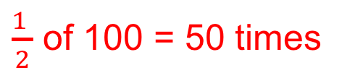
UNIT:
Probability of One Event
Section 1
Section 1: Fitness Check
3. Scott chooses a playing card* from a full pack 100 times without looking at the cards. How many times would you expect him to get:
a red card,
a black card,
a heart,
d) a diamond?
$\frac{1 }{2}$ of 100 = 50 times
50 times
$\frac{1 }{4}$ of 100 = 25 times
25 times
* See next slide if you are not familiar with packs of playing cards.

Slide 7
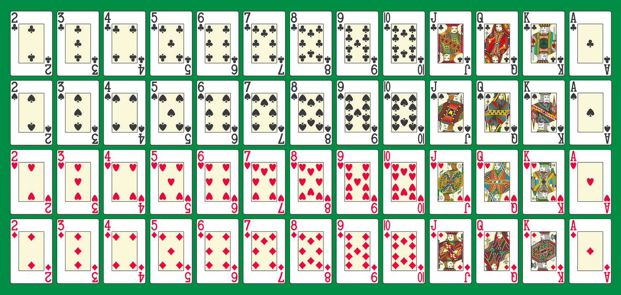
UNIT:
Probability of One Event
Section 1
Section 1: Pack of playing cards
Here is a complete set of playing cards.
There are 13 cards in each of 4 suites and the suites are in 2 colours:
RED: Diamonds & Hearts BLACK: Clubs & Spades

Slide 8
UNIT:
Probability of One Event
Section 1
Section 1: Review
You have completed the first section.
If you have completed and mastered this section,
click to start the next Section
If you need more examples and interactive practice,
press here
You might also find it helpful to look at:
Essential Information: press here

Slide 9
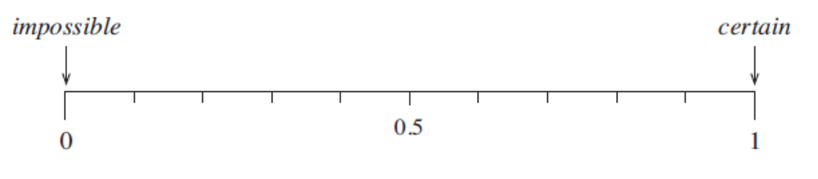
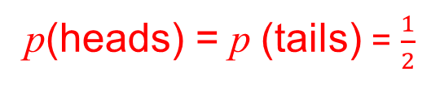
UNIT:
Probability of One Event
Section 2
Straightforward Probabilities
Probabilities are given values between 0 and 1.
A probability of 0 means that the event is impossible, while a probability of 1 means that it is certain to happen.
The closer the probability is to 1, the more likely the event is to happen whilst the closer the probability is to 0, the less likely it is to happen.
Example
When you toss a fair coin, what is the probability that it lands heads up?
Solution
p(heads) + p(tails) = 1
p(heads) = p (tails) = $\frac{1}{2}$

Slide 10
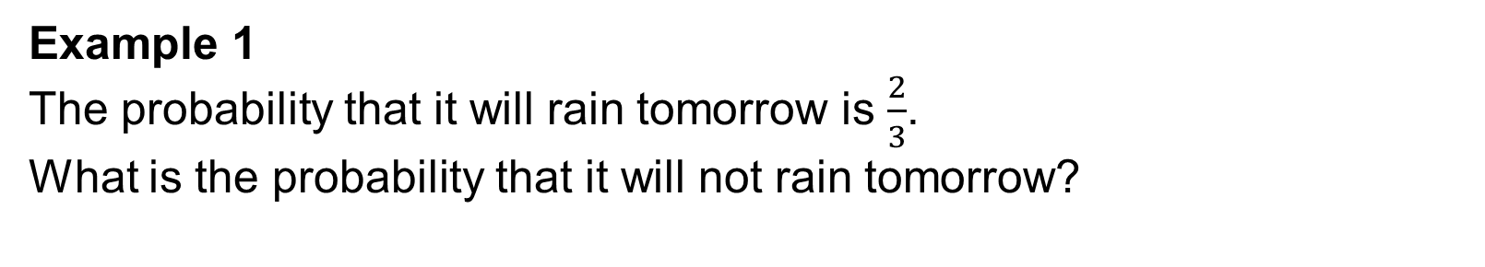
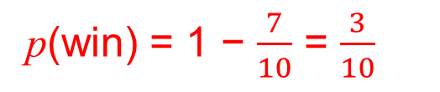
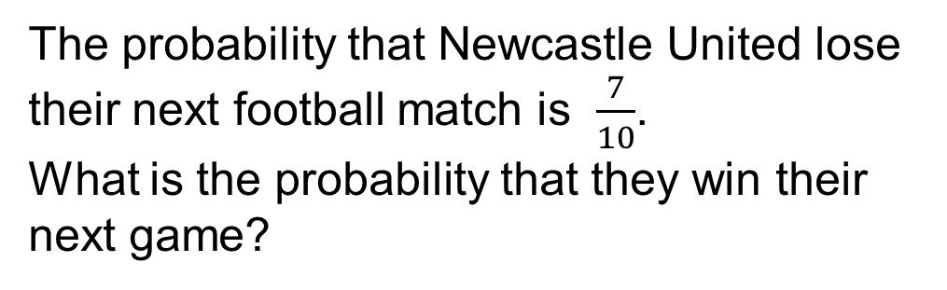
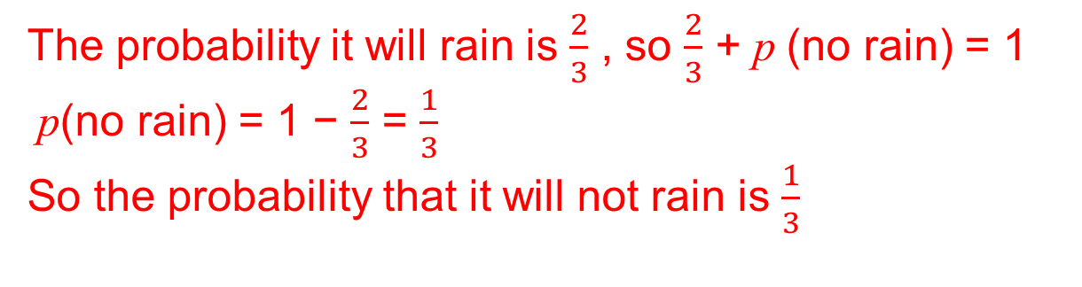
UNIT:
Probability of One Event
Section 2
Straightforward Probabilities
Example 1
The probability that it will rain tomorrow is $\frac{2}{3}$.
What is the probability that it will not rain tomorrow?
Solution
Tomorrow it must either rain or not rain, so p(rain) + p (no rain) = 1
The probability it will rain is $\frac{2}{3}$ , so $\frac{2}{3}$ + p (no rain) = 1
p(no rain) = 1 − $\frac{2}{3}$ = $\frac{1}{3}$
So the probability that it will not rain is $\frac{1}{3}$
Example 2
Solution
The probability that Newcastle United lose their next football match is $\frac{7}{10}$.
What is the probability that they win their next game?
p(win) = 1 − $\frac{7}{10}$ = $\frac{3}{10}$

Slide 11
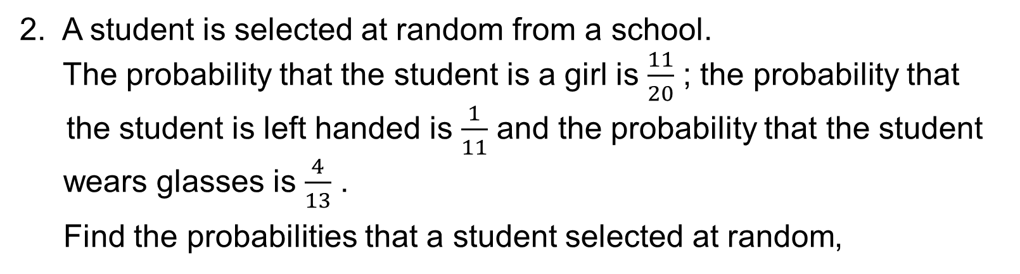
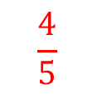
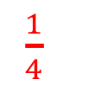

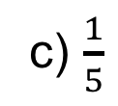

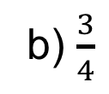

UNIT:
Probability of One Event
Section 2
Section 2: Fitness Check
1. What is the probability that it will not rain tomorrow, if the probability that it will is
a) 0.9
0.1
b) $\frac{3}{4}$
$\frac{1}{4}$
c) $\frac{1}{5}$
$$\frac{4}{5}$$
2. A student is selected at random from a school.
The probability that the student is a girl is $\frac{11}{20}$ ; the probability that the student is left handed is $\frac{1}{11}$ and the probability that the student
wears glasses is $\frac{4}{13}$ .
Find the probabilities that a student selected at random,
$\frac{9}{20}$
$\frac{10}{11}$
$\frac{9}{13}$
a) is a boy
b) is right handed
c) does not wear glasses

Slide 12
UNIT:
Probability of one Event
Section 2
Section 2: Review
You have completed the second section.
If you have completed and mastered this section,
click to start the next Section
If you need more examples and interactive practice,
press here
You might also find it helpful to look at:
Essential Information: press here

Slide 13
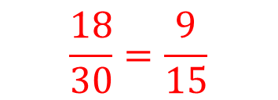
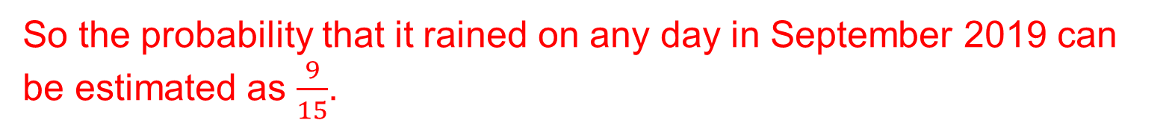
UNIT:
Probability of One Event
Section 3
Finding Probabilities Using Relative Frequency
Sometimes it is possible to calculate values for the probability of an event such as tossing a coin and getting a head, by symmetry arguments. For other events probabilities can be estimated by using results of experiments or records of past events.
Example 1
In a town in Yorkshire there was rain on 18 days in September 2019. Use this information to estimate the probability that it rained there on a particular day in September 2019.
Solution
It rained on 18 out of the 30 days, so the relative frequency of rain is
$$\frac{18}{30}=\frac{9}{15}$$
So the probability that it rained on any day in September 2019 can be estimated as $\frac{9}{15}$.

Slide 14
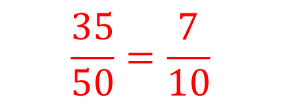
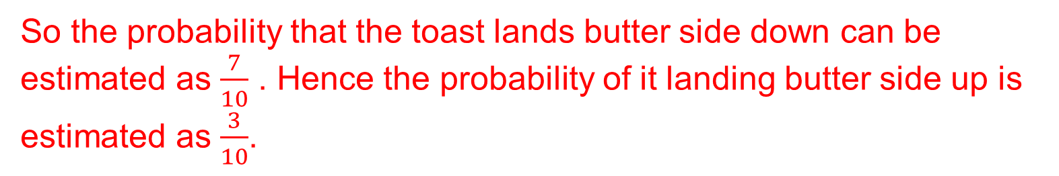
UNIT:
Probability of One Event
Section 3
Finding Probabilities Using Relative Frequency
Example 2
Henry carries out an experiment with a piece of buttered toast. He drops it 50 times and finds that 35 times it lands butter side down.
Use these results to estimate the probability that a piece of toast lands butter side up when dropped.
Solution
The toast landed butter side down 35 of the 50 times, so the relative frequency of it landing butter side down is
$$\frac{35}{50}=\frac{7}{10}$$
So the probability that the toast lands butter side down can be estimated as $\frac{7}{10}$ . Hence the probability of it landing butter side up is estimated as $\frac{3}{10}$.

Slide 15
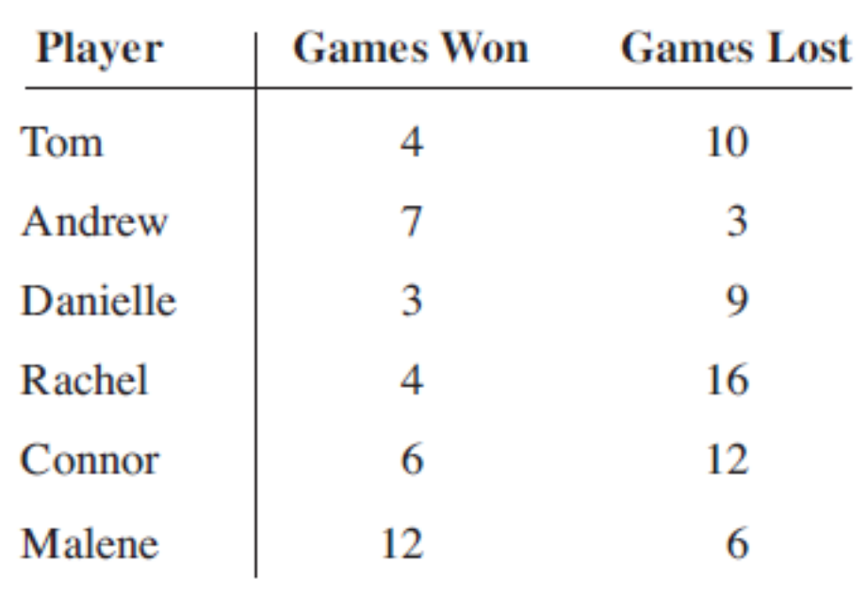
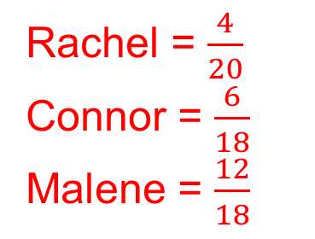
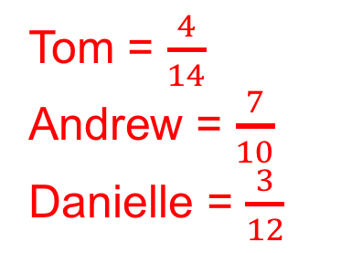
UNIT:
Probability of One Event
Section 3
Section 3: Fitness Check
Six students play regularly in a chess club.
The number of games that each student won or lost is given below
Answers a)
Answers a)
Tom = $\frac{4}{14}$
Andrew = $\frac{7}{10}$
Danielle = $\frac{3}{12}$
Rachel = $\frac{4}{20}$
Connor = $\frac{6}{18}$
Malene = $\frac{12}{18}$
a) Use the data to estimate the probability that each student wins a match.
b) Which student is the best player?
c) Which student is the worst player?
d) If Connor played Tom, who do you think is more likely to win?
Andrew
Rachel
Connor

Slide 16
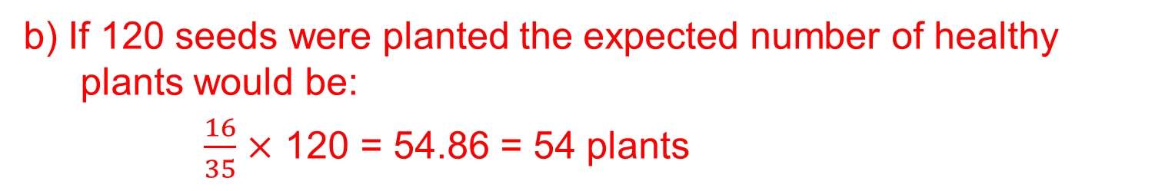
UNIT:
Probability of One Event
Section 3
Section 3: Fitness check
2. A gardener plants 40 seeds and 32 of them produce healthy plants.
a) Estimate the probability that a seed produces a healthy plant.
b) If 120 seeds were planted, how many healthy plants can the
gardener expect to obtain?
Answers
a) The probability that a seed produces a healthy plant = $\frac{32}{70}$= $\frac{16}{35}$
b) If 120 seeds were planted the expected number of healthy plants would be:
$\frac{16}{35}$ $×$ 120 = 54.86 = 54 plants

Slide 17
UNIT:
Probability of One Event
Section 2
Section 3: Review
You have completed the third section.
If you have completed and mastered this section,
click to start the next Section
If you need more examples and interactive practice,
press here
You might also find it helpful to look at:
Essential Information: press here

Slide 18
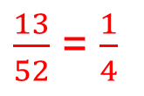
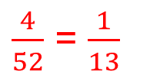
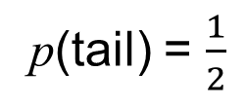
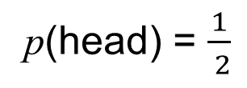
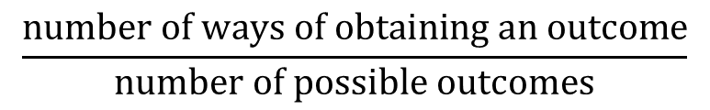
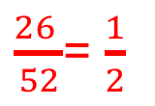
UNIT:
Probability of One Event
Section 4
Determining Probabilities
When the outcomes of an event are all equally likely, then probabilities can be found by considering all the possible outcomes.
For example, when you toss a fair coin there are two possible outcomes, either heads or tails.
so
p(head) = $\frac{1}{ 2}$
p(tail) = $\frac{1}{2}$
The probability of an outcome is given by
$$\frac{number of ways of obtaining an outcome}{number of possible outcomes}$$
provided all outcomes are equally likely.
Example 1
A card is taken at random from a full pack of 52 playing cards with no jokers. What is the probability that the card is:
a) an ace?
$\frac{4}{52}$ = $\frac{1}{13}$
b) a heart,
$\frac{13}{52}$ = $\frac{1}{4}$
c) black,
$\frac{26 }{52}$= $\frac{1}{2}$

Slide 19
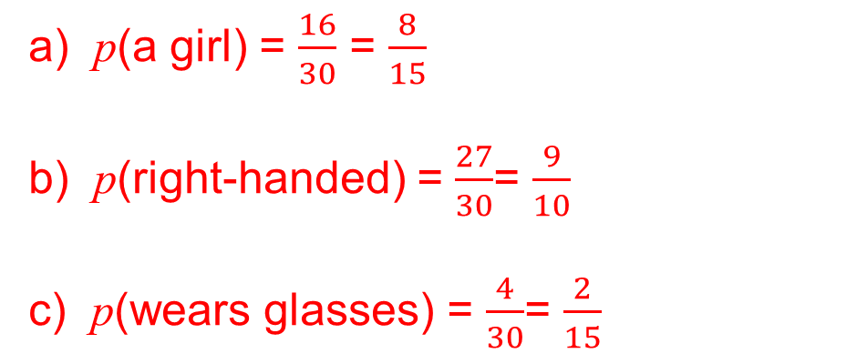
UNIT:
Probability of One Event
Section 4
Determining Probabilities
Example 2
In a class of 30 students, 16 are girls, 4 wear glasses and 3 are left- handed. A student is chosen at random from the class. What is the probability that this student:
a) is a girl b) is right-handed c) wears glasses?
Solution
All the students in the class are equally likely to be selected when the choice is made at random.
a) p(a girl) = $\frac{16}{30}$ = $\frac{8}{15}$
b) p(right-handed) = $\frac{27}{30}$= $\frac{9}{10}$
c) p(wears glasses) = $\frac{4}{30}$= $\frac{2}{15}$

Slide 20
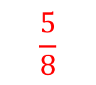
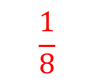
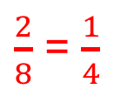
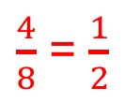
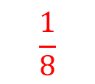
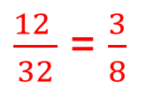
UNIT:
Probability of One Event
Section 4
Section 4: Fitness Check
A new game includes an octagonal roller with equal-sized faces
numbered from 1 to 8.
When the roller is rolled, what is the probability of obtaining:
$$\frac{1}{8}$$
a) a number 8,
b) an odd number,
c) a number less than 3
d) a number 1
e) a number greater than 3 ?
$\frac{4}{8}$ = $\frac{1}{2}$
$\frac{2}{8}$ = $\frac{1}{4}$
$$\frac{1}{8}$$
$$\frac{5}{8}$$
2. In a class of 32 students, 20 have school lunches and the rest bring their own food. What is the probability that a student chosen at random from the class brings their own food?
$\frac{12 }{32}$ = $\frac{3}{8}$

Slide 21
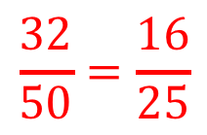
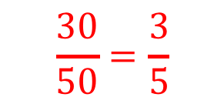
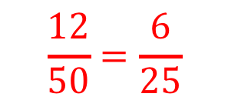
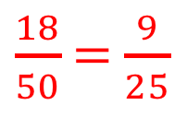
UNIT:
Probability of One Event
Section 4
Section 4: Fitness Check
3. An express bus leaves Edinburgh with 18 passengers.
It stops at Perth, where another 12 passengers join the bus.
At Dundee it stops again and 20 more passengers get on board.
When the bus arrives at its destination, Aberdeen, all the passengers get off and one is chosen at random to be interviewed about the journey. Find the probabilities that this passenger:
a) was on the bus for the whole journey
b) got on the bus at Perth
c) got on the bus at Perth or Edinburgh
d) got on the bus at Perth or Dundee.
$\frac{18}{50}$ = $\frac{9}{25}$
$$\frac{12}{50}=\frac{6}{25}$$
$$\frac{30}{50}=\frac{3}{5}$$
$$\frac{32}{50}=\frac{16}{25}$$

Slide 22
UNIT:
Probability of one Event
Section 4
Section 4: Review
You have completed the fourth section.
If you have completed and mastered this last section,
click here for the Unit audit
If you need more examples and interactive practice,
press here
You might also find it helpful to look at:
Essential Information: press here

