Slide 1
Supporting and Enhancing Mathematics and Statistics
UNIT: Measures of Central Tendency

Slide 2
UNIT:
Measures of
Central
Tendency
Methods of Central Tendency
Analysing data is one of the key aspects of Data Science.
Here we look at methods of central tendency, that is, ways
of representing the average.
The concept of variation in the data is in the unit Measures of Variation.
There are three sections in this unit, namely:
Mean, Median, Mode and Range
Finding the Mean from Tables and Tally Charts
Calculations with the Mean

Slide 3
UNIT:
Measures of
Central
Tendency
Section 1
Measures of Central Tendency
Mean, Median and Mode are all different ways of
describing the “average” for a set of data.
To find the Mean, add up all the numbers and
divide by the number of numbers.
This gives what is often called the average.
To find the Median, place all the numbers in order
and select the middle one.
This gives another measure for the average.
To find the Mode, find the value that occurs most often.
It is not quite a measure of central tendency
but in some contexts it is an important measure.

Slide 4
UNIT:
Measures of
Central
Tendency
Section 1
Mean
The marks below were obtained by students on a maths test that was marked out of 20:
9, 12, 10, 15, 8, 14, 19, 12, 11, 7, 17, 12, 10, 13, 11.
To find the mean of this set of data we add up all the marks and divide by the total number of students.
There were 15 students, so this gives:
9 +12 +10 +15 + 8 + 14 + 19 + 12 + 11 + 7 + 17 + 12 + 10 + 13 + 11 = 180
and 180 ÷ 15 = 12
So the mean of this set of data is 12.

Slide 5
UNIT:
Measures of
Central
Tendency
Section 1
Median and Mode
To find the median of the set of marks, we first put all the values in order and find the middle value:
7, 8, 9, 10, 10, 11, 11, 12, 12, 12, 13, 14, 15, 17, 19
middle value
Note that there are 7 values to the left of this ‘12’ and 7 values to the right. So the median of this data set is 12.
The mode is the most common value, that is, the value that occurs most frequently.
Looking at the data, 12 occurs 3 times, whilst 10 and 11 both occur twice and all the other values only once. So the mode is 12.
Note: You can see that the mean, mode and median are all equal to 12; this will not always be the case.

Slide 6
UNIT:
Measures of
Central
Tendency
Section 1
Median
In the last example, we could easily identify the median as there were 15 data values and the middle one, when the data is put in order, was the 8th data value. If we have an even number of data values, the median is the mean of the two middle numbers.
Example
In a singing contest, the scores awarded by the eight judges were:
5.9, 6.7, 6.8, 6.5, 6.7, 8.2, 6.1, 6.3
Determine the median value of the eight scores.
If the highest and lowest scores are omitted, does the median value change?
Solution
a) We put the numbers in order: 5.9, 6.1, 6.3, 6.5, 6.7, 6.7, 6.8, 8.2
So we take the mean of the two middle values, $\frac{6.5+6.7}{2}=6.6$
b) If we delete 5.9 and 8.2, then the median remains the same.

Slide 7
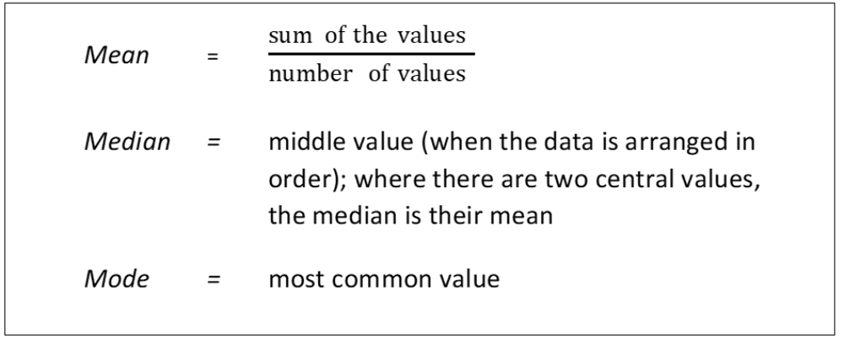
UNIT:
Measures of
Central
Tendency
Section 1
Measures of Central Tendency
We can summarise these measures of central tendency as below.
We define the range as the difference between the largest and smallest values; this is, in fact, a simple measure of the variation in the data as is seen in the unit “Measures of Variation”.

Slide 8
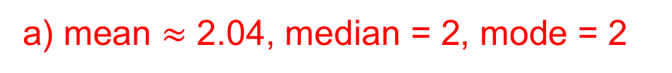
UNIT:
Measures of
Central
Tendency
Section 1
Section 1: Fitness Check
1. Twenty students were asked their shoe size. Here are the results:
For this data, find the a) mean b) median c) mode.
Answers
a) 6.8 b) 6.75 c) 6
The students in a class state how many children there are in their family. The results are given below:
1, 2, 1, 3, 2, 1, 2, 4, 2, 2, 1, 3, 1, 2, 2, 2, 1, 1, 7, 3, 1, 2, 1, 2, 2, 1, 2, 3
a) Find the mean, median and mode for this data set.
b) Which could be considered the most sensible average to use?
Answers
a) mean $≈$ 2.04, median = 2, mode = 2
b) It would depend on the context but they are all very close.

Slide 9
UNIT:
Measures of
Central
Tendency
Section 1
Section 1: Review
You have completed the first section.
If you have completed and mastered this section,
click to start the next Section
If you need more examples and interactive practice,
press here
You might also find it helpful to look at:
Essential Information: press here

Slide 10
UNIT:
Measures of
Central
Tendency
Section 2
Comparing Data Sets
During one week of August, Jamal recorded the maximum daily temperatures in two cities. Here are his results:
a) What was the range of the temperatures in
i) London
b) What was the mean temperature in
i) London
(Give your answers to one decimal place.)
c) What are the main differences in the temperature between London and Edinburgh?
 | Sunday | Monday | Tuesday | Wednesday | Thursday | Friday | Saturday
London | 22ºC | 25ºC | 26ºC | 24ºC | 24ºC | 29º | 28ºC
Edinburgh | 22ºC | 22ºC | 23ºC | 24ºC | 25ºC | 24ºC | 26ºC
7ºC
ii) Edinburgh ?
4ºC
25.4ºC
ii) Edinburgh ?
23.7ºC
London has a higher mean temperature than Edinburgh and also has a larger range of temperature.

Slide 11
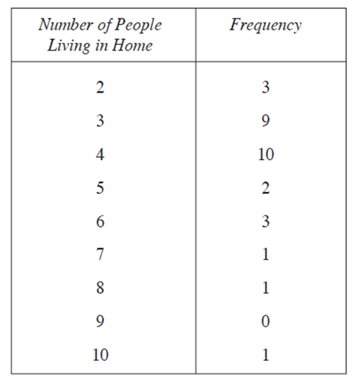
UNIT:
Measures of
Central
Tendency
Section 2
Data Frequency
Data is often given in terms of frequency; for example, here is the data from pupils in a class giving the number of people living in their home:
The frequency can refer to the number of people in that category (as it does here) or the number of times an occurrence happens.

Slide 12
UNIT:
Measures of
Central
Tendency
Section 2
Calculating from Frequency Tables
We need to find the mean, mode and median for this data in the frequency table opposite.
Mean: As ‘2’ occurs twice, ‘3’ occurs 9 times,
etc., we have
3×2 + 9×3 + 10×4 + 2×5 + 5×6 + 1×7 +
1×8 + 0×9 + 1×10 = 138
and the total number of data entries is
3 + 9 + 10 + 2 + 3 + 1 + 1 + 0 + 1 = 30
So the mean is given by 138 ÷ 30 = 4.6.
Mode: This is straightforward as the value 4 has the highest frequency.
Median: There are 30 values, so we need to find the average of the 15th and 16th values. We could write out all the numbers but it is easier to note that ‘2’ occurs 3 times and ‘3’ occurs 9 times so there are 12 values for 2 and 3. As ‘4’ occurs 10 times, it is clear that the 15th and 16th values are both 4. Hence the median value is 4.

Slide 13

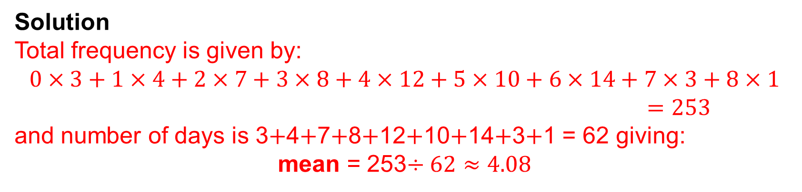
$$×$$
UNIT:
Measures of
Central
Tendency
Section 2
Another Example
Example
A manager keeps a record of the number of work calls she makes each day on her mobile phone.
Calculate the mean, median and mode for the number of calls per day.
Solution
Total frequency is given by:
$$0×3+1×4+2×7+3×8+4×12+5×10+6×14+7×3+8×1$$
$=253$
and number of days is 3$+$4$+$7$+$8$+$12$+$10$+$14$+$3$+$1 = 62 giving:
mean = 253$÷62≈4.08$
Median and mode: we must identify the 31st and 32nd values of the data in numerical order. Adding up the frequencies, we get to the 34th value up to 4 calls per day; so clearly both the 31st and 32nd values are 4 and hence the median is 4 and the mode is 6 as it has the highest frequency.

Slide 14
$$×$$
UNIT:
Measures of
Central
Tendency
Section 2
Section 2: Fitness Check
A survey of 100 households in America asked how many TV sets were in each household. Here are the results:
Calculate the mean number per household, giving your answer to one decimal place
Answer
1.9

Slide 15
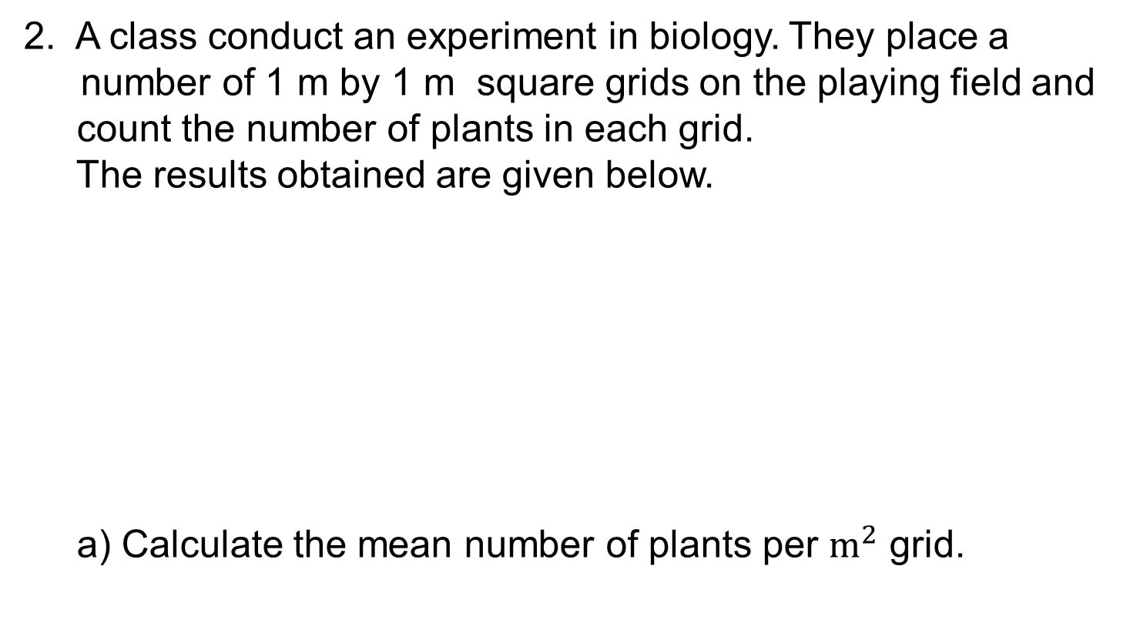
$$×$$
UNIT:
Measures of
Central
Tendency
Section 2
Section 2: Fitness Check
2. A class conduct an experiment in biology. They place a
number of 1 m by 1 m square grids on the playing field and
count the number of plants in each grid.
The results obtained are given below.
a) Calculate the mean number of plants per $m^{2}$ grid.
1.95
b) How many times was the number of plants per grid greater than the mean?
22 times

Slide 16
UNIT:
Measures of
Central
Tendency
Section 2
Section 2: Review
You have completed the second section.
If you have completed and mastered this section,
click to start the next Section
If you need more examples and interactive practice,
press here
You might also find it helpful to look at:
Essential Information: press here

Slide 17
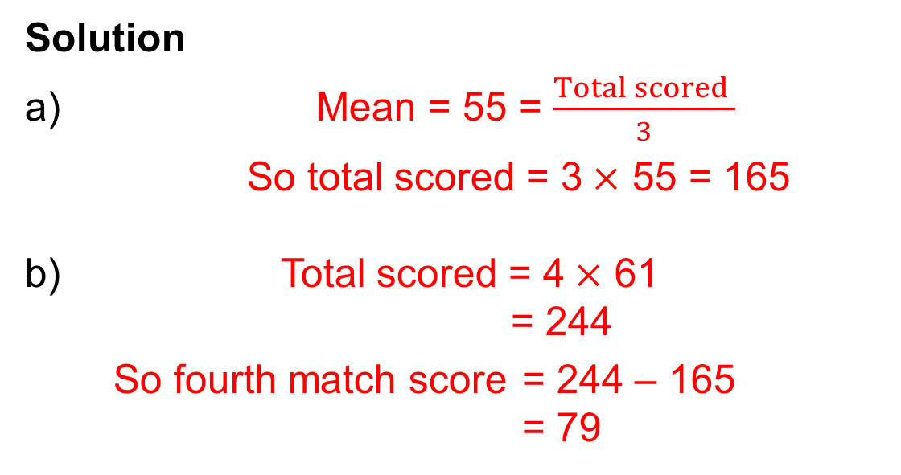
UNIT:
Measures of
Central
Tendency
Section 3
Calculations with the Mean
Example 1
Rohan's mean score in three cricket matches was 55 runs.
a) How many runs did he score altogether?
After four matches his mean score was 61 runs.
b) How many runs did he score in the fourth match?
Solution
a) Mean = 55 = $\frac{Total scored }{3}$
So total scored = 3$×$ 55 = 165
Total scored = 4$×$ 61
= 244
So fourth match score = 244 – 165
= 79

Slide 18
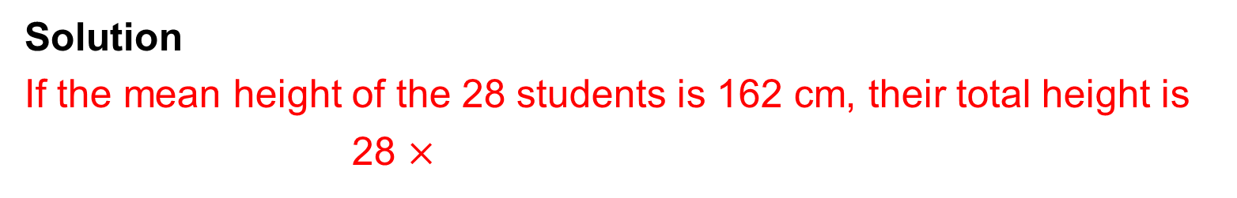
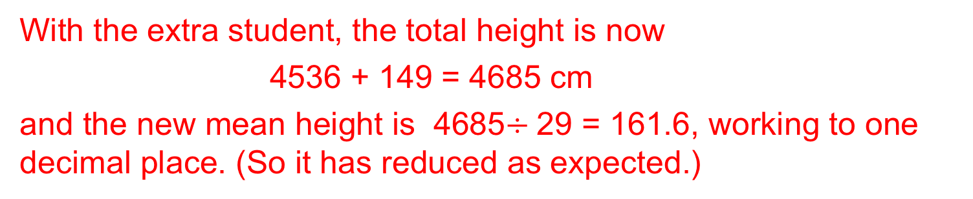
UNIT:
Measures of
Central
Tendency
Section 3
Calculations with the Mean
Example 2
The mean height of a class of 28 students is 162 cm. A new student of height 149 cm joins the class.
What is the mean height of the class now?
Solution
If the mean height of the 28 students is 162 cm, their total height is
28 $×$
162 cm = 4536 cm
With the extra student, the total height is now
4536 + 149 = 4685 cm
and the new mean height is 4685$÷$29 = 161.6, working to one decimal place. (So it has reduced as expected.)

Slide 19
UNIT:
Measures of
Central
Tendency
Section 3
Section 3: Fitness Check
After 5 matches the mean number of goals scored by a football team per match is 1.8. If they score 3 goals in their 6th match, what is the mean after the 6th match?
Answer
2 goals
2. The mean salary of the 8 people who work for a small company is £15 000. When an extra worker is taken on this mean drops to £14 000 . How much does the new worker earn?
Answer
£6000

Slide 20
UNIT:
Measures of
Central
Tendency
Section 3
Section 3: Review
You have completed the third section.
If you have completed and mastered this last section,
click here for the Unit audit.
If you need more examples and interactive practice,
press here
You might also find it helpful to look at:
Essential Information: press here

