Slide 1
Supporting and Enhancing Mathematics and Statistics
UNIT: Linear Equations

Slide 2
UNIT:
Linear
Equations
Linear Equations
Linear Equations are an important part of algebra work.
You have three sections to work through and there are check up audits and fitness tests for each section.
Simplifying Expressions
Simple Equations
Solving Linear Equations

Slide 3
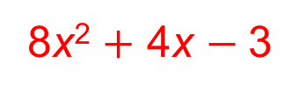
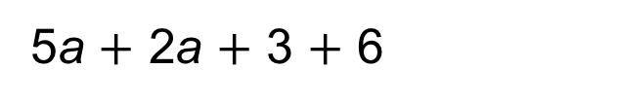
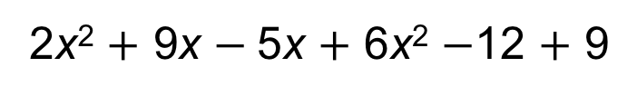
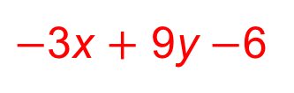
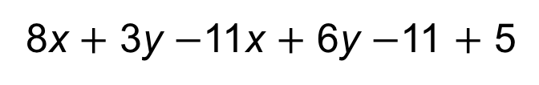
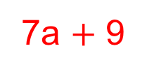
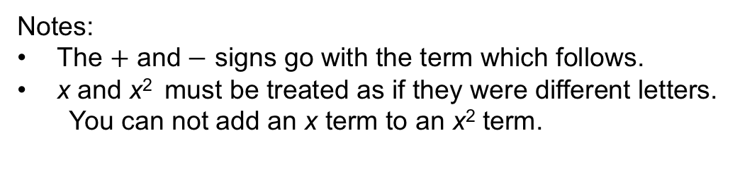
UNIT:
Linear
Equations
Section 1
Simplifying Expressions
An expression is a group of terms.
To simplify an expression, we collect together ‘like terms’,
i.e. terms with the same variable.
Simplify
5a $+$ 2a $+$ 3 $+$ 6
Solution:
7a $+$ 9
Simplify
8x $+$ 3y $−$11x $+$ 6y $−$11 $+$ 5
Solution:
$−$3x $+$ 9y $−$6
Simplify
2x² $+$ 9x $−$5x $+$ 6x² $−$12 $+$ 9
Solution:
8x² $+$ 4x $−$3
Notes:
The $+$ and$−$ signs go with the term which follows.
x and x² must be treated as if they were different letters.
You can not add an x term to an x² term.

Slide 4
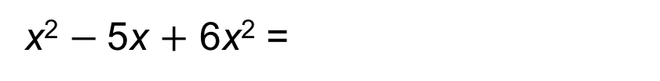
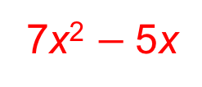
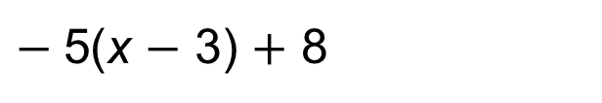
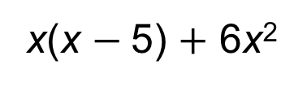
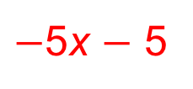

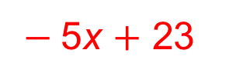
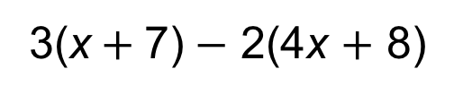
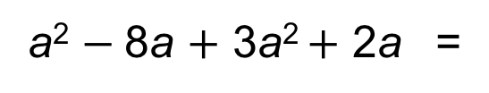
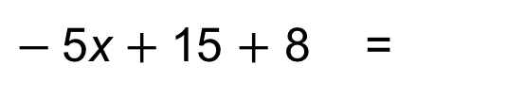
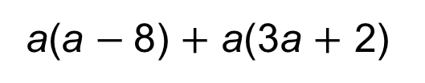
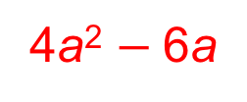
Simplifying Expressions
UNIT:
Linear
Equations
Section 1
To simplify an expression with brackets, we first expand the expression.
Simplify
$−$5(x $−$ 3) $+$ 8
Solution:
$−$5x $+$15 $+$ 8 =
$−$5x $+$ 23
Simplify
3(x$+$7)$−$ 2(4x $+$ 8)
Solution:
$$\text{3}\text{x}+\text{21}−\text{8}\text{x}−\text{16 =}$$
$−$5x $−$ 5
Simplify
x(x $−$5) $+$ 6x²
Solution:
7x² $−$5x
x² $−$5x $+$ 6x² =
Simplify
a(a $−$8) $+$ a(3a $+$ 2)
Solution:
a² $−$8a $+$ 3a² $+$ 2a =
4a² $−$6a

Slide 5
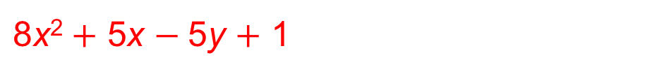
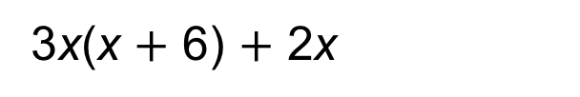
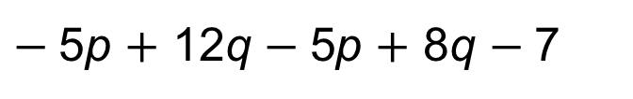
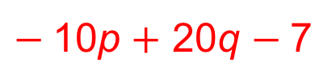
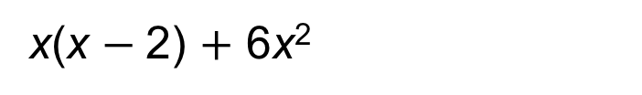
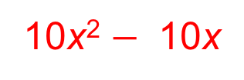
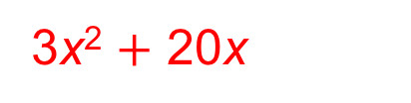
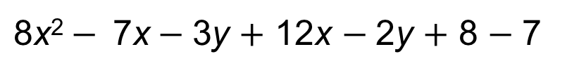
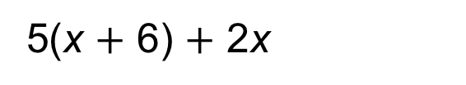
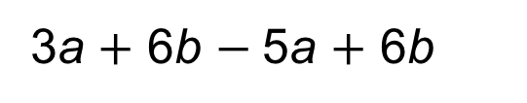
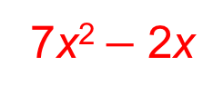
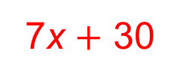
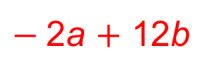
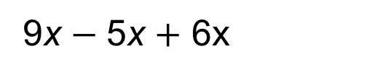
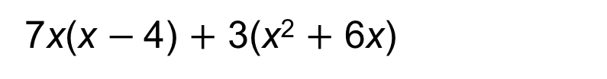
Section 1: Fitness Check
UNIT:
Linear
Equations
Section 1
Here are some questions to check your progress;
there are more practice questions if needed.
Simplify each of these expressions.
9x $−$5x $+$ 6x
10x
3a $+$ 6b $−$5a $+$ 6b
$−$2a $+$ 12b
$−$5p $+$ 12q $−$5p $+$ 8q $−$7
$−$10p $+$ 20q $−$7
$\text{8}\text{x}\text{2}− \text{7}\text{x}−$3y $+$ 12x $−$2y $+$ 8 $−$7
$\text{8}\text{x}\text{2}+$ 5x $−$5y $+$ 1
5(x $+$ 6) $+$ 2x
7x $+$ 30
x(x $−$2) $+$ 6x²
7x² $−$2x
3x(x $+$ 6) $+$ 2x
3x² $+$ 20x
7x(x $−$4) $+$ 3(x² $+$ 6x)
10x² $−$ 10x

Slide 6
UNIT:
Linear
Equations
Section 1
Section 1: Review
You have completed the first Section.
If you have completed and understood this section,
click to start the next Section
If you need more examples and interactive practice,
press here
You might also find it helpful to look at:
Essential Information: press here

Slide 7
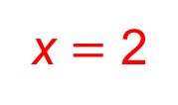
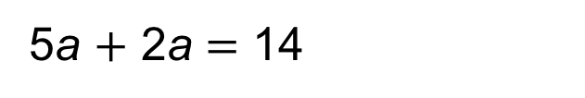
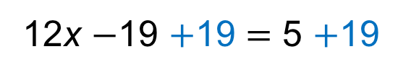
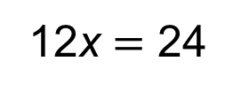
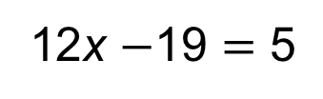
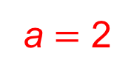
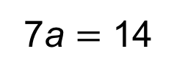
UNIT:
Linear
Equations
Section 2
Simple Equations
An equation has terms on both sides of an equals sign.
To solve simple equations, we collect together ‘like terms’ on each side of the equals sign.
Then, we make sure the equation always remains balanced:
so whatever operation we do on one side of the equation, we must also do on the other.
Solve
5a $+$ 2a $=$ 14
Solution:
7a $=$ 14
Collect like terms
Now divide both sides by 7
a $=$ 2
Solve
12x $−$19 $=$ 5
Solution:
Eliminate the ‘$−$19’ by adding 19 to both sides
12x $−$19 $+$19 $=$ 5 $+$19
12x $=$ 24
Now divide both sides by 12
x $=$ 2

Slide 8
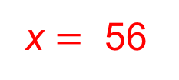
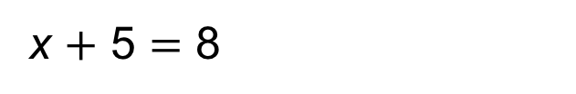
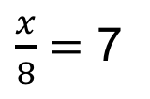
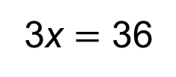

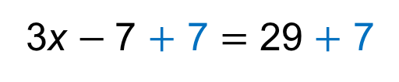
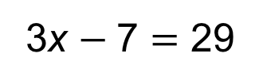
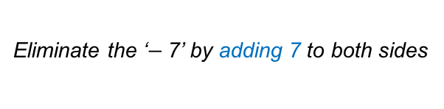
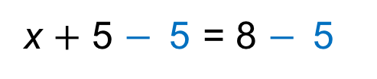
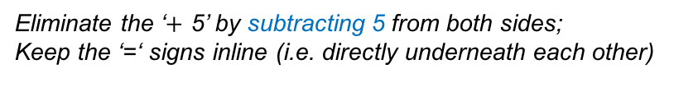
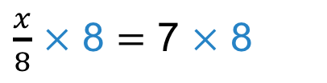
UNIT:
Linear
Equations
Section 2
Simple Equations
Further examples 1:
Solve
x $+$ 5 $=$ 8
Solution:
Eliminate the ‘$+$ 5’ by subtracting 5 from both sides;
Keep the ‘=‘ signs inline (i.e. directly underneath each other)
x $+$ 5 $−$5 = 8 $−$5
x = 3
Solve
3x $−$7 $=$ 29
Eliminate the ‘$−$7’ by adding 7 to both sides
Solution:
3x $−$7 $+$ 7 $=$ 29 $+$ 7
3x $=$ 36
Now divide both sides by 3
$$\text{x}=\text{12}$$
Solve
$\frac{x}{8}$ $=$ 7
Solution:
To eliminate the ‘$÷$ 8’ multiply both sides by 8
$\frac{x}{8}$ $×$ 8 $=$ 7 $×$ 8
x $=$ 56

Slide 9













UNIT:
Linear
Equations
Section 2
Simple Equations
Further examples 2:
Solve
2x $−$ 8 $=$ $−$18
Eliminate the ‘$−$ 8’ by adding 8 to both sides;
Solution:
2x $−$8$+$ 8 $=$ $−$18 $+$ 8
2x $=$ $−$10
x $=$ $−$5
Solve
5x $−$4 $=$ 26
Eliminate the ‘$−$4’ by adding 4 to both sides
Solution:
5x $−$4 $+$ 4 $=$ 26 $+$ 4
5x $=$ 30
Now divide both sides by 5
$$\text{x}=\text{6}$$
Solve
$\frac{\text{m}}{\text{3}}=$ $−$6
Solution:
To eliminate the ‘$÷$ 3’ multiply both sides by 3
$\frac{\text{m}}{\text{3}}×$ 3 $=$ $−$6 $×$ 3
m $=$ $−$18

Slide 10
















Section 2: Fitness Check
UNIT:
Linear
Equations
Section 2
Here are some questions to check your progress;
there are more practice questions if needed.
Solve each of these equations.
9x $−$5 $=$ 31
x $=$ 4
3a $+$ 6 $=$ $−$144
a $=$ $−$50
$−$5p $+$ 12 $=$ 62
p $=$ $−$10
$\frac{m}{7}$ $=$ 11
m $=$ 77
5x $+$ 6 $=$ 61
x $=$ 11
x $−$2 $=$ $−$6
x $=$ $−$4
$−$3x $+$ 6 $=$ $−$6
x $=$ 4
7(x $−$4) $=$ 35
x $=$ 9

Slide 11
UNIT:
Linear
Equations
Section 2
Section 2: Review
You have completed the second Section.
If you have completed and understood this section,
click to start the next Section
If you need more examples and interactive practice,
press here
You might also find it helpful to look at:
Essential Information: press here

Slide 12




UNIT:
Linear
Equations
Section 3
Solving Linear Equations
Linear equations are simple equations which would
draw a straight (linear) line if plotted.
To solve linear equations, we sometimes need to complete
a number of steps along the way.
For example, 3x $+$ 8 $=$ $−$4(x $+$ 5)
To solve an equation with brackets, we can first expand the expression.
$\text{3}\text{x} +\text{ 8} =$ $−$4x$−$ 20
Now look for the smallest number of ‘x’ and eliminate this term
(remember: $−$4x is smaller than 3x).
To eliminate $−$4x we must $+$ 4x
$\text{3}\text{x} +\text{ 8} +$ 4x$=−$4x$−$ 20 $+$ 4x
this is continued on next slide...

Slide 13






UNIT:
Linear
Equations
Section 3
Solving Linear Equations
Continued …
$\text{3}\text{x} +\text{ 8} +$ 4x$=−$4x$−$ 20 $+$ 4x
Now, collect together any like terms on each side
$\text{7}\text{x} +\text{ 8 }=−$ 20
To get the ‘7x’ term on its own, we must eliminate the 8.
(remember: to eliminate $+$ 8 we must $−$8)
7x $+$ 8 $−$8 $=$ $−$20 $−$8
$\text{7}\text{x} =$ $−$ 28
Now to find the value of one x, we divide both sides by 7.
x $=$ $−$4

Slide 14









UNIT:
Linear
Equations
Section 3
Solving Linear Equations
$\frac{\text{m}}{\text{2}}$ $=$ 3m $−$10
Here is another example:
To solve this equation, we first need to multiply throughout by 2;
this will eliminate the ‘divide by 2’ on the left hand side.
$\text{m}=$ 6m $−$20
Now look for the smallest number of ‘m’ and eliminate this term
To eliminate ‘m’ we must $− \text{m}$from each side.
$\text{m}− \text{m}=$ 6m $−$20 $− \text{m}$
$\text{0}=$ 5m $−$20
To get the ‘m’ term on its own, we must eliminate the $−$20.
(remember: to eliminate $−$20 we must $+$20)
$\text{0}+ \text{20}=$ 5m $−$20 $+$20
$\text{2}\text{0}=$ 5m
Now to find the value of one m, we divide both sides by 5 to give:
$\text{4}=$ m
Which is, of course, exactly the same as: m $=\text{4}$

Slide 15
















UNIT:
Linear
Equations
Section 3
Section 3: Fitness Check
Here are some questions to check your progress;
there are more practice questions if needed.
Solve each of these equations.
9(x $−$4) $=$ 18
x $=$ 6
3(a $+$ 6) $=$ $−$3(a $+$ 6)
a $=$ $−$6
$−$5(p $+$ 12) $=$ 6 $−$4p
p $=$ $−$66
$\frac{\text{m}}{\text{3}}=$ 2(m $−$5)
m $=$ 6
$−$5x $+$ 6 $=$ $−$3x$−$ 6
x $=$ 6
x $−$4 $=$ $−$6 (x $−$4)
x $=$ 4
$−$3x $+$ 6(x $−$4) $=$ $−$5x
x $=$ 3
9(x $−$4) $=$ 3(x $−$4)
x $=$ 4

Slide 16
UNIT:
Linear
Equations
Section 3
Section 3: Review
You have completed the third and last Section.
If you have completed and mastered this last section,
click here for the Unit audit
If you need more examples and interactive practice,
press here
You might also find it helpful to look at:
Essential Information: press here

