Slide 1
Supporting and Enhancing Mathematics and Statistics
UNIT: Further Trigonometry

Slide 2
Strand:
Further Trigonometry
Section 1
Further Trigonometry
This unit on Further Trigonometry is divided into the following five units of work.
Radian Measure
Arc and Sector
Sine, Cosine and Tangent Functions
Solving Trigonometrical Equations
5. Properties of Trig Functions

Slide 3
Strand:
Further Trigonometry
Section 1
Radian Measure
What are radians ?
Radians are an alternative unit of measure for angles, often used in trigonometry. They relate the arc length of a sector to its angle. Here is an explanation of how radians are worked out. One radian corresponds to the angle which gives the same arc length as the radius.
Remember for any circle with radius r
Circumference of the circle = 2𝜋𝑟
Here is a drawing of the circle showing a sector

Slide 4
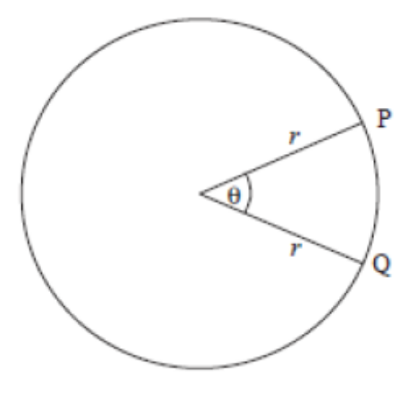
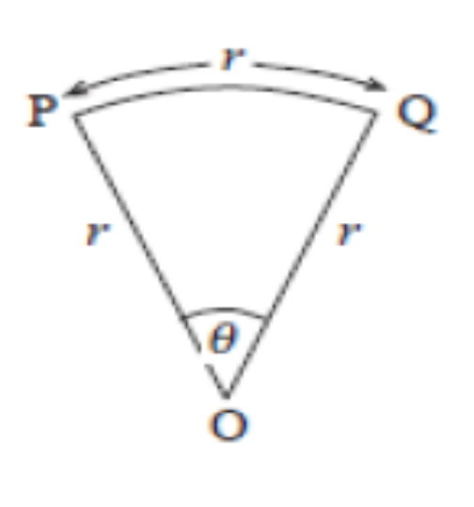
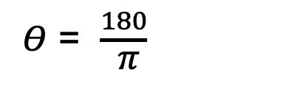

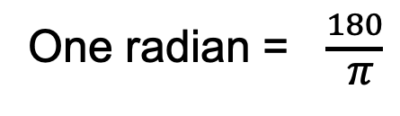
Strand:
Further Trigonometry
Section 1
Radian Measure
The arc length PQ = $\frac{Θ}{360}$ $×$ 2𝜋𝑟 ( see unit xxx )
If PQ = r
Then r = $\frac{Θ}{360}$ $×$ 2𝜋𝑟
Rearranging, $Θ$ = $\frac{360}{\text{2}\text{π}}$
$Θ$ = $\frac{180}{ \text{π}}$
One radian = $\frac{180}{ \text{π}}$

Slide 5
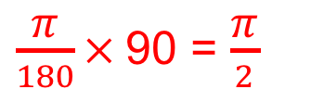
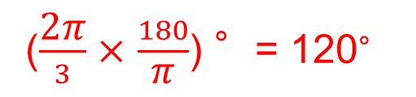
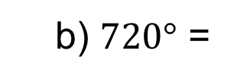
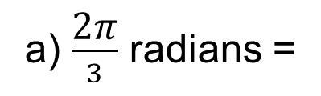
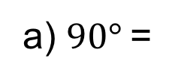

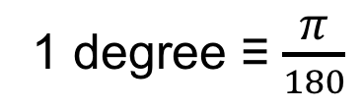
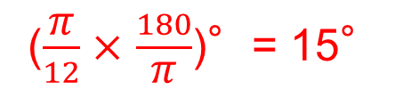
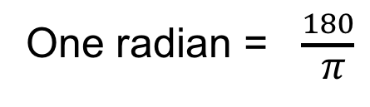
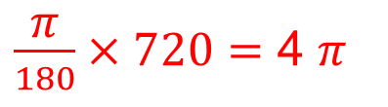
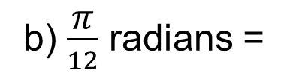
Strand:
Further Trigonometry
Section 1
Radian Measure
One radian = $\frac{180}{ \text{π}}$
This is not a very convenient definition, so it is usual to note that:
𝜋 radians = 180 degrees
1 degree ≡ $\frac{\text{π}}{180}$
Example 1
Convert the following angles in degrees to radians.
Solution
a) $90°$=
$\frac{\text{π}}{180}×$90 = $\frac{\text{π}}{2}$
b) $720°$ =
$\frac{\text{π}}{180}×720=$ 4 $\text{π}$
Example 2
Convert the following angles in radians to degrees.
Solution
a) $\frac{\text{2}\text{π}}{3}$ radians =
($\frac{\text{2}\text{π}}{3}$ $×$ $\frac{180}{\text{π}}$) °= 120°
b) $\frac{\text{π}}{12}$ radians =
($\frac{\text{π}}{12}$ $×$ $\frac{180}{\text{π}}$)°= 15°

Slide 6
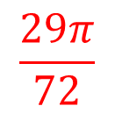
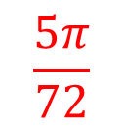
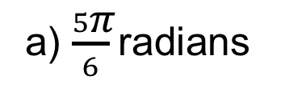
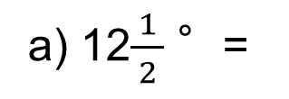
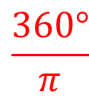
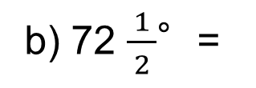
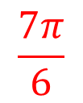
Strand:
Further Trigonometry
Section 1
Section 1 Fitness Check
Here are some questions to check your progress
1. Convert these angles in degrees to radians.
$$\frac{\text{5}\text{π}}{72}$$
b) 72 $\frac{ 1 }{2}$°=
$$\frac{\text{29}\text{π}}{72}$$
$$\frac{\text{7}\text{π}}{6}$$
a) 12$\frac{ 1 }{2}$ °=
c) 210°=
2. Convert these angles in radians to degrees:
𝜋 radians = 180 degrees
a) $\frac{5\text{π}}{6}$radians
150°
b) 3𝜋 radians
540°
c) 2 radians
$$\frac{360°}{\text{π}}$$
= 114.59°

Slide 7
Strand:
Further Trigonometry
Section 1
Section 1: Review
You have completed the first section.
If you have completed and mastered this section,
click to start the next Section
If you need more examples and interactive practice,
press here
You might also find it helpful to look at:
Essential Information: press here

Slide 8
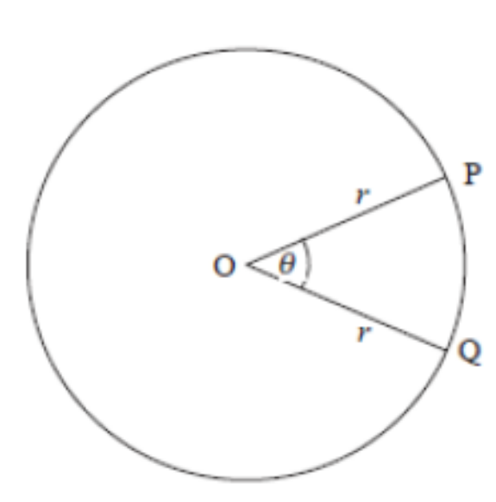
Strand:
Further Trigonometry
Section 2
Arc and Sector Area
Ever wanted to prove that your friend has cut a bigger slice of pizza for themselves than they did for you? Here is how to do it. In fact you can work out the area of pizza slice as well the length of your slice on the curve, known as the arc. Go on, amaze and shame your mate!
Let’s start, as always in trigonometry, with a diagram. In this case a pizza which a perfect circle (congratulations to the chef).

Slide 9
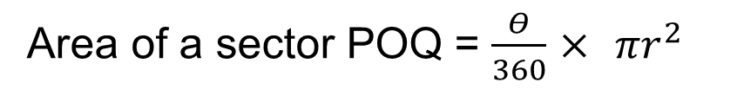
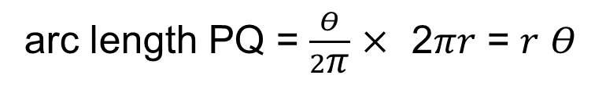
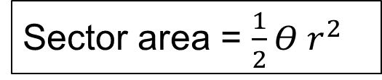


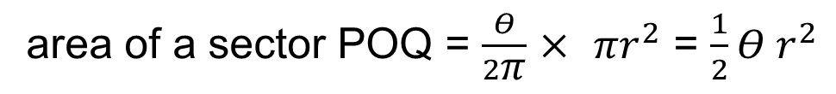

Strand:
Further Trigonometry
Section 2
Arc and Sector Area
From our formula , Arc length PQ = $\frac{Θ}{360}$ $×$ 2𝜋𝑟 = $\frac{\text{π}\text{r}Θ}{180}$
If $Θ$ is measured in radians
arc length PQ = $\frac{Θ}{2\text{π}}$ $×$ 2𝜋𝑟 = 𝑟 $Θ$
The region between the two radii and the arc is called a sector of the circle.
Area of a sector POQ = $\frac{Θ}{360}$ $×$ 𝜋$r^{2}$
If $Θ$ is measured in radians
area of a sector POQ = $\frac{Θ}{2\text{π}}$ $×$ 𝜋$r^{2}$ = $\frac{1}{2}Θ r^{2}$
In summary, when $Θ$ is measured in radians,
Arc length = 𝑟 $Θ$ and
Sector area = $\frac{1}{2}Θ r^{2}$

Slide 10
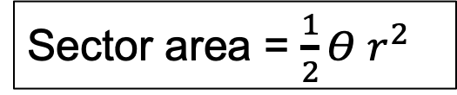
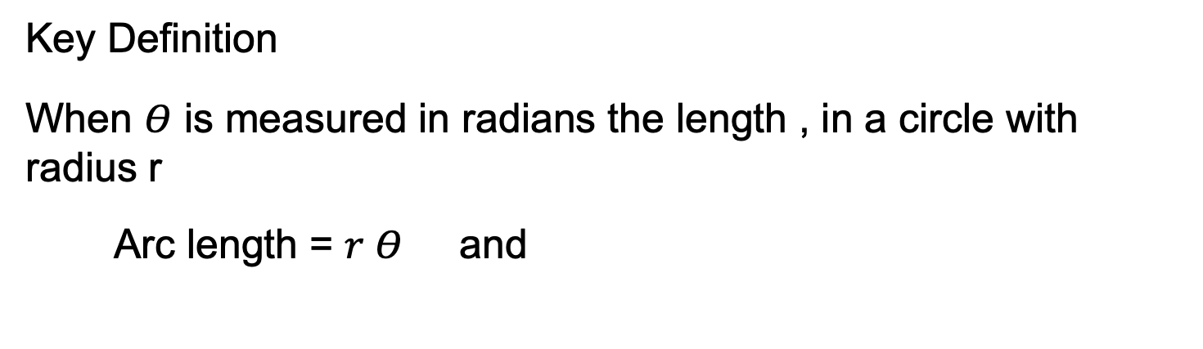
Strand:
Further Trigonometry
Section 2
Arc and Sector Area
Key Definition
When $Θ$ is measured in radians the length , in a circle with radius r
Arc length = 𝑟 $Θ$ and
Sector area = $\frac{1}{2}Θ r^{2}$

Slide 11
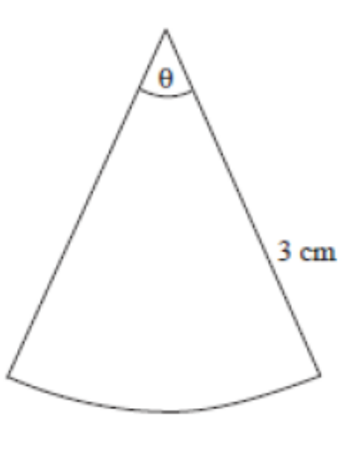
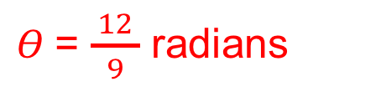


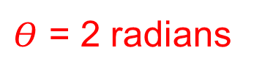

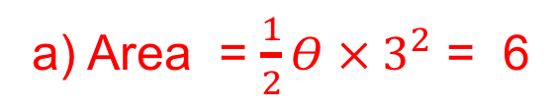
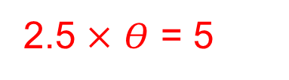


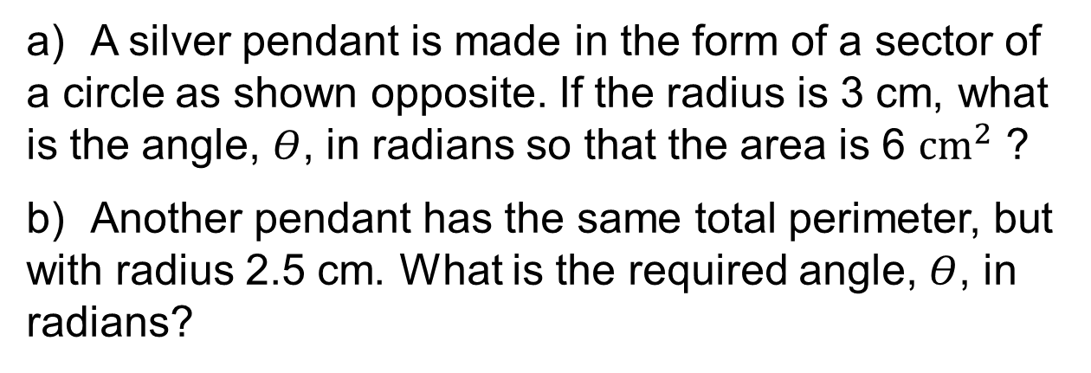
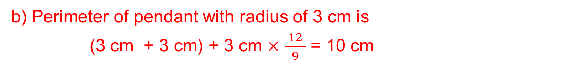

Strand:
Further Trigonometry
Section 2
Arc and Sector Area
Example
a) A silver pendant is made in the form of a sector of a circle as shown opposite. If the radius is 3 cm, what is the angle, $Θ$, in radians so that the area is 6 ${cm}^{2}$ ?
b) Another pendant has the same total perimeter, but with radius 2.5 cm. What is the required angle, $Θ$, in radians?
Solution
a) Area = $\frac{1}{2}Θ {× 3}^{2}$ = 6
$$⟹$$
$Θ × 3^{2}$ = 12
$Θ$= $\frac{ 12 }{9}$ radians
$$⟹$$
b) Perimeter of pendant with radius of 3 cm is
(3 cm + 3 cm) + 3 cm $×$ $\frac{ 12 }{9}$ = 10 cm
Perimeter of pendant with radius of 2.5 cm is 10 cm
2.5 $×$ $Θ$ = 5
$Θ$ = 2 radians
2.5 + 2.5 + 2.5 $×$ $Θ$ = 10
$$⟹$$
$$⟹$$

Slide 12
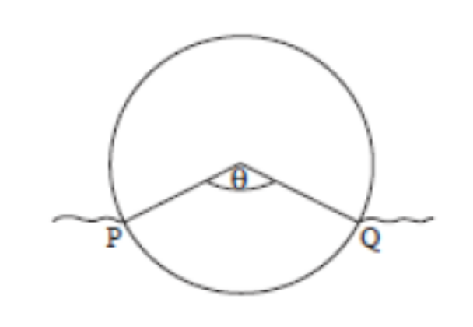
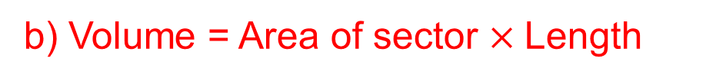

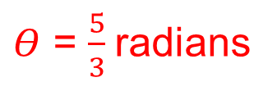
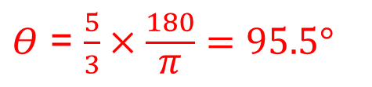

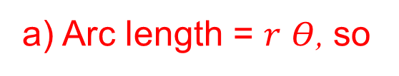
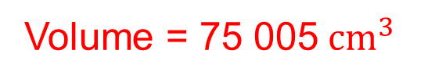


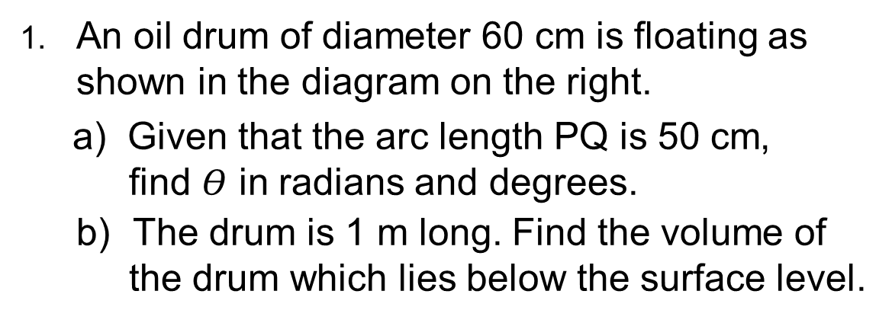


Strand:
Further Trigonometry
Section 2
Section 2 Fitness Check
Here is a question to check your progress
1. An oil drum of diameter 60 cm is floating as shown in the diagram on the right.
a) Given that the arc length PQ is 50 cm, find $Θ$ in radians and degrees.
b) The drum is 1 m long. Find the volume of the drum which lies below the surface level.
Answers
a) Arc length = 𝑟 $Θ$, so
50 = 30 𝜃
$Θ$ = $\frac{5}{3}$radians
$$⟹$$
$Θ$ = $\frac{5}{3}×\frac{180}{\text{π}}=95.5°$
$$⟹$$
b) Volume = Area of sector $×$Length
Volume = $\frac{Θ}{360}\text{π}r^{2}×\text{Length}$
$$⟹$$
Volume = ${\frac{95.5\text{π}}{360}×30}^{2}×100$
Volume = 75 005${ cm}^{3}$
$$⟹$$

Slide 13
Strand:
Further Trigonometry
Section 2
Section 2: Review
You have completed the second section.
If you have completed and mastered this section,
click to start the next Section
If you need more examples and interactive practice,
press here
You might also find it helpful to look at:
Essential Information: press here

Slide 14
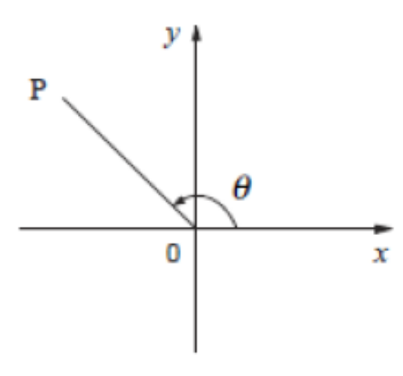
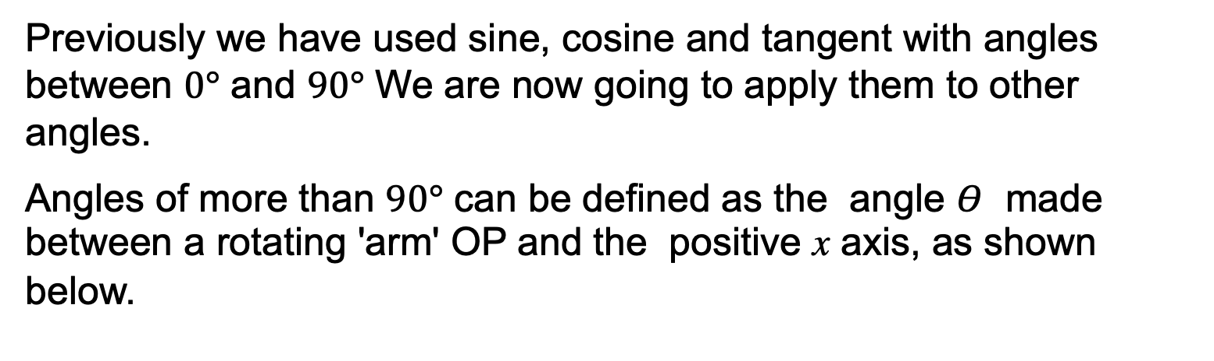
Strand:
Further Trigonometry
Section 3
Sine, Cosine and Tangent Functions for Angles greater than 90
Previously we have used sine, cosine and tangent with angles between $0°$ and $90°$ We are now going to apply them to other angles.
Angles of more than $90°$ can be defined as the angle $Θ$ made between a rotating 'arm' OP and the positive x axis, as shown below.

Slide 15
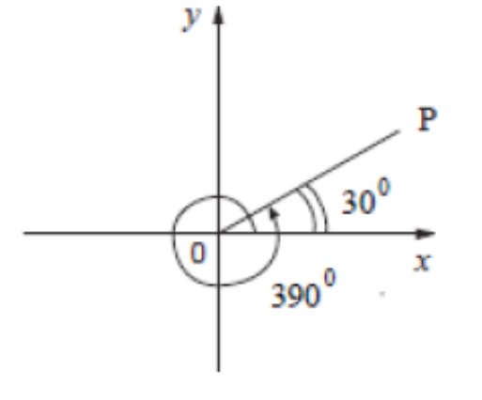
Strand:
Further Trigonometry
Section 3
Sine, Cosine and Tangent Functions
It is possible to define angles of more than 360° in this way, or even negative angles, as shown in the diagram blow.

Slide 16
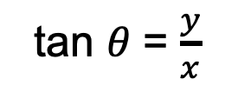
Strand:
Further Trigonometry
Section 3
Sine, Cosine and Tangent Functions
Key Definition
If the length of OP is 1 unit, then the sine, cosine and tangent of any angle is defined in terms of the x and y co-ordinates of the point P as follows;
sin 𝜃 = 𝑦
cos 𝜃 = 𝑥
tan 𝜃 = $\frac{y}{x}$

Slide 17
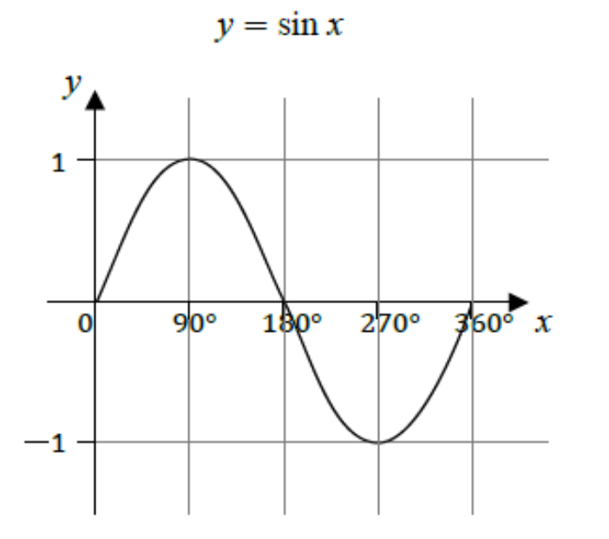
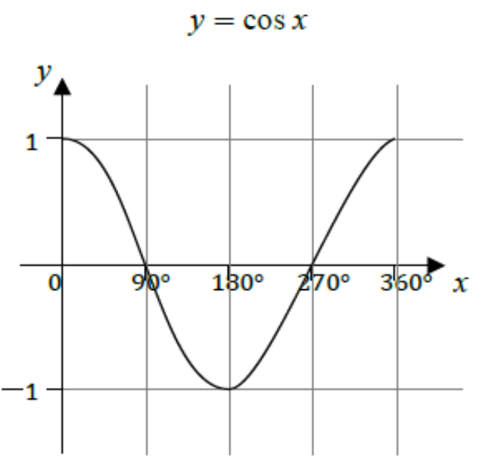
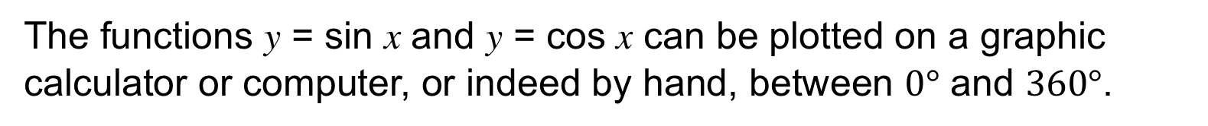
Strand:
Further Trigonometry
Section 3
Sine, Cosine and Tangent Functions
The functions y = sin x and y = cos x can be plotted on a graphic calculator or computer, or indeed by hand, between $0°$ and $360°$.
The maximum and minimum values of the function y are 1 and −1.
Both functions, sin x and cos x, lie between ±1.
The amplitude is the height from the x -axis to the peak (or trough).
The amplitude for both sine and cosine functions is 1.

Slide 18
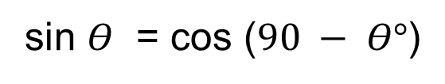


Strand:
Further Trigonometry
Section 3
Sine, Cosine and Tangent Functions
For the range $360°$ ≤ 𝑥 ≤ $720°$, the pattern will repeat itself, and similarly for negative values.
A period is the length of one cycle before the pattern repeats. The period for both sine and cosine functions is $360°$.
The graphs are illustrated below.
You can see that the the function y = sin x is an odd function as 𝑦(−𝑥) = −𝑦(𝑥) whilst y = cos x is an even function as 𝑦(−𝑥) = 𝑦(𝑥).
Note that:
cos $Θ$ = sin $(90 − Θ°)$
sin $Θ$ = cos ($90 − Θ°$)

Slide 19

Strand:
Further Trigonometry
Section 3
Tangent Function
The last function to consider here is tan x, which has rather different properties from sin x and cos x.
We can use a graphic calculator or computer to sketch the function
𝑦 = tan 𝑥 for x in any range.
The period of the function is the distance between any two consecutive asymptotes (dotted lines);
the period for 𝑦 = tan 𝑥 $is 180°.$
Unlike the sine and cosine functions, tan x is not bounded by ±1.
In fact, as x increases to $90°$,
tan x increases without limit.

Slide 20
Here is a useful reminder of some of the values of the trig functions

Slide 21




Strand:
Further Trigonometry
Section 3
Sine, Cosine and Tangent Functions
Example 1
Show that sin $30°$ = $\frac{1}{2}.$
Solution
First, lets sketch an equilateral triangle showing the angles and sides
sin $Θ$ = $\frac{Opp}{Hyp}$
, in this case
sin $30°$= $\frac{1}{2}$

Slide 22












Strand:
Further Trigonometry
Section 3
Example 2
From the graphs, find the following values shown on the graphs
a) sin $150°$ =
sin($180°−30°)$= sin $30°$ = $\frac{1}{2}$
b) sin $210°$ =
$− \frac{1}{2}$
c) sin $390°$ =
sin $30°$ = $\frac{1}{2}$
d) sin$(−30°$) =
$−$sin $30°$ = $− \frac{1}{2}$
e) cos $60° :$
since cos $Θ$ = sin ($90 − Θ°$)
cos $60°$ =
sin($90°−60°)$= sin $30°$ = $\frac{1}{2}$

Slide 23














Strand:
Further Trigonometry
Section 3
Tangent Functions
Example
Using the values:
tan $45°$= 1 and tan $30°$ = $\frac{1}{\sqrt{3}}$
find the following without a calculator:
a) tan $135°$ =
tan ($135°−180°)$
= tan ($− 45°$) = $−$1
b) tan ($−45°$) =
$−$ tan $45°$ = $−$1
c) tan $315°$ =
$−$tan ($315°− 360°)$= $−$1
d) tan($−$30$°$) =
$−$ tan $30°$ = $−$ $\frac{1}{\sqrt{3}}$
e) tan $150°$=
$−$tan ($150°−180°$) = $−$ $\frac{1}{\sqrt{3}}$
Note that:
tan $Θ$ = $\frac{1}{(\tan{90 −Θ)}}$
f) tan $60°$ =
$\frac{\sin{60°}}{\cos{60°}}$ = $\frac{\cos{30°}}{\sin{30°}}$ = $\frac{1}{\tan{30°}}$ = $\sqrt{3}$

Slide 24








Strand:
Further Trigonometry
Section 3
Section 3: Fitness Check
Here are some questions to check your progress
1. Find the length marked x to 2 d.p.
Answer
x = $\frac{2}{\sin{50}}$ = 2.61
2. Given that sin 45$°$ = $\frac{1}{√2}$ , find, without using a calculator,
Answers
a) sin135$°$ =
sin(180$°−$ 135$°$) = sin 45$°$= $\frac{1}{√2}$
b) sin($−$45$°$) =
$−$sin 45$°$ = $− \frac{1}{√2}$
c) cos 225°=
sin(90$° −$225$°$) = sin($−$135$°$) = $− \frac{1}{√2}$
d) tan 135°=
tan (135$°$ $−$180$°$) = tan ($−$45$°$) = $−$1

Slide 25
Strand:
Further Trigonometry
Section 3
Section 3: Review
You have completed the third section.
If you have completed and mastered this section,
click to start the next Section
If you need more examples and interactive practice,
press here
You might also find it helpful to look at:
Essential Information: press here

Slide 26



Strand:
Further Trigonometry
Section 4
Solving Trigonometrical Equations
Trigonometric functions can be used to model physical phenomena but applying these functions to problems in the real world will often result in a trigonometric equation to solve.
In this section, you will consider some simple equations to solve. These will highlight the difficulties that can occur.
Example
Solve 3 cos 𝑥 = −0.6 for 0$°$≤ 𝑥 ≤ 360$°$, giving the answer to 1 d.p.
Solution
Rearranging
cos 𝑥 = $\frac{−0.6}{3}$ = − 0.2.
The graphs of the functions are shown
and using the ‘inverse cos’ button on
your calculator gives:
𝑎 = 101.5$°$
and by symmetry,
b = (180$°$ $−a)$ + 180$°$ = 360$°−a$= 258.5$°$

Slide 27

Strand:
Further Trigonometry
Section 4
Solving Trigonometrical Equations
Example
Solve the equation tan x = −2 where x is
measured in radians and −2𝜋 ≤ 𝑥 ≤ 2𝜋.
Give your answers to 2 decimal places.
(Set your calculator to radian mode.)
Solution
The graphs of y = tan x and y = −2 are
shown opposite. You can see that there
are four solutions denoted by a, b, c and d that lie between −2𝜋 and 2𝜋.
To find b, the solution between −𝜋 ≤ 𝑥 ≤ 𝜋 input −2 in your calculator and use the 'inverse tan' (or 'arctan’) button. This gives b = −1.107 .
Now 𝑎 = 𝑏 − 𝜋 = −4.249
𝑐 = 𝑏 + 𝜋 = 2.035
𝑑 = 𝑏 + 2𝜋 = 5.177

Slide 28



Strand:
Further Trigonometry
Section 4
Section 4: Fitness Check
Here are some questions to check your progress
1. Solve cos x = 0.5, 0° ≤ x ≤ 360°
𝜋 radians =180°
Answers
x = 60° x = 300°
2. Solve cos x = $\frac{1}{3}$ for $−$2𝜋 ≤ 𝑥 ≤ 2𝜋
Answers
x = $−$4.372, $−$1.231, 1.231, 4.372

Slide 29
Strand:
Further Trigonometry
Section 4
Section 4: Review
You have completed the fourth section.
If you have completed and mastered this section,
click to start the next Section
If you need more examples and interactive practice,
press here
You might also find it helpful to look at:
Essential Information: press here

Slide 30




Strand:
Further Trigonometry
Section 5
Properties of Trigonometrical Functions
Example
Find all solutions between 0$°$ and 360$°$ of the equation
sin x = 2 cos x to 2 decimal places.
Solution
Assuming cos 𝑥 ≠ 0, you can divide both sides of the equation by cos 𝑥 to give
tan 𝑥 = 2.
The graphs of y = tan 𝑥 and y = 2 show that there are 2 solutions in the range 0$°$ to 360$°$. Thus
$\tan^{−1}$(2) = 63.43$°$
giving A= 63.43$°$ and
B = 180$°$+ 63.43$°$= 243.43$°.$

Slide 31




Strand:
Further Trigonometry
Section 5
Properties of Trigonometrical Functions
Example
Find all solutions between 0$°$ and 360$°$ of the equation
cos 𝑥 sin 𝑥 = 3 cos 𝑥
Solution
The equation can be rewritten as:
cos 𝑥 sin 𝑥 − 3 cos 𝑥 = 0
or cos 𝑥 (sin 𝑥 − 3) = 0.
So either cos 𝑥 = 0 or sin 𝑥 − 3 = 0 ⟹ sin 𝑥 = 3.
However the graphs opposite, of y =sin x and y = 3, show there are no solutions.
The graph of 𝑦 = cos 𝑥 is shown opposite
for 0$°$ ≤ 𝑥 ≤ 360°.
The solutions are given by cos 𝑥 = 0,
which gives 𝑥 = 90° or x = 270°

Slide 32





Strand:
Further Trigonometry
Section 5
Properties of Trigonometrical Functions
Example
Find all solutions between 0$°$ and 360$°$ to the equation
3 cos x = 2 $\sin^{2}$ x
Solution
Using the identity
$\sin^{2}$x +$\cos^{2}$x = 1
$\sin^{2}$x = 1 − $\cos^{2}$x
makes it possible to express the equation in ‘cos’ terms only:
3 cos x = 2 (1 − $\cos^{2}$x ) = 2 − 2 $\cos^{2}$x
Rearrange to make a quadratic equation
2 $\cos^{2}$x + 3 cos x – 2 = 0
Continued on next slide

Slide 33




Strand:
Further Trigonometry
Section 5
Properties of Trigonometrical Functions
Solution Continued
2 $\cos^{2}$x + 3 cos x – 2 = 0
This can be factorised to give
(2 cos x – 1)(cos x + 2) = 0
Hence cos x = – 2 or cos x = $\frac{1}{2}$
But cos x = – 2 has no solutions.
From the graph opposite we can see that cos x = $\frac{1}{2}$ has the solutions
x = 60° and x = 300°

Slide 34


Strand:
Further Trigonometry
Section 5
Section 5: Fitness Check
Here is a question to check your progress.
Find all solutions between 0$°$ and 360$°$ to 1 decimal place, of the equation:
5 − 2 cos 𝑥 = 8 $\sin^{2}$𝑥
Answers
cos x = $\frac{3}{4}$ or cos x = $−\frac{1}{2}$ giving
x = 41.4$° , 120°$, $240° ,\text{ 316}\text{.}18°$

Slide 35
Strand:
Further Trigonometry
Section 5
Section 5: Review
You have completed the fifth section.
If you have completed and mastered this section,
click here for the Unit audit
If you need more examples and interactive practice,
press here
You might also find it helpful to look at:
Essential Information: press here

