Slide 1
Supporting and Enhancing Mathematics and Statistics
UNIT: Correlation and Regression

Slide 2
UNIT
Correlation and Regression
Correlation and Regression
This unit is divided into the five related sections listed below.
The sections are based on whether data shows any correlation and
developing a line of best fit when high correlation is shown.
Correlation
2. Spearman’s Rank Correlation Coefficient (SRCC)
3. Product Moment Correlation Coefficient (PMCC)
Regression Line
Line of Regression Equation

Slide 3
Correlation
UNIT
Correlation and Regression
Section 1
You may already have an understanding of the concept of correlation between two sets of data. We can illustrate this by using a scatter diagram. Here are some examples.
Can you think of examples of variables that have:
a) positive correlation b) no correlation c) negative correlation?

Slide 4
Correlation Examples
UNIT
Correlation and Regression
Section 1
Write down the number of the diagram that is most likely to represent:
a) the heights of a group of boys (x-axis) and sizes of shirts worn (y-axis);
b) temperature during the day (x-axis) and gas used to heat a house (y-axis);
c) the shoe sizes of a group of adults (x-axis) and their ages (y-axis).
1
3
2
What sort of correlation is shown in these diagrams?
positive, none, negative correlation

Slide 5
Scatter Diagram
UNIT
Correlation and Regression
Section 1
The scatter diagram shows the ages, in years, and the selling prices, in thousands of pounds, of second-hand cars of the same model.
The price of one of these cars has been advertised wrongly. Give the age and price of the car that is incorrectly advertised.
6 years and £7200
Another car is to be included in the advertisement next week. The car is four years old. Do you think the price will be more than £6500 or less?
What sort of correlation is shown?
Negative correlation
Less if it follows the trend

Slide 6
Section 1: Fitness Check
UNIT
Correlation and Regression
Section 1
a) Write down the mark of the student who missed most lessons.
b) Write down the number of lessons missed by the student having a mark of 36.
c) One student missed many lessons but still had a high mark in the test. Write down the mark and number of lessons missed by this student.
28
Mark in
Spanish
written
test
2
Number of Spanish lessons missed
d) The teacher concludes, "The more Spanish lessons a student attends, the higher their test mark." Is this justified by the data?
80, 11
Not entirely

Slide 7
UNIT
Correlation and Regression
Section 1
Section 1: Review
You have completed the first section.
If you have completed and mastered the first section,
click to continue to the next Section
If you need more examples and interactive practice,
press here
You might also find it helpful to look at:
Essential Information: press here

Slide 8
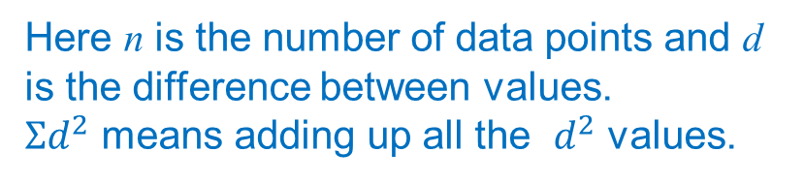
Spearman’s Rank Correlation Coefficient
UNIT
Correlation and Regression
Section 2
This is a method used to assign a meaning to the correlation between pairs of data points. Any coefficient, say r, is designed so that $−$1 ≤ r ≤ 1
and r = $−$1 corresponds to perfect negative correlation, r = 0 to no correlation and r = 1 to perfect positive correlation (as illustrated below).
This coefficient is based on adding the squares of the differences between data points after ranking - that is, put in numerical order and then given the values 1, 2, 3, ..., etc. Here is the formula:
Here n is the number of data points and d is the difference between values.
$Σd^{2}$ means adding up all the $d^{2}$ values.

Slide 9
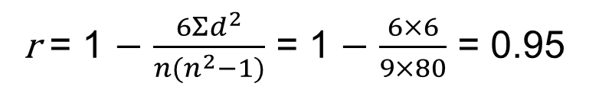
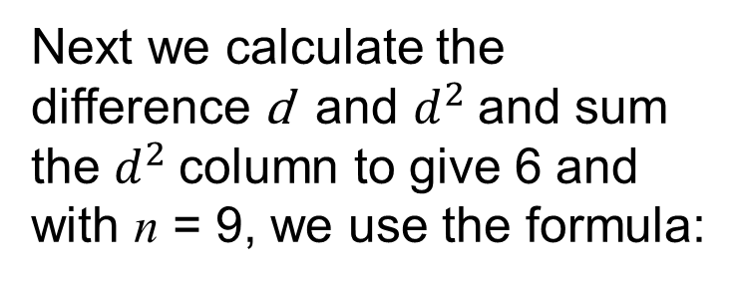
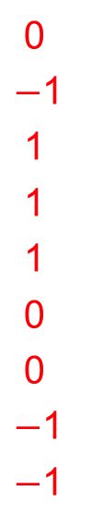
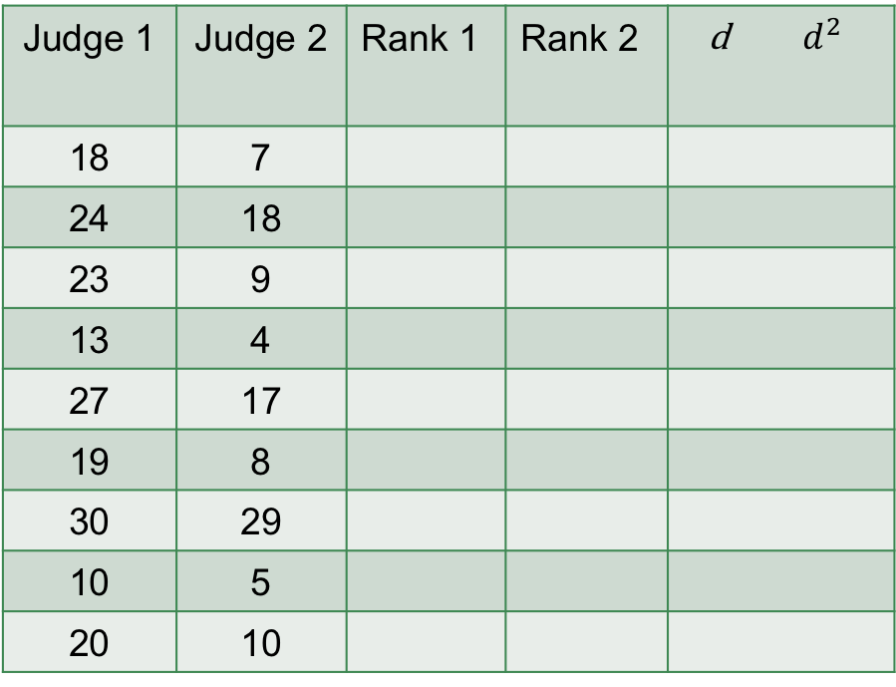
SRCC: Example 1
UNIT
Correlation and Regression
Section 2
At the 'Best of British Pie' competition two judges award marks for 9 different pies:
To calculate SRCC, we rank the scores for each judge, with 9 the highest score down to 1.
Judge 1 | Judge 2 | Rank 1 | Rank 2 | d $d^{2}$
18 | 7
24 | 18
23 | 9
13 | 4
27 | 17
19 | 8
30 | 29
10 | 5
20 | 10
3
7
6
2
8
4
9
1
5
3
8
5
1
7
4
9
2
6
0
$−$1
1
1
1
0
0
$−$1
$−$1
0
1
1
1
1
0
0
1
1
Next we calculate the difference d and $d^{2}$and sum the $d^{2}$column to give 6 and with n = 9, we use the formula:
r = 1 $−$ $\frac{6Σd^{2}}{n(n^{2}−1)}$ = 1 $−$ $\frac{6×6}{9×80}$ = 0.95
Note: there is high positive correlation although the judges’ scoring was very different!

Slide 10
SRCC: Example 2
UNIT
Correlation and Regression
Section 2
An investigation was conducted by a company on the value of various assessment methods for recruiting employees. The data is given here:
This is based on 8 employees, giving their Educational Test scores together with an Assessment score from the Personnel Officer of their ability one year after joining the company.
Possible test scores in each case can range from a low of 1 to a high of 20.
Rank each employee for both Educational Test score and Assessment score by the Personnel Officer, calculate Spearman’s rank correlation coefficient and interpret the answer.
Continued on next slide

Slide 11
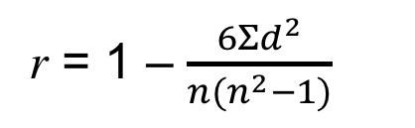
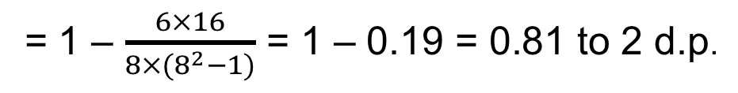
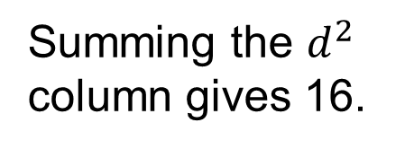
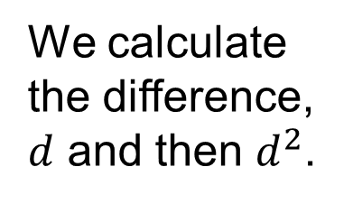

SRCC Calculation
UNIT
Correlation and Regression
Section 2
We first rank the two scores using 1 as the highest rank, etc.
8
7
3
4
2
6
5
1
6
5
3
4
2
8
7
1
2
2
0
0
0
$−$2
$−$2
0
4
4
0
0
0
4
4
0
We calculate the difference, $d$ and then $d^{2}$.
Summing the $d^{2}$ column gives 16.
r = 1 – $\frac{6Σd^{2}}{n(n^{2}−1)}$
= 1 – $\frac{6×16}{8×(8^{2}−1)}$ = 1 – 0.19 = 0.81 to 2 d.p.
This gives
This gives highly positive agreement showing that the two methods of assessment are in strong agreement.

Slide 12
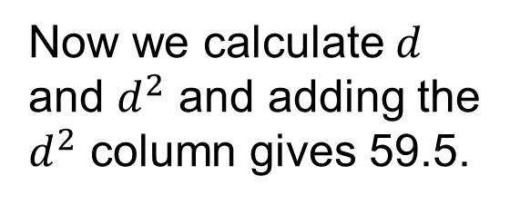
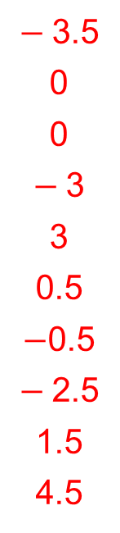

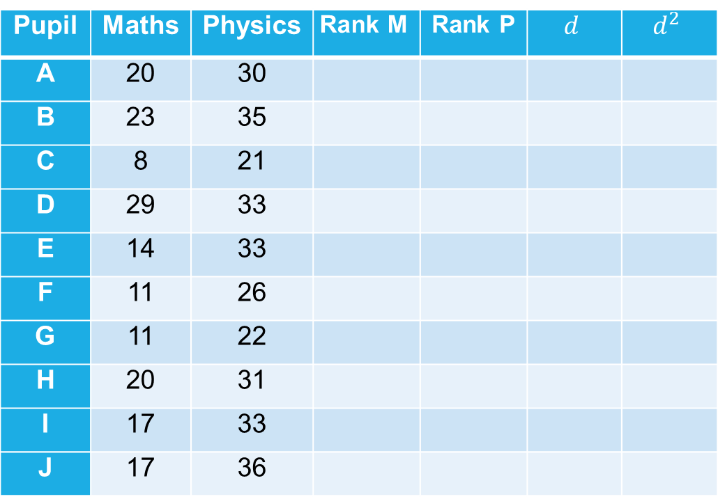
Equal Ranks: Example
UNIT
Correlation and Regression
Section 2
Mathematics and Physics marks for 10 students are given in this table.
We first rank the two scores using 1 as the highest rank, etc but for Maths, ranks I and J are both 5.5 and in Physics, D, E and I are all ranked 4 (to cover ranks 2, 3, 4) etc.
Pupil | Maths | Physics | $$\text{Rank} \text{M}$$ | Rank P | $$d$$ | $$d^{2}$$
A | 20 | 30
B | 23 | 35
C | 8 | 21
D | 29 | 33
E | 14 | 33
F | 11 | 26
G | 11 | 22
H | 20 | 31
I | 17 | 33
J | 17 | 36
3.5
2
10
1
7
8.5
8.5
3.5
5.5
5.5
7
2
10
4
4
8
9
6
4
1
$−$3.5
0
0
$−$3
3
0.5
$−$0.5
$−$2.5
1.5
4.5
12.25
0
0
9
9
0.25
0.25
6.25
2.25
20.25
Now we calculate $d$ and $d^{2}$ and adding the $d^{2}$ column gives 59.5.
With $n$ = 10, using the formula, we get r = 0.64 to 2 decimal places,
showing positive correlation between Mathematics and Physics marks.

Slide 13
Section 2: Fitness Check
UNIT
Correlation and Regression
Section 2
In a music festival, each competitor was judged on their performance on two different musical instruments. The judge awarded marks out of 100 for each instrument, as shown below.
a) Determine the rank correlation coefficient for this data; what does it show?
0.96; very positive correlation
b) It was later discovered that the marks from one of the judges, for one competitor, had been misread. This competitor should have had 10 more marks on his second instrument. The mark was changed and on re-calculation it was found that the correlation coefficient remained the same at 0.96. Which competitor's mark was originally incorrect?
Competitor C

Slide 14
UNIT
Correlation and Regression
Section 2
Section 2: Review
You have completed the second section.
If you have completed and mastered the first section,
click to continue to the next Section
If you need more examples and interactive practice,
press here
You might also find it helpful to look at:
Essential Information: press here

Slide 15

Correlation Coefficients
UNIT
Correlation and Regression
Section 3
There are many other correlation coefficients.
What is the advantage of Spearman’s Correlation Coefficient?
Easy to calculate
What do you think is one of the main disadvantages of Spearman’s Correlation Coefficient?
Ranking the data loses accuracy
Another correlation coefficient that does not lose the accuracy is the Product Moment Correlation Coefficient (PMCC) but is is more complicated to calculate. Here is the formula for the PMCC:
r = $\frac{Σxy −n\overline{x }\overline{y}}{\sqrt{(Σx^{2}−n{\overline{x}}^{2})(Σy^{2}−n{\overline{y}}^{2})}}$
Here $\overline{x }$ and $\overline{y}$ are the mean values of the x and y data points.

Slide 16
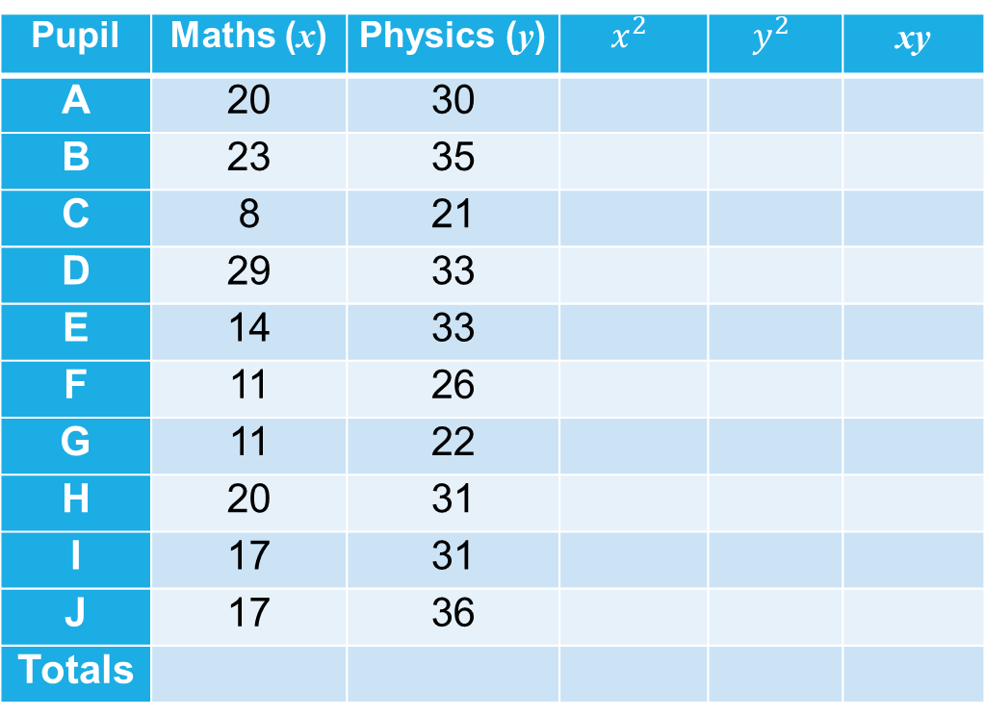

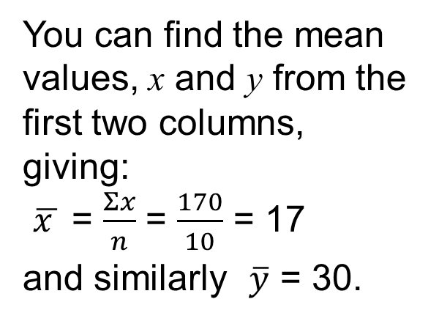
PMCC: Example
UNIT
Correlation and Regression
Section 3
You can calculate PMCC by completing the table opposite and finding the totals in each column.
Pupil | Maths (x) | Physics (y) | $$x^{2}$$ | $$y^{2}$$ | xy
A | 20 | 30
B | 23 | 35
C | 8 | 21
D | 29 | 33
E | 14 | 33
F | 11 | 26
G | 11 | 22
H | 20 | 31
I | 17 | 31
J | 17 | 36
Totals
400
529
64
841
196
121
121
400
289
289
900
1225
441
1089
1089
676
484
961
1089
1296
600
805
168
957
462
286
242
620
561
612
You can find the mean values, x and y from the first two columns, giving:
$\overline{x }$ = $\frac{Σx}{n}$ = $\frac{170}{10}$ = 17
and similarly $\overline{y}$ = 30.
179 300 3250 9250 5313
Substituting the values in the formula:
r = $\frac{Σxy −n\overline{x }\overline{y}}{\sqrt{(Σx^{2}−n{\overline{x}}^{2})(Σy^{2}−n{\overline{y}}^{2})}}$
= $\frac{5313 −10×17×30}{\sqrt{(3250−10×17×17)(9250−10×30×30}}$ = 0.71 to 2 decimal places

Slide 17
Product Moment Correlation Coefficient (PMCC)
UNIT
Correlation and Regression
Section 3
Note that the value of the PMCC is 0.71 whilst from earlier work we calculated Spearman’s Rank Correlation Coefficient as 0.64.
So the more accurate value from the PMCC shows a higher level of positive correlation.
Important Note:
it is much more efficient to use a calculator to calculate the PMCC but you need to be sure to be accurate when inputting the data into your calculator.

Slide 18
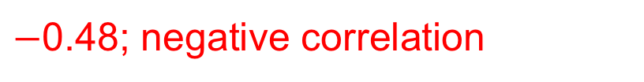
Section 3: Fitness Test
UNIT
Correlation and Regression
Section 3
A group of 12 children participated in a psychological study designed to assess the relationship, if any, between age, x years, and average total sleep time (ATST), y minutes.
To obtain a measure for ATST, recordings were taken on each child on five consecutive nights and then averaged.
The results are shown opposite.
Calculate the value of the product moment correlation coefficient between x and y and interpret your results.
$−$0.48; negative correlation

Slide 19
UNIT
Correlation and Regression
Section 3
Section 3: Review
You have completed the third section.
If you have completed and mastered this section,
click to continue to the next Section
If you need more examples and interactive practice,
press here
You might also find it helpful to look at:
Essential Information: press here

Slide 20

UNIT
Correlation and Regression
Section 4
Regression Lines
You will have met the idea of trend lines - these are essentially ‘lines of best fit’. There is little value in attempting to draw lines of best fit unless there is either strong positive or strong negative correlation between the points plotted, as shown in the following diagrams.
Also note that the lines of best fit should always pass through the point representing the mean values, $\overline{x} \text{and} \overline{y}$ , of the data points.

Slide 21
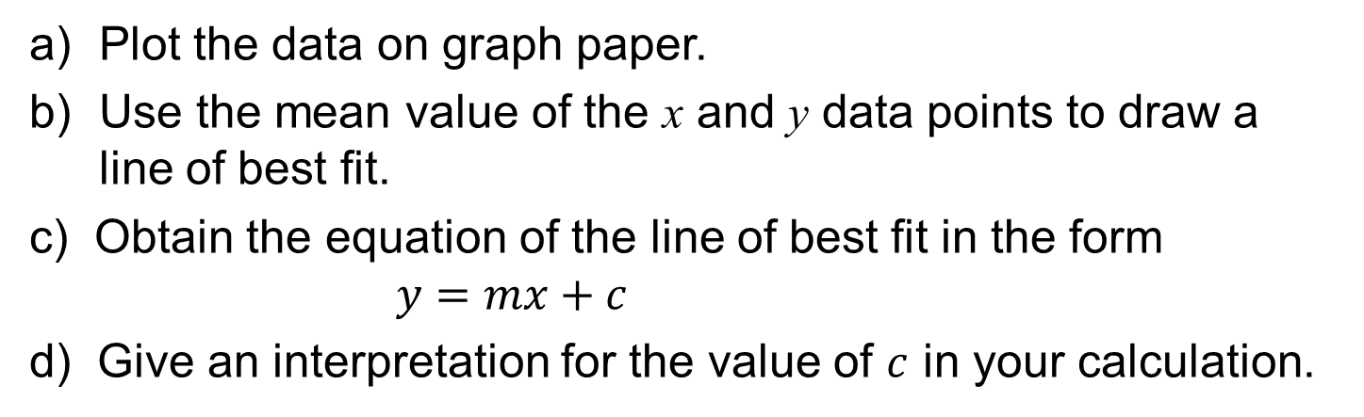
UNIT
Correlation and Regression
Section 4
Regression Line: Example
Mr Bean often travels by taxi and has to keep details of the journeys in order to complete his claim form at the end of the week. Details for journeys made during a week are:
a) Plot the data on graph paper.
b) Use the mean value of the x and y data points to draw a line of best fit.
c) Obtain the equation of the line of best fit in the form $y=mx+c$
d) Give an interpretation for the value of $c$ in your calculation.

Slide 22
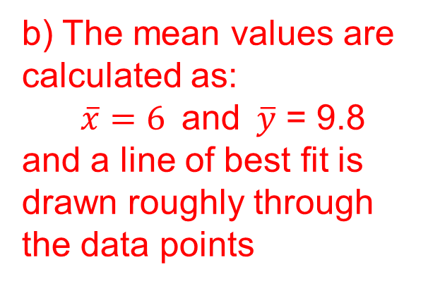
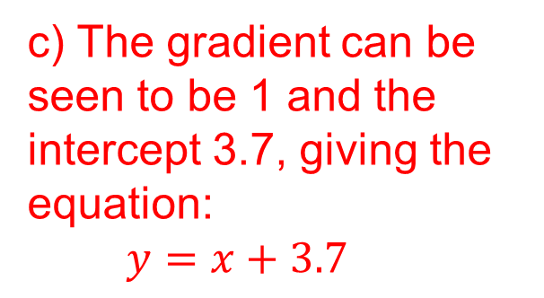
UNIT
Correlation and Regression
Section 4
Regression Line: Example
a) Points are plotted
b) The mean values are calculated as:
$\overline{x}=6 \text{and} \overline{y}$ = 9.8
and a line of best fit is drawn roughly through the data points
c) The gradient can be seen to be 1 and the intercept 3.7, giving the equation:
$y=x+3.7$
d) The £3.70 could be standing fee before any distance is driven.

Slide 23
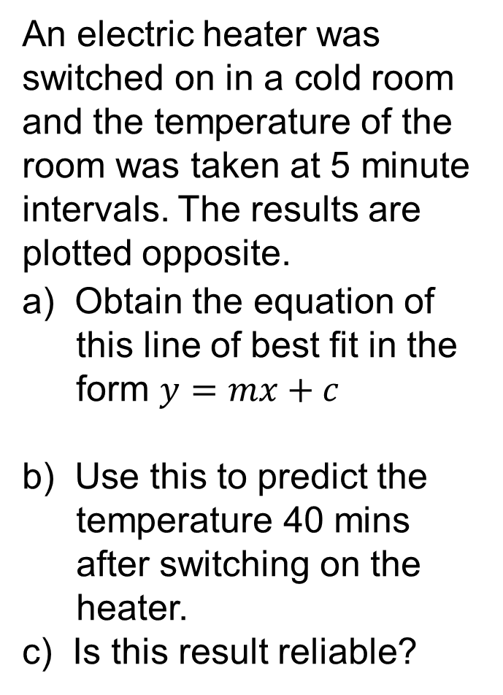
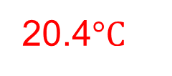
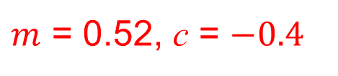
UNIT
Correlation and Regression
Section 4
Section 4: Fitness Check
An electric heater was switched on in a cold room and the temperature of the room was taken at 5 minute intervals. The results are plotted opposite.
a) Obtain the equation of this line of best fit in the form $y=mx+c$
b) Use this to predict the temperature 40 mins after switching on the heater.
c) Is this result reliable?
$m$ = 0.52, c = $−0.4$
20.4$°C$
May not be as outside range of temperatures on which the line of best fit is based, etc.

Slide 24
UNIT
Correlation and Regression
Section 4
Section 4: Review
You have completed the fourth section.
If you have completed and mastered this section,
click to continue to the next Section
If you need more examples and interactive practice,
press here
You might also find it helpful to look at:
Essential Information: press here

Slide 25
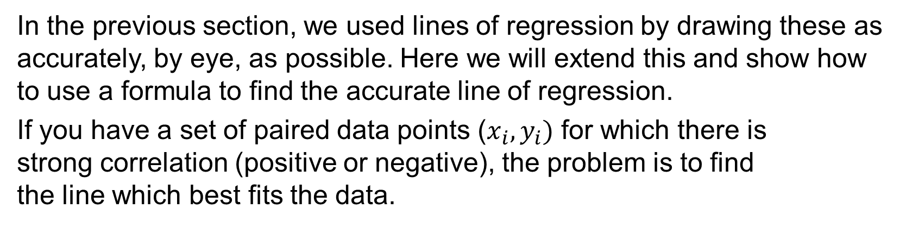
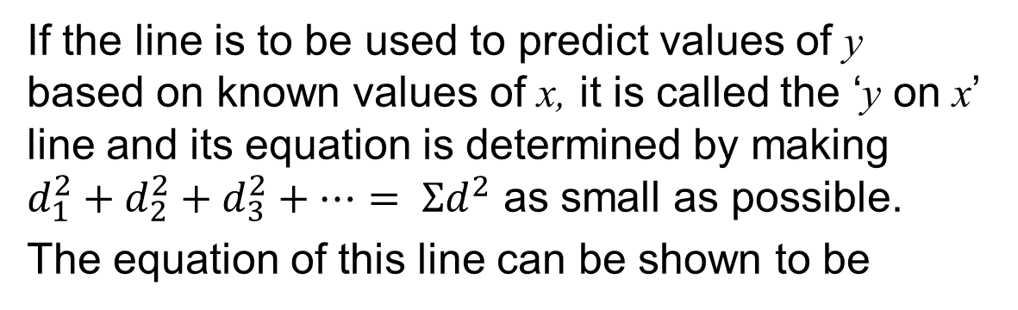
UNIT
Correlation and Regression
Section 5
Line of Regression Equation
In the previous section, we used lines of regression by drawing these as accurately, by eye, as possible. Here we will extend this and show how to use a formula to find the accurate line of regression.
If you have a set of paired data points ($x_{i}, y_{i})$ for which there is
strong correlation (positive or negative), the problem is to find
the line which best fits the data.
If the line is to be used to predict values of y based on known values of x, it is called the ‘y on x’ line and its equation is determined by making
$d_{1}^{2}+d_{2}^{2}+d_{3}^{2}+…= Σd^{2}$ as small as possible.
The equation of this line can be shown to be
The symbols are defined on the next slide

Slide 26
UNIT
Correlation and Regression
Section 5
Line of Regression Equation
The y on x regression line is given by
where and
Fortunately we do not need to make these calculations as calculators with STATS mode will do the work for us. So make sure you are familiar with how to use your calculator to find the equation of the regression line.
We will show the actual calculation for one example on the next slide but suggest you use the STATS mode on your calculator to confirm the equation of the line of regression.

Slide 27
UNIT
Correlation and Regression
Section 5
Line of Regression Equation: Example
Data obtained from an experiment where weights were attached to an elastic band and the length of the band measured, are shown below.
The data points have been graphed opposite and you can see that they are very close to a straight line so it is appropriate to find the equation of the line of regression.
Full calculation shown on the next slide

Slide 28
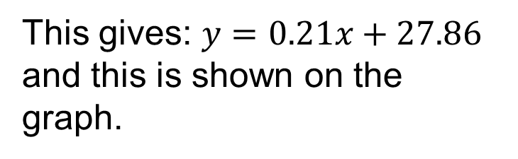
UNIT
Correlation and Regression
Section 5
Line of Regression Equation: Example
Here is the general formula:
where
and
Here is the calculation:
This gives: $y=0.21x+27.86$
and this is shown on the graph.

Slide 29
UNIT
Correlation and Regression
Section 5
Section 5: Fitness Check
Eight test areas of a field were given different concentrations of a new fertiliser and the resulting crop was weighed. The data is shown below:
a) Draw a scatter diagram to show the data and calculate the equation of the regression line y on x and show it on your diagram.
b) What increase in weight of crop might be expected from raising the concentration of fertiliser by 1 g/L ?

Slide 30
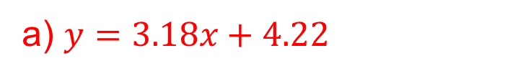
UNIT
Correlation and Regression
Section 5
Section 5: Fitness Check
Answers
a) $y=3.18x+4.22$
b) Increase: 3.18 kg

Slide 31
UNIT
Correlation and Regression
Section 5
Section 5: Review
You have completed the last section.
If you have completed and mastered this section,
click here for the Unit audit.
If you need more examples and interactive practice,
press here
You might also find it helpful to look at:
Essential Information: press here

