Slide 1
Supporting and Enhancing Mathematics and Statistics
UNIT: Coordinates

Slide 2
UNIT:
Coordinates
Coordinates
Coordinates are used to describe position in two dimensions. This
Unit will show you how to use coordinates and apply them to some
problems.
You have five sections to work through and there are check up audits
through fitness tests for each section.
Positive Coordinates
Coordinates
Plotting Straight Lines
Plotting Curves
5. Mid-Points of Line Segments

Slide 3
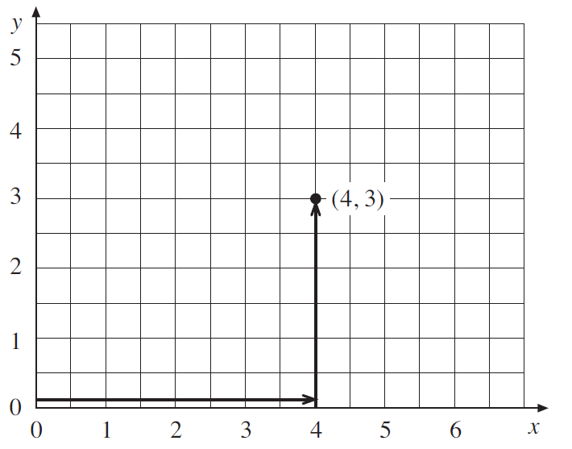
UNIT:
Coordinates
Section 1
Positive Coordinates
Coordinates are pairs of numbers that uniquely describe a position on
a rectangular grid. These numbers are sometimes referred to as
Cartesian coordinates.
The first number refers to
the horizontal (x-axis) and
the second the vertical
(y-axis).
The coordinates (4, 3)
describe a point that is 4
units across and 3 units
up on a grid from the
origin (0, 0).
Note that axes should always be labelled

Slide 4
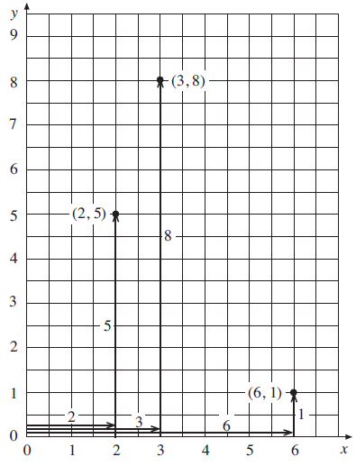
UNIT:
Coordinates
Section 1
Positive Coordinates: Examples
Example 1
Plot the points with coordinates (3, 8), (6, 1) and (2, 5).
Solution
For (3, 8) move 3 across and 8 up.
For (6, 1) move 6 across and 1 up.
For (2, 5) move 2 across and 5 up.

Slide 5
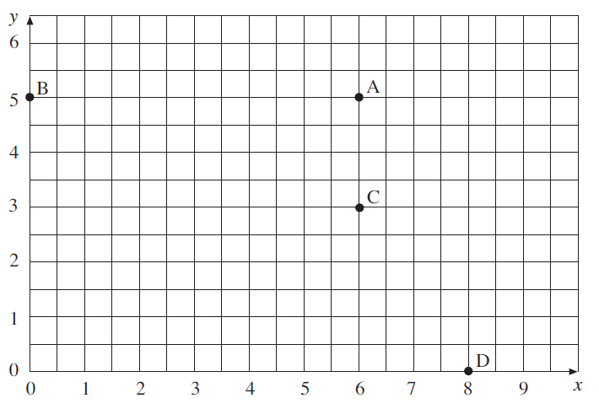
UNIT:
Coordinates
Section 1
Positive Coordinates: Examples
Example 2
Write down the coordinates of each point in the diagram below.
Solution
A is 6 across and 5 up, so the coordinates are (6, 5).
B has no movement across and is straight up 5, so the coordinates are (0, 5).
C is 6 across and 3 up, so the coordinates are (6, 3).
D is 8 across and no movement up, so the coordinates are (8, 0).

Slide 6
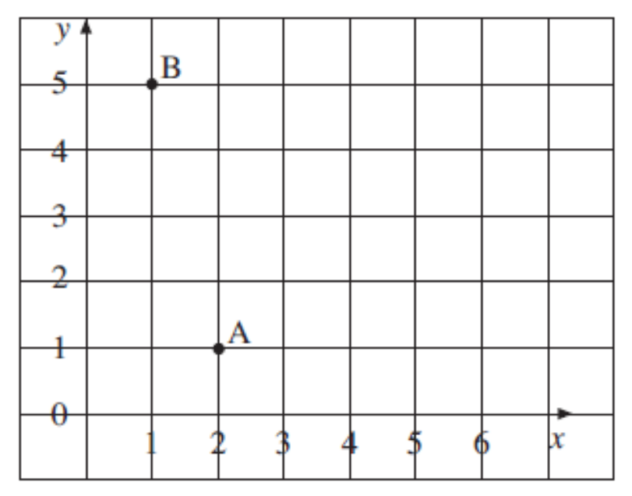
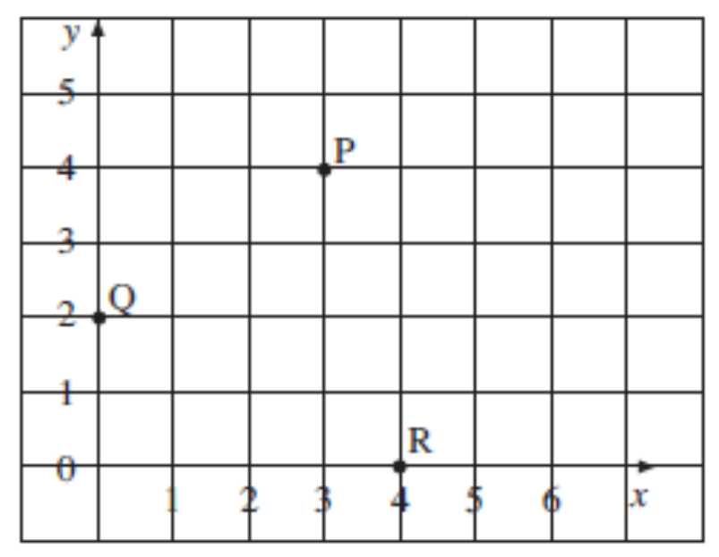
UNIT:
Coordinates
Section 1
Section 1: Fitness Check
Here are some questions to check your progress; there are more practice questions if needed.
1) Write down the co-ordinates of A and the coordinates of B.
Solution
A (2, 1) B) (1, 5)
2) On the coordinate grid, plot the points P (3,4), Q (0,2), R (4,0)
Solution

Slide 7
UNIT:
Coordinates
Section 1
Section 1: Review
You have completed the first Section.
If you have completed and understood this section,
to start the next Section
If you need more examples and interactive practice,
press here
You might also find it helpful to look at:
Essential Information: press here

Slide 8
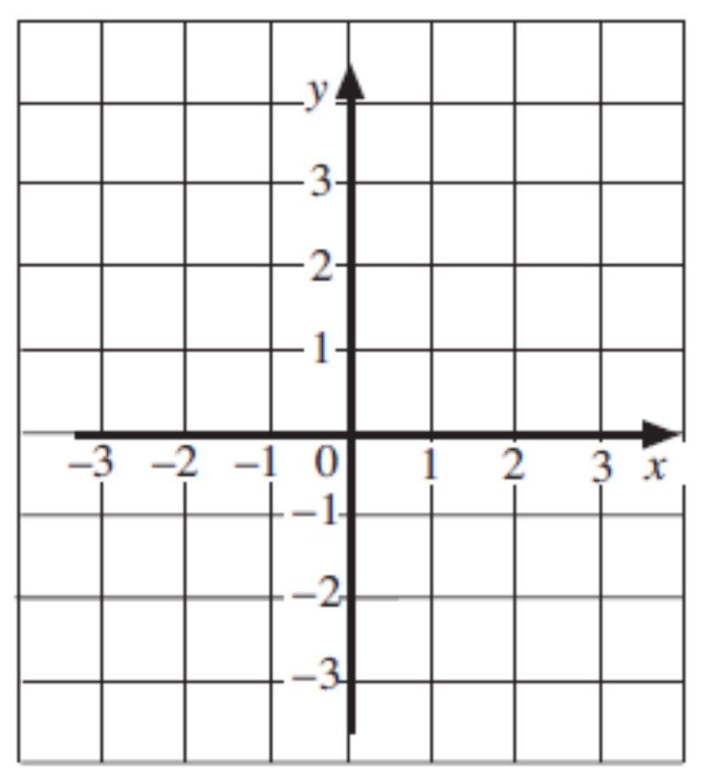
UNIT:
Coordinates
Section 2
Coordinates
The coordinates of a point are written as a pair of numbers, (x, y), which describe where the point is on a set of axes. The axes can include positive and negative values for x and y.
The x-axis is always horizontal (i.e. across the page) and the y-axis always vertical (i.e. up the page).
The x-coordinate is always given first and the y-coordinate second.

Slide 9
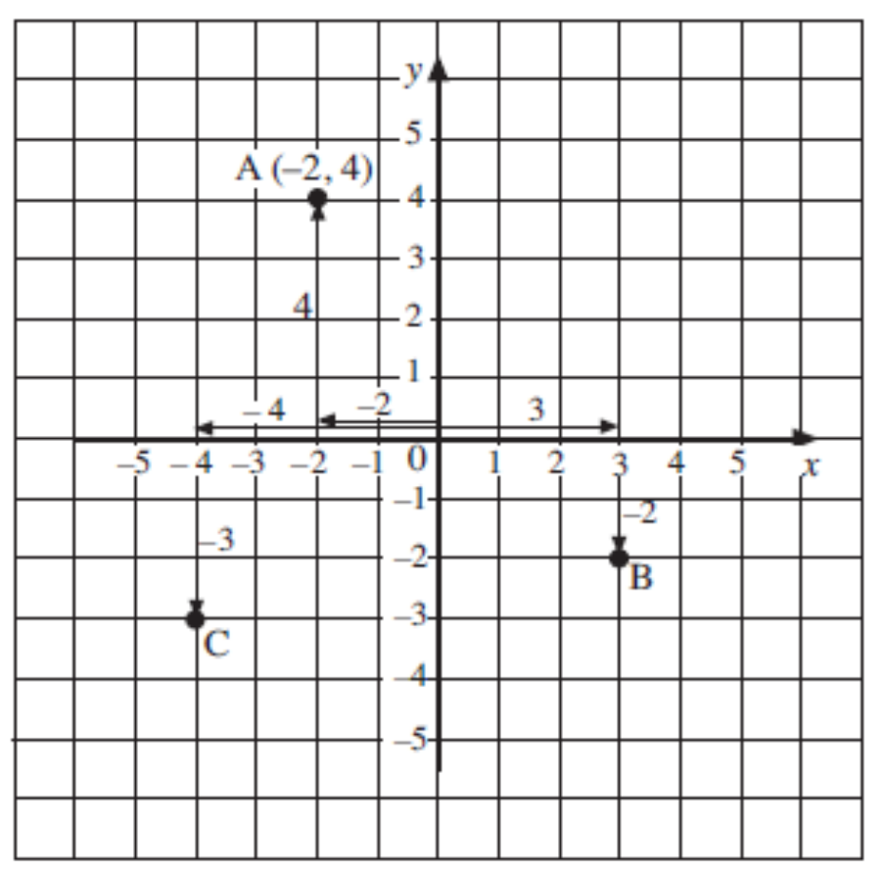
UNIT:
Coordinates
Section 2
Coordinates: Examples
Example 1
On a grid, plot the point A which has coordinates (–2, 4), the point B with coordinates (3, –2) and the point C with coordinates (– 4, –3).
Solution
For A, begin at (0, 0), where the two axes cross. Move –2 in the x direction. Move 4 in the y direction.
Points B and C are plotted in a similar way:
For B, move 3 in the x direction and –2 in the y direction.
For C, move –4 in the x direction and –3 in the y direction.

Slide 10
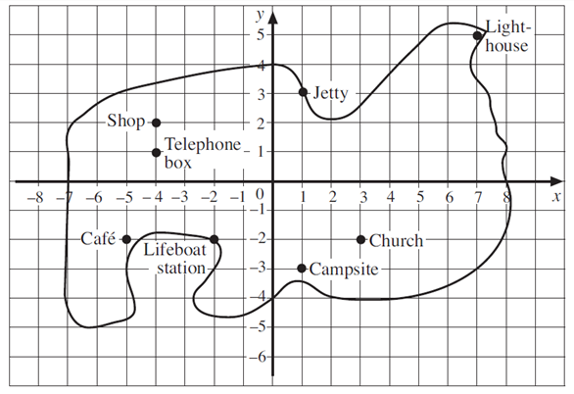
UNIT:
Coordinates
Section 2
Coordinates: Examples
Example 2
Write down the coordinates of each place on the map of the island.
Solutions
Lighthouse (7, 5)
Jetty (1, 3)
Church (3, –2)
Camp Site (1, –3)
Shop (–4, 2)
Telephone Box (–4, 1)
Café (–5 , –2)
Lifeboat Station (–2, –2)

Slide 11
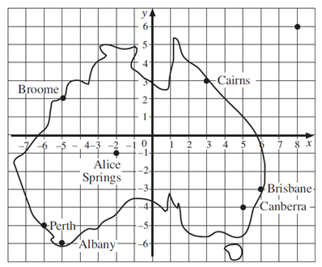
UNIT:
Coordinates
Section 2
Coordinates: Fitness Check
Here are some questions to check your progress; there are more practice questions if needed.
The map shows some Australian towns and cities.
a) Write down the coordinates of Canberra, Brisbane and Perth.
Solutions
Canberra (5, –4)
Brisbane (6, –3)
Perth (–6, –5)
Continued on next slide

Slide 12
UNIT:
Coordinates
Section 2
Coordinates: Fitness Check
Here are some questions to check your progress; there are more practice questions if needed.
b) A ship has coordinates
(–5, 2) at the start of a voyage and coordinates (–6, –5) at the end. Where does it start and where does it finish?
Solution
Broome, Perth

Slide 13
UNIT:
Coordinates
Section 2
Section 2: Review
You have completed the second Section.
If you have completed and understood this section,
click to start the next Section
If you need more examples and interactive practice,
press here
You might also find it helpful to look at:
Essential Information: press here

Slide 14
UNIT:
Coordinates
Section 3
Plotting Straight Lines
By calculating values of coordinates you can find points and draw a graph for any relationship, such as y = 2x − 5.
Example 1
a) Copy and complete the following pairs of coordinates using the relationship y = x − 2.
(4, ? ), (1, ? ), (–1, ? )
b) Plot the points on a set of axes and draw a straight line through them.
Solution
With y = x − 2, for the first point x = 4 , so y = 4 − 2 = 2
So the first point is (4, 2).
For the second point x = 1 , so y = 1 − 2 = –1
So the second point is (1, –1).
For the third point x = –1 , so y = –1 − 2 = –3
So the third point is (–1, –3).
Continued on next slide

Slide 15
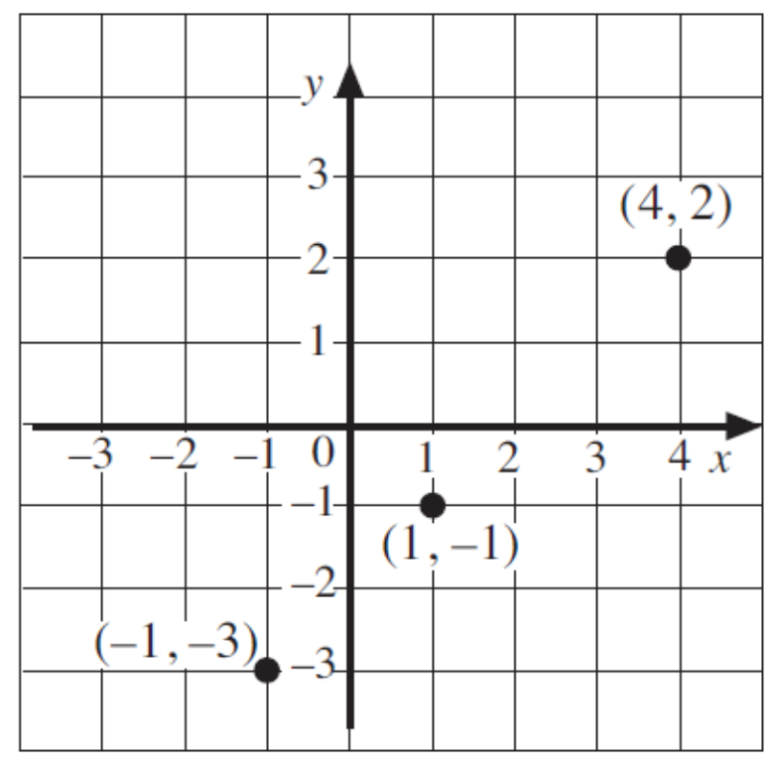
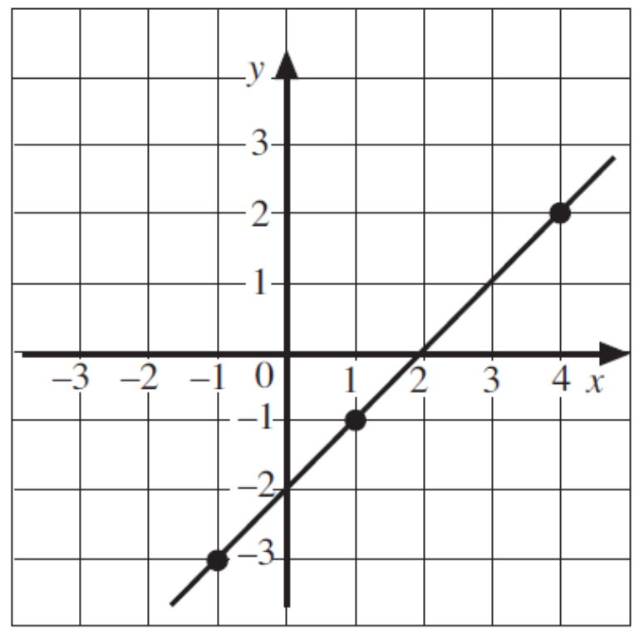
UNIT:
Coordinates
Section 3
Plotting Straight Lines: Examples
Solution (continued)
b) The points can be plotted, as shown on the right.
c) Then a straight line can be drawn through these points, as below.

Slide 16
UNIT:
Coordinates
Section 3
Plotting Straight Lines: Examples
Example 2
Draw the graph of y = 2x − 1.
Solution
The first step is to find the coordinates of three points on the line. Choose any three x-values for the coordinates. Three possible values are given below:
(4, ? ), (2, ? ), (–2, ? )
With y = 2x − 1, for the first point x = 4, y = 2×4 − 1 = 7
So the first point is (4, 7).
For the second point x = 2 , so y = 2×2 − 1 = 3
So the second point is (2, 3).
For the third point x = −2 , so y = 2× −2 − 1 = –5
So the third point is (−2, −5).
Continued on next slide

Slide 17
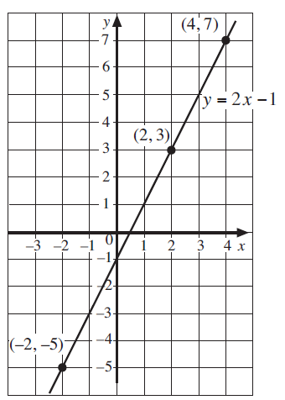
UNIT:
Coordinates
Section 3
Plotting Straight Lines: Examples
Solution (continued)
So three coordinates which lie on the line are:
(4, 7), (2, 3) and (−2, −5)
These points can now be plotted, as shown on the axes on the right.
Then a straight line can be drawn through them.

Slide 18
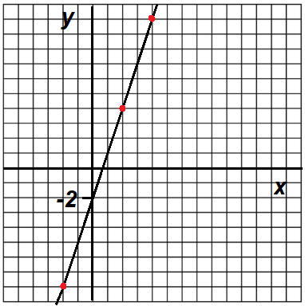
UNIT:
Coordinates
Section 3
Plotting Straight Lines: Fitness Check
Here are some questions to check your progress; there are more practice questions if needed.
1. Use the relationship y = 3x − 2
to complete the coordinates below:
(4, ? ), (2, ? ), (–2, ? )
2. Plot these points on a set of axes and
draw a straight line through the points.
Answers
1. (4, 10), (2, 4) and (−2, −8)
2. Graph shown opposite:

Slide 19
UNIT:
Coordinates
Section 3
Section 3: Review
You have completed the third Section.
If you have completed and understood this section,
click to start the next Section
If you need more examples and interactive practice,
press here
You might also find it helpful to look at:
Essential Information: press here

Slide 20
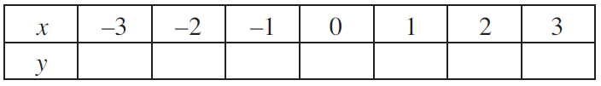
UNIT:
Coordinates
Section 4
Plotting Curves
Some relationships produce curves rather than straight lines when plotted.
Example 1
a) Complete the table below using the relationship y = x² − 2.
b) Write a list of coordinates using the data in the table.
c) Plot the points and draw a smooth curve through them.
Solution
With y = x² − 2, for the last column, with x = 3 , then
y = 3² − 2
= 9 – 2 = 7
So in the table, in the last column, the value for y is 7
Continued on next slide

Slide 21
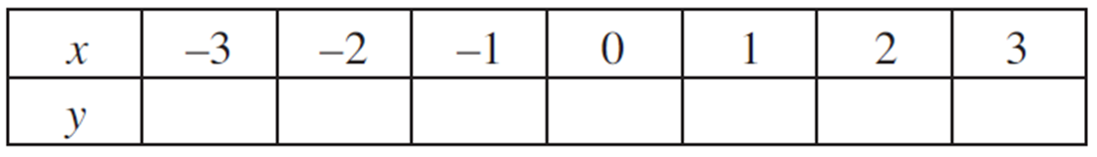


UNIT:
Coordinates
Section 4
Plotting Curve: Examples
Solution (continued)
You can start to fill in the blanks in the table:
7
Similarly, as another example, if x = 2 , y = 2² − 2 = 2
Note that it doesn’t matter what order you complete the table in.
Another example: if x = −2 , y = (−2)² − 2 = 4 – 2 = 2
You can fill in more blanks in the table:
Continued on next slide

Slide 22
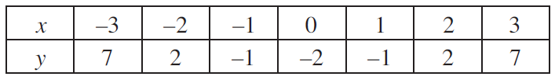
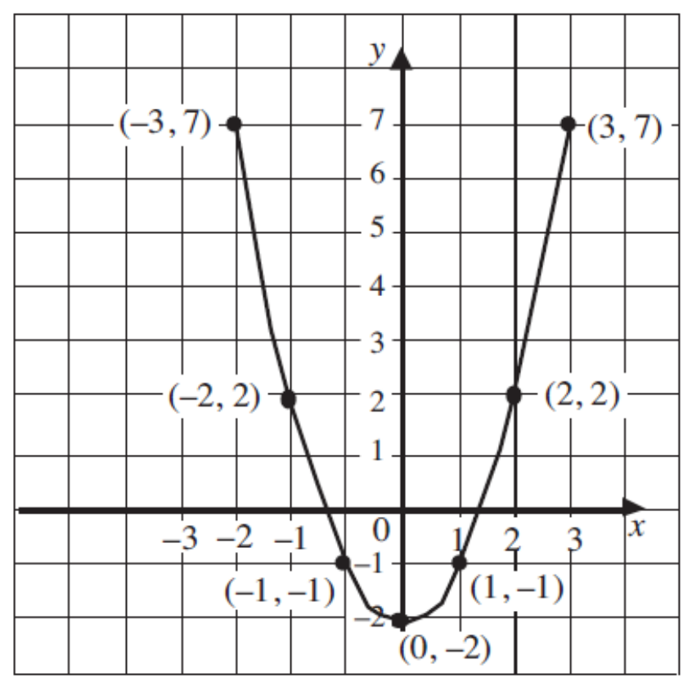
Plotting Curve: Examples
UNIT:
Coordinates
Section 4
Solution (continued)
Do the same for all x values. The complete table looks like this:
The coordinates of the points are
(–3, 7), (–2, 2), (–1, –1), (0, –2),
(1, –1), (2, 2) and (3, 7).
These points plotted are shown opposite.

Slide 23
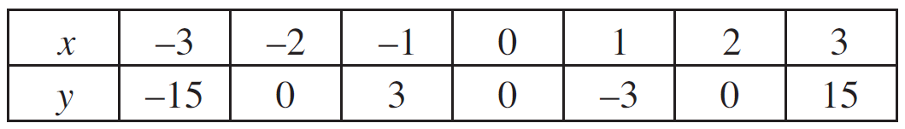
UNIT:
Coordinates
Section 4
Plotting Curve: Examples
Example 2
Draw the graph of y = x³ − 4x for values of x from –3 to 3.
Solution
The first step is to draw up and complete a table of values using the relationship.
For example, if x = –3, y = (−3)³ − 4×(–3) = −27 + 12
= −15
and, if x = 2, y = 2³ − 4×2 = 8 − 8
= 0
Continued on next slide

Slide 24
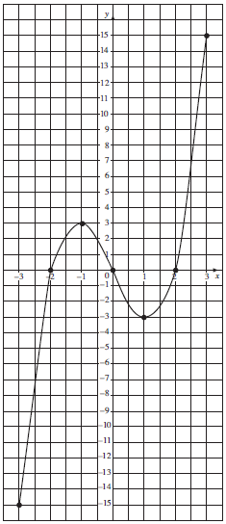
UNIT:
Coordinates
Section 4
Plotting Curves: Examples
Solution (continued)
Each pair of values from the table represent coordinates:
(–3, –15), (–2, 0), (–1, 3), (0, 0),
(1, –3), (2, 0), (3, 15)
These coordinates can be plotted and a smooth curve can be drawn through them, as seen on the graph.

Slide 25

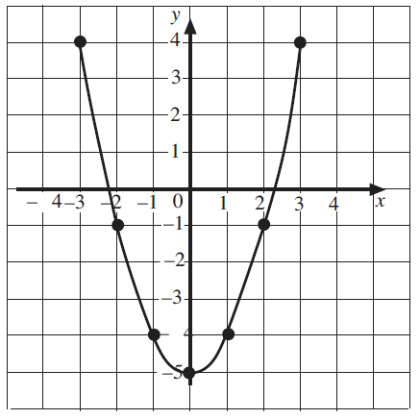
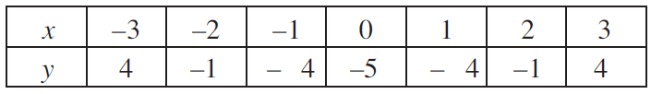
UNIT:
Coordinates
Section 4
Plotting Curves: Fitness Check
Here are some questions to check your progress; there are more practice questions if needed.
1) a) Complete a copy of the table below for y = x² − 5.
b) Plot the points and draw a
smooth curve through the points.
Answers
a)

Slide 26
UNIT:
Coordinates
Section 4
Plotting Curves: Fitness Check
Here are some questions to check your progress; there are more practice questions if needed.
1) a) Complete a copy of the table below for y = x² − 5.
b) Plot the points and draw a
smooth curve through the points.
Answers
a)

Slide 27
UNIT:
Coordinates
Section 4
Plotting Curves: Fitness Check
Here are some questions to check your progress; there are more practice questions if needed.
1) a) Complete a copy of the table below for y = x² − 5.
b) Plot the points and draw a
smooth curve through the points.
Answers
a)
b) Graph shown opposite

Slide 28
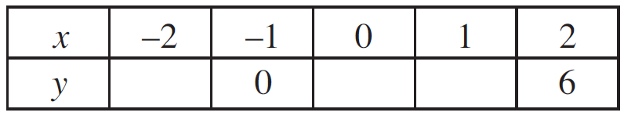
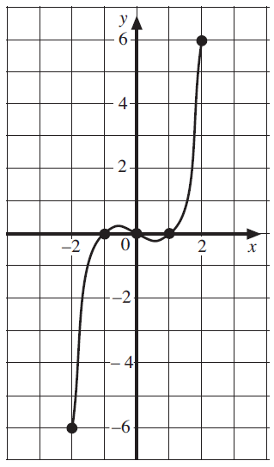
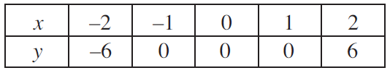
UNIT:
Coordinates
Section 4
Plotting Curves: Fitness Check
Here are some questions to check your progress; there are more practice questions if needed.
2. a) Complete a copy of the table using the relationship y = x³ − x.
b) Plot the points and draw a smooth
curve through the points.
Answers
a)
b) Graph shown opposite

Slide 29
UNIT:
Coordinates
Section 4
Section 4: Review
You have completed the fourth Section.
If you have completed and understood this section, click to start the next Section
If you need more examples and interactive practice, press here
You might also find it helpful to look at:
Essential Information: press here

Slide 30
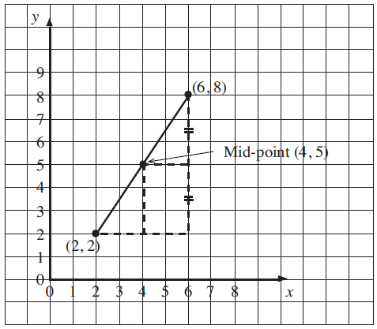
UNIT:
Coordinates
Section 5
Mid-Points of Line Segments
The coordinates of the mid-point between two other points may be found by drawing or by calculation. The diagram below shows the mid-point of the coordinates (2, 2) and (6, 8); the coordinate of the mid-point is (4, 5).

Slide 31
UNIT:
Coordinates
Section 5
Mid-Points of Line Segments
The value of the x-coordinate of the mid-point of the line segment AB is the mean value of the two x-coordinates of the end points A and B.
B
Here, the value of the x-coordinate of the mid-point is the mean of 2 and 6, which is 4.
A
Similarly, for the y-coordinate of the mid-point, it is the mean of the y-coordinates of the end points A and B.
Here, the value of the y-coordinate of the mid-point is the mean of 2 and 8, which is 5.
This is how the mid-point coordinate of (4, 5) has been found.

Slide 32
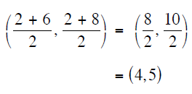

UNIT:
Coordinates
Section 5
Mid-Points of Line Segments
The coordinates of the mid-point could
have been calculated directly as follows:
B
Generally, for any two points, the
coordinates of the mid-point of the
line segment joining the points
(a, b) and (c, d) is given by
A

Slide 33
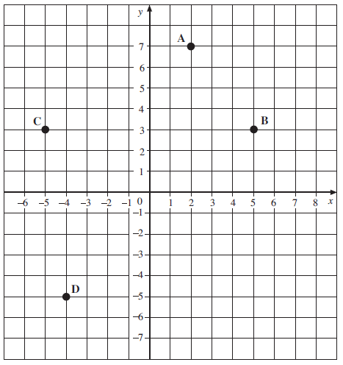
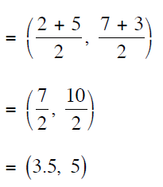
UNIT:
Coordinates
Section 5
Mid-Points of Line Segments: Examples
Example
Find the coordinates of the mid-point of the line segment:
a) AB b) AC c) BD
Solution
The coordinates of A are (2, 7).
The coordinates of B are (5, 3).
The coordinates of the mid-point AB are (3.5, 5), as calculated below:
Continued on next slide

Slide 34
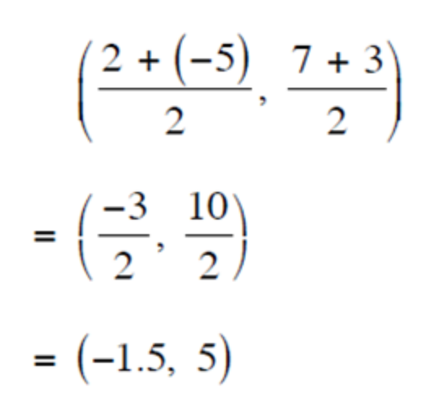
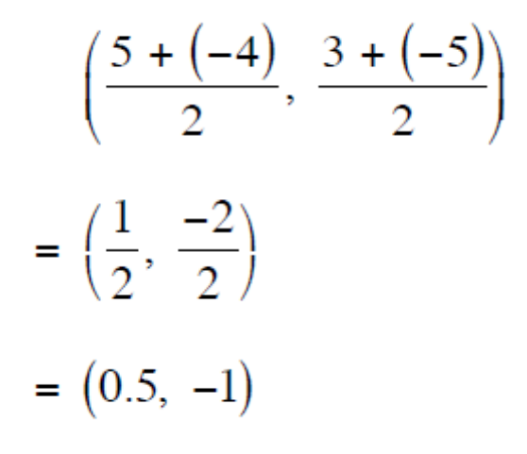
Mid-Points of Line Segments: Examples
UNIT:
Coordinates
Section 5
Solution (continued)
The coordinates of A are (2, 7).
The coordinates of C are (–5, 3).
The coordinates of the mid-point AC are (–1.5, 5), as calculated on the right.
The coordinates of B are (5, 3).
The coordinates of D are (−4, −5)
The coordinates of the mid-point BD are (0.5, −1), as calculated on the right.

Slide 35
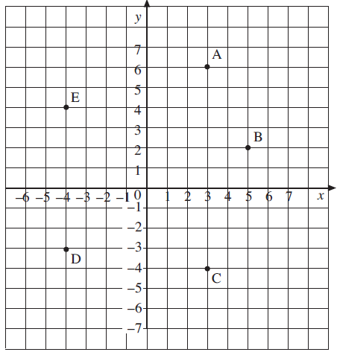
UNIT:
Coordinates
Section 5
Mid-Points of Line Segments: Fitness Check
Here are some questions to check your progress; there are more practice questions if needed.
The diagram shows the points
A, B, C, D and E.
Find the coordinates of the mid-point of these line segments:
a) AB b) AD c) CD d) CE
Answers
(4, 4) b) (–0.5, 1.5)
c) (–0.5, –3.5) d) (–0.5, 0)

Slide 36
UNIT:
Coordinates
Section 5
Section 5: Review
You have completed the fifth Section.
If you have completed and mastered this last section,
click here for the Unit audit
If you need more examples and interactive practice,
press here
You might also find it helpful to look at:
Essential Information: press here

